Slide 1
Three-way data reduction based on essential information
Raffaele Vitale, Azar Azizi, Mahdiyeh Ghaffari,
Nematollah Omidikia, Cyril Ruckebusch

Slide 2
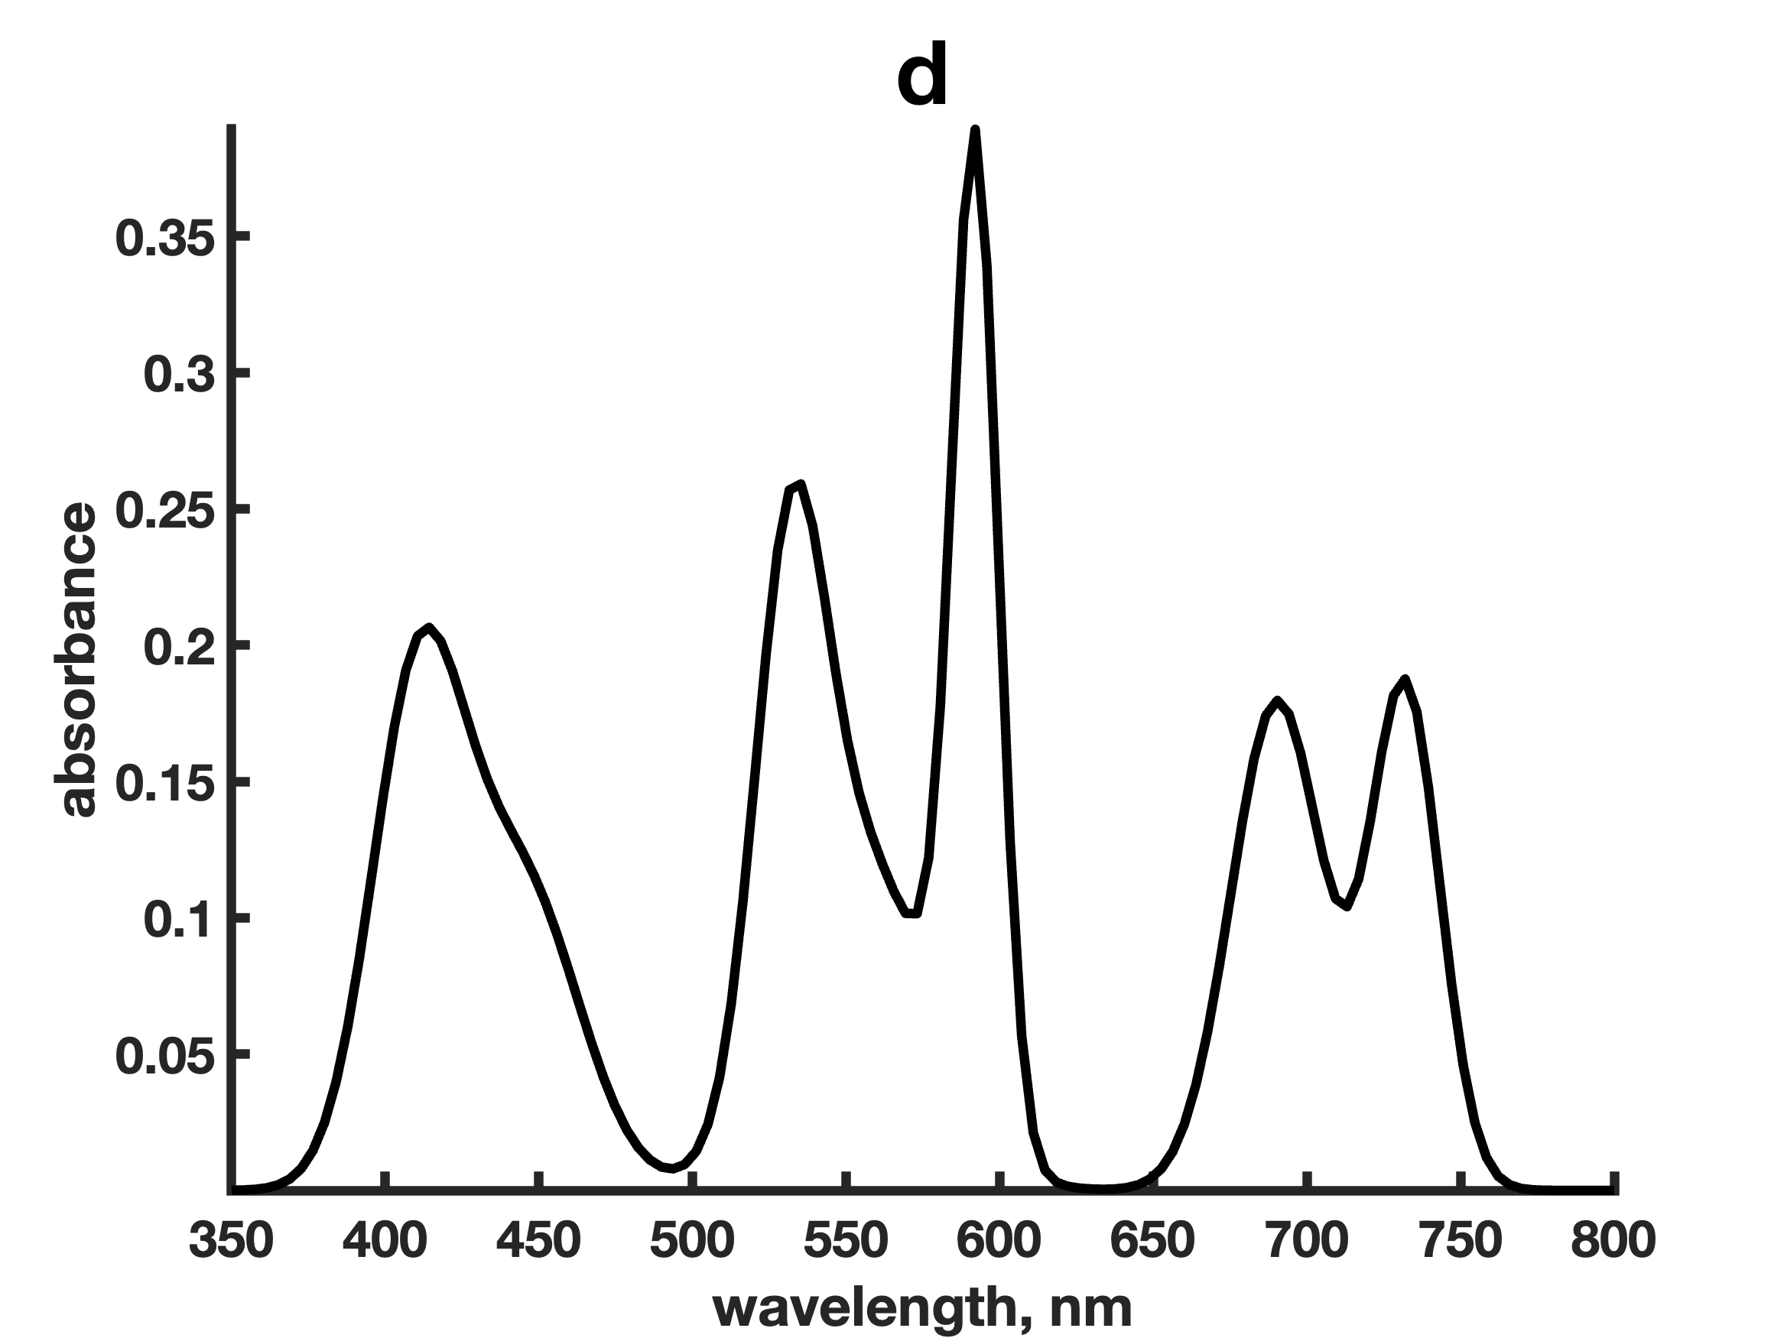
Bilinear spectral resolution
2

Slide 3
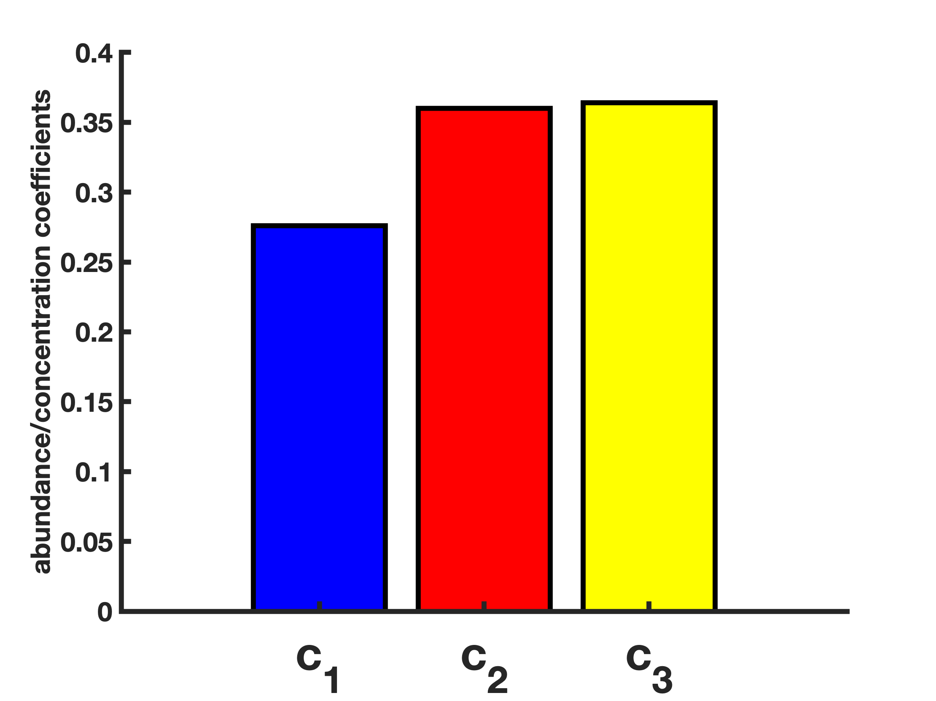
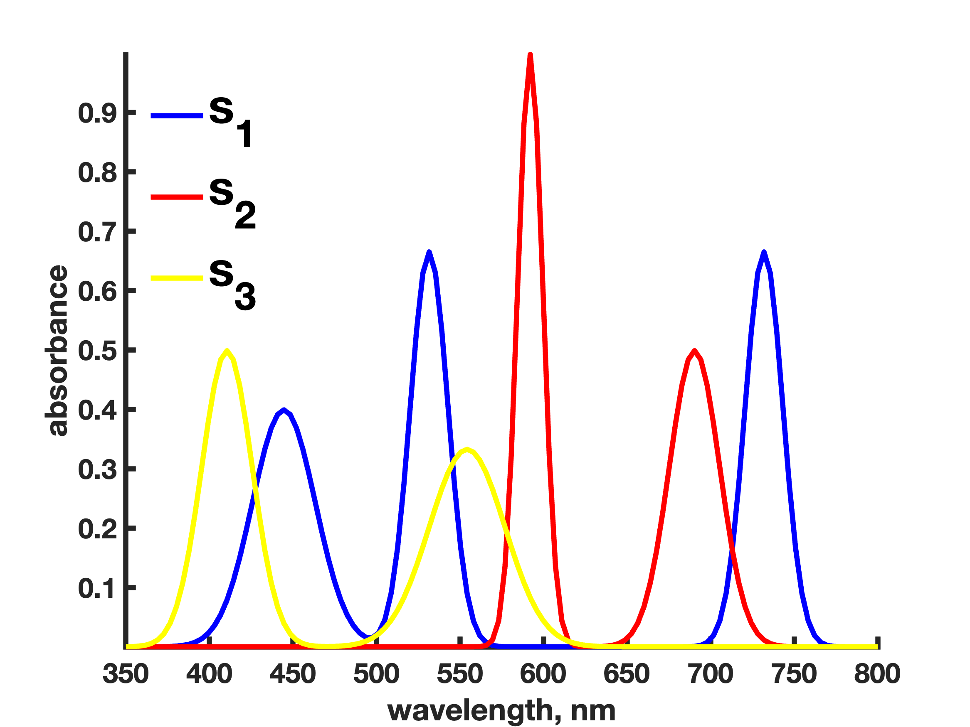
Bilinear spectral resolution
=
×
d = c₁s₁ + c₂s₂ + … + c_{A}s_{A} = Σ_{a}c_{a}s_{a} (Beer-Lambert’s law)
2

Slide 4
Bilinear spectral resolution
The bilinear spectral resolution/unmixing model
J
A
J
A
=
×
S^{T}
=
N
N
D
C
d = c₁s₁ + c₂s₂ + … + c_{A}s_{A} = Σ_{a}c_{a}s_{a} (Beer-Lambert’s law)
2

Slide 5
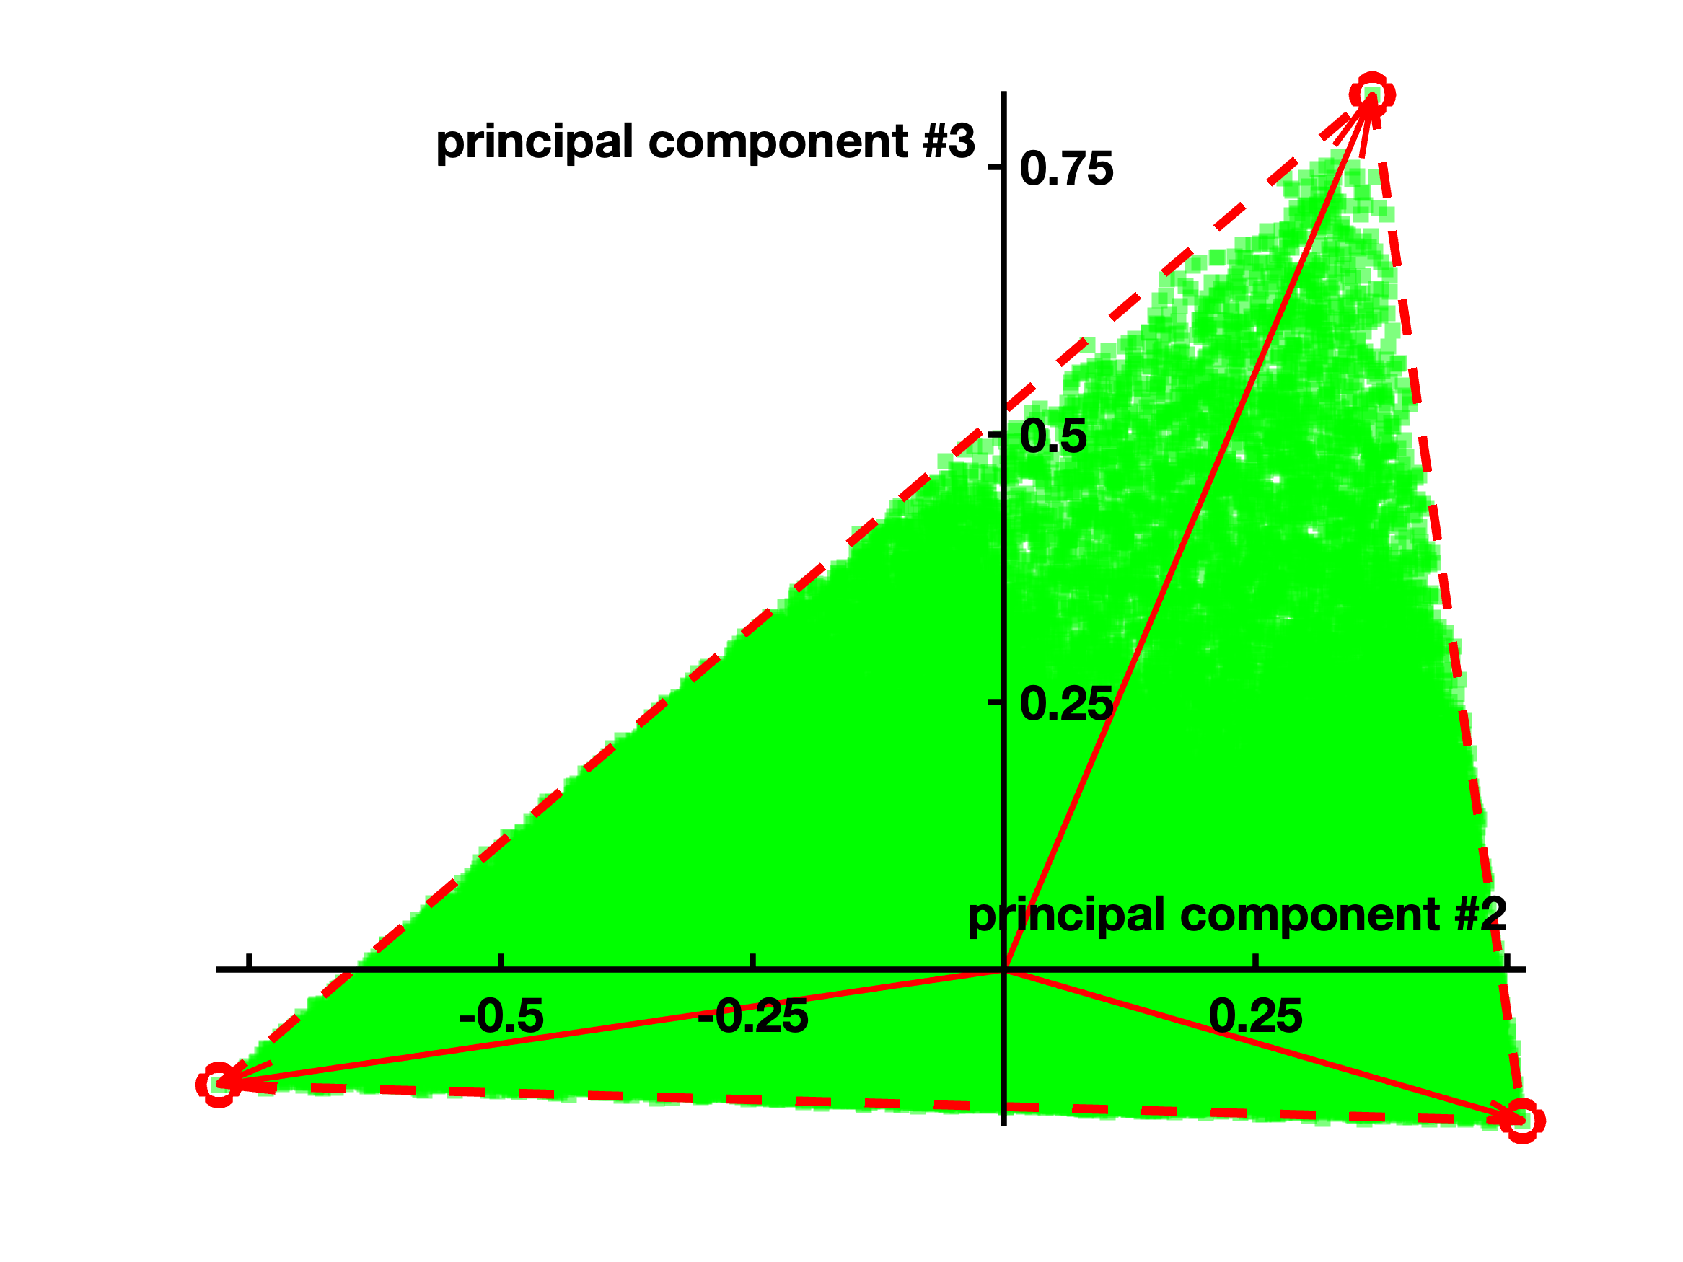


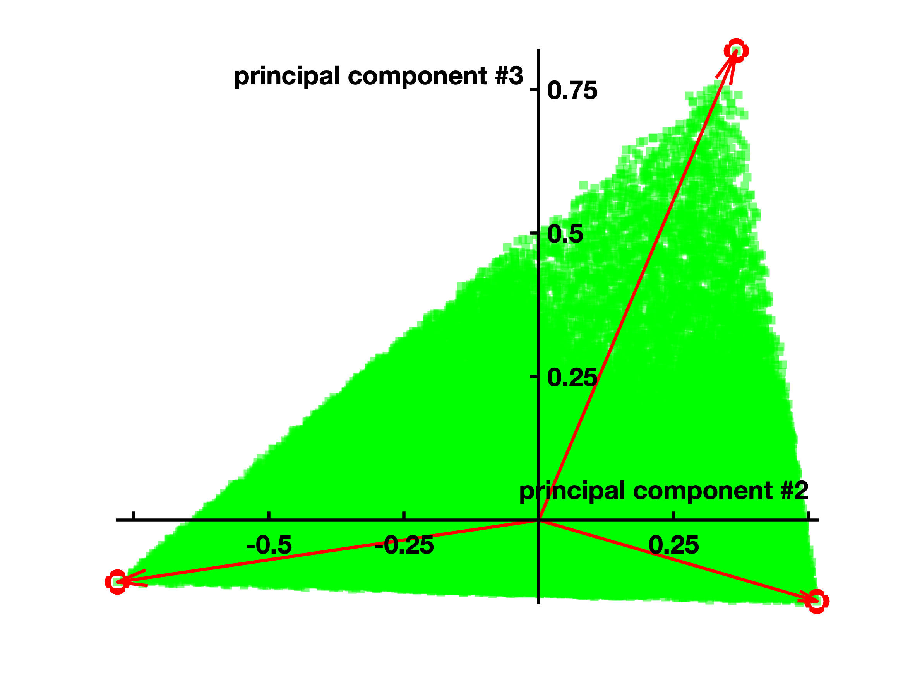
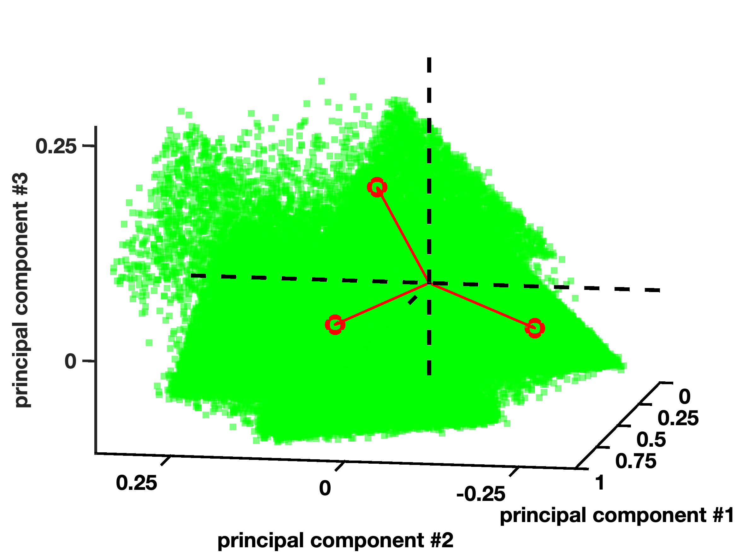
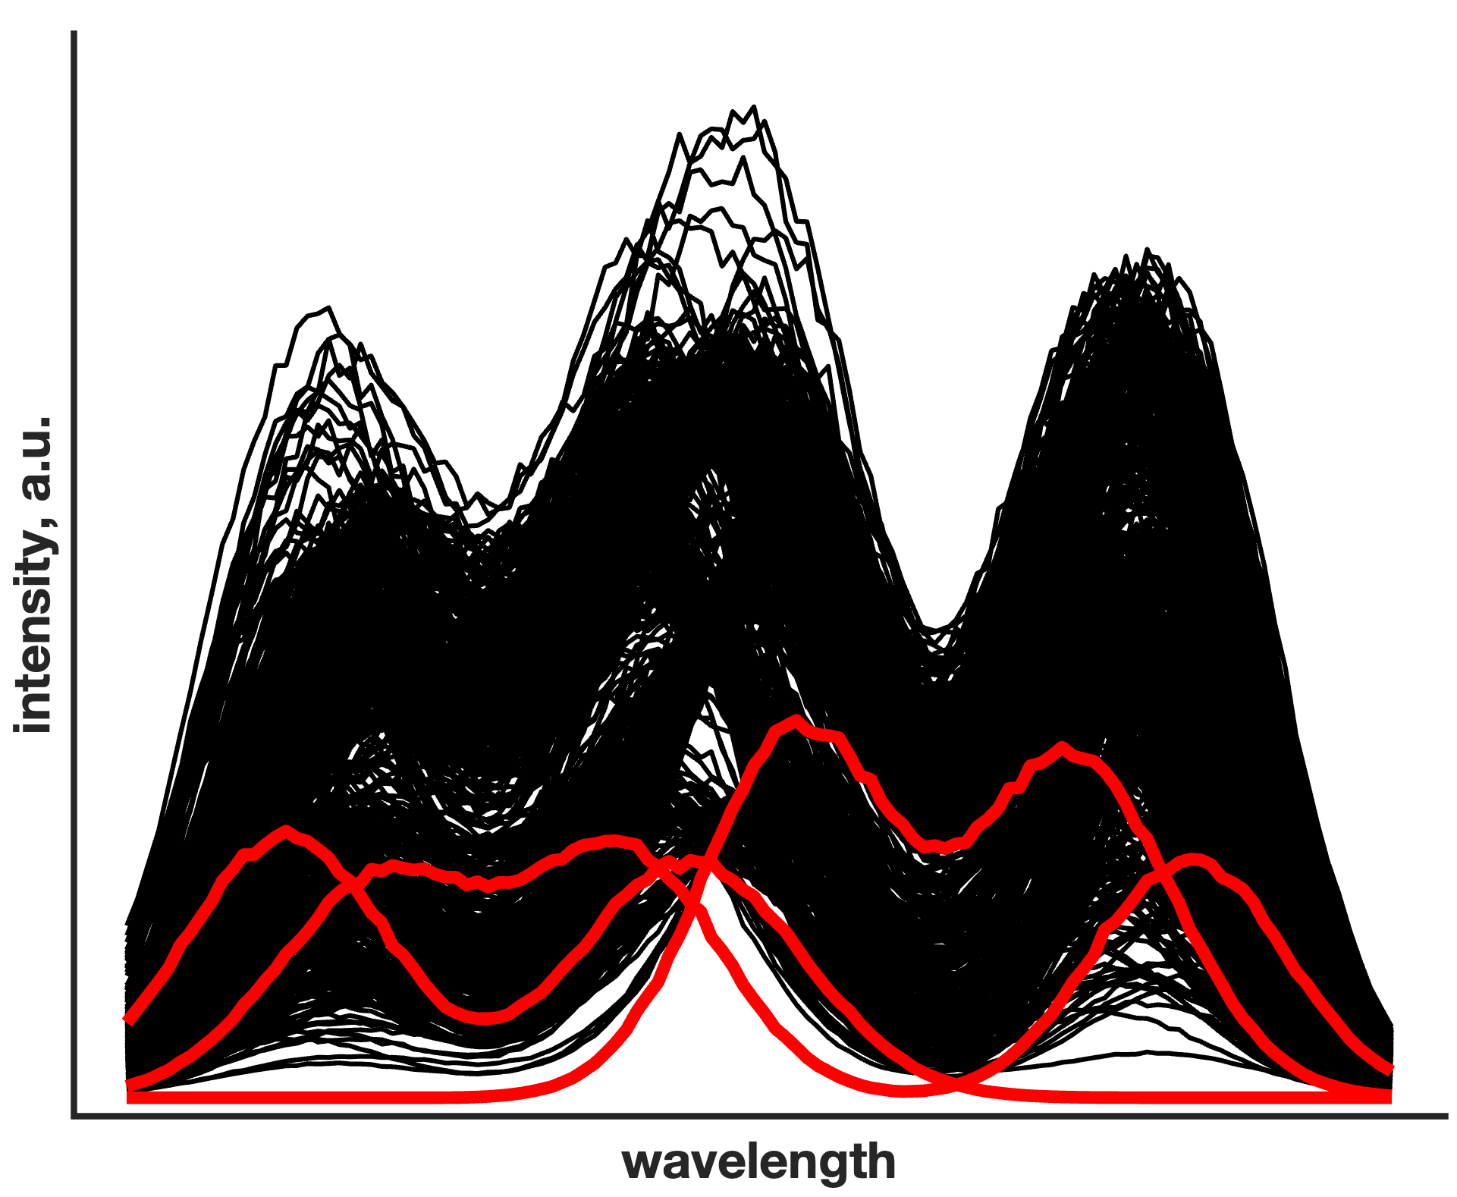
The spectral resolution problem
D = TP^{T} + E
T = T⊘(t₁1^{T})
Manne, R., Chemometr. Intell. Lab., 2000 (50), 19-33
3

Slide 6
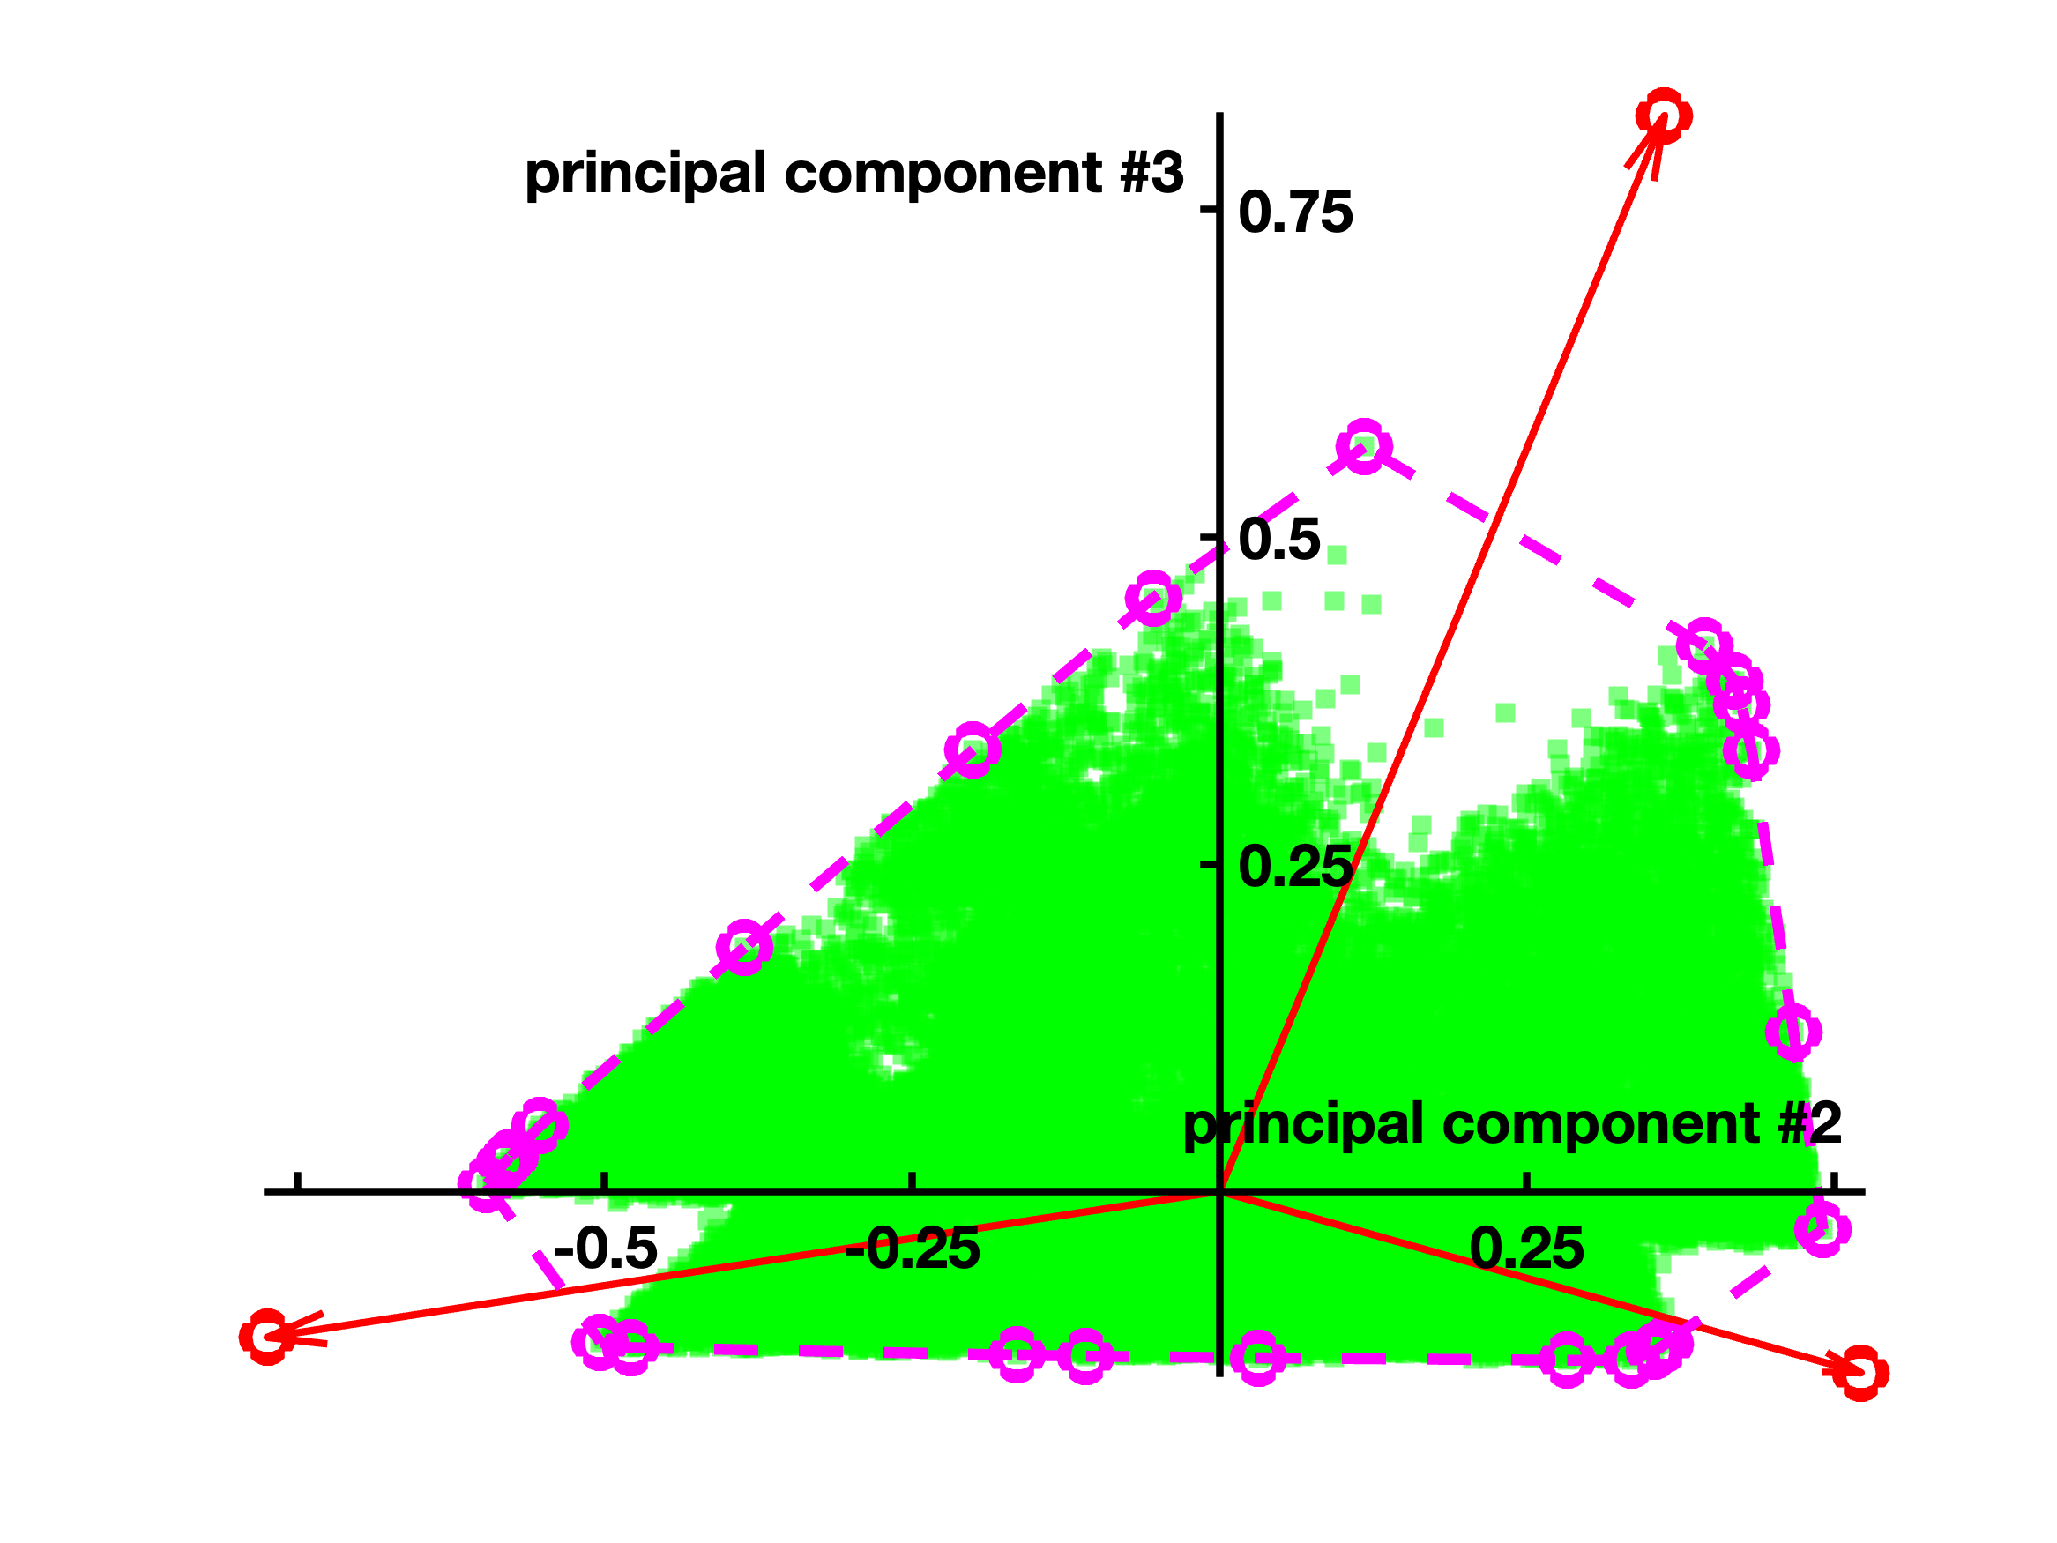
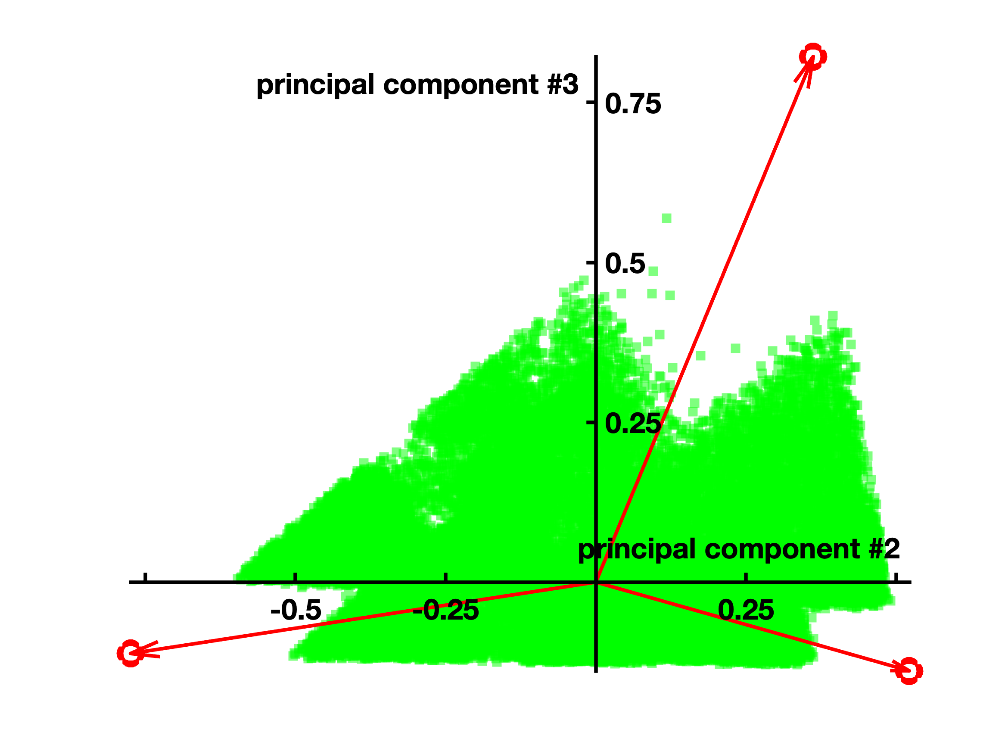
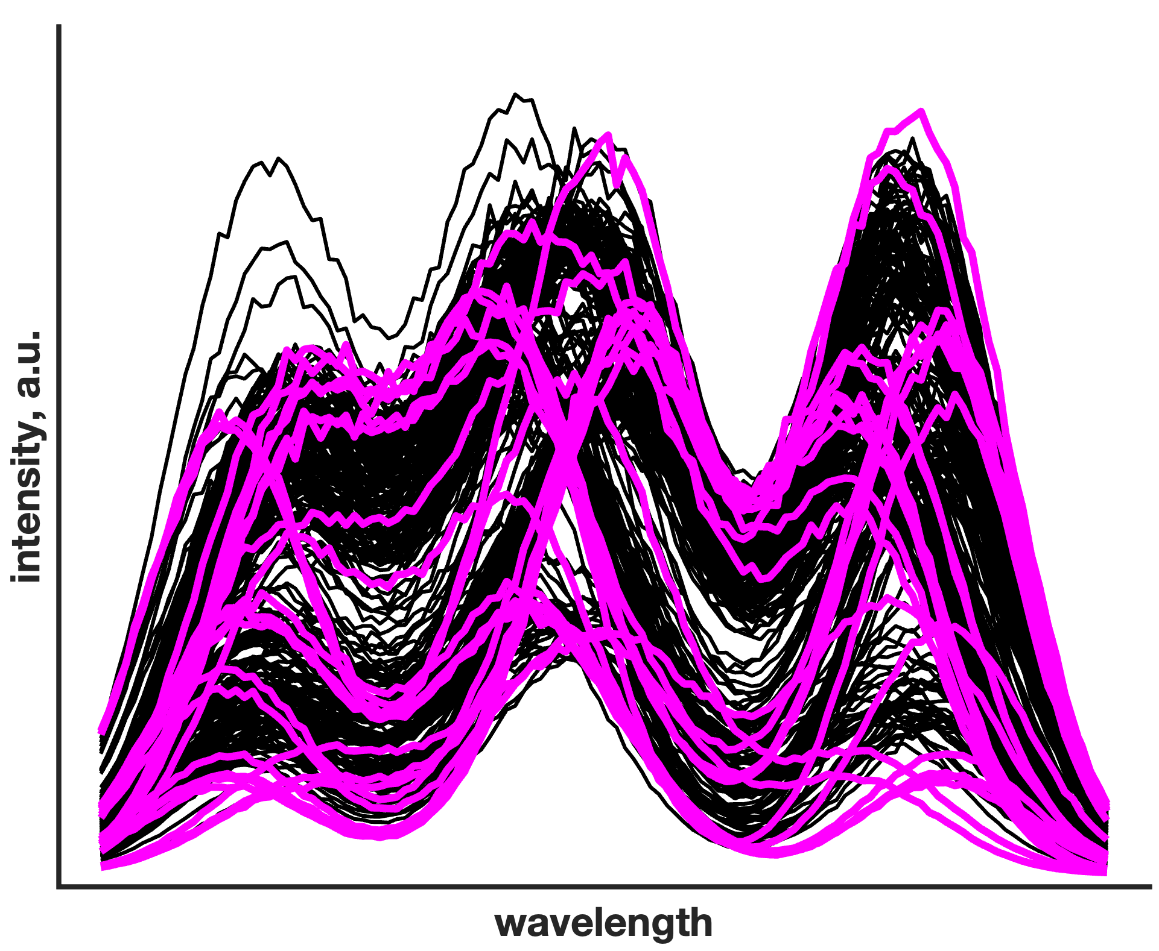
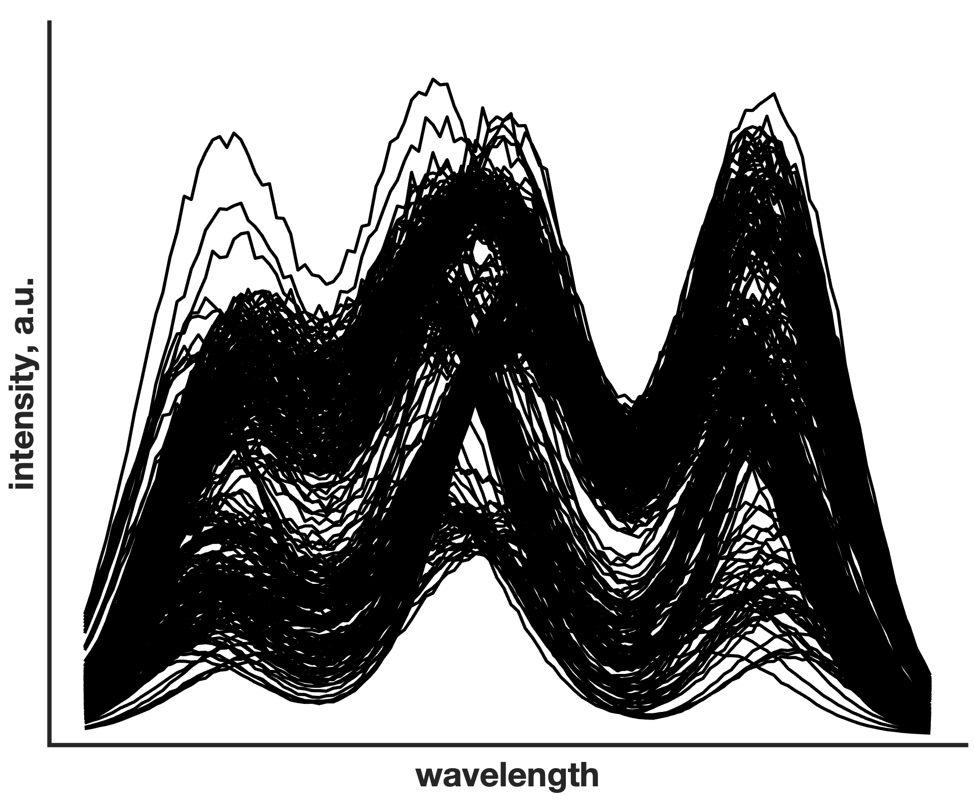
Spectral resolution and archetype identification
D = TP^{T} + E
T = T⊘(t₁1^{T})
Only archetypal (essential) samples matter for the sake of multivariate curve resolution
Ghaffari, M. et al., Anal. Chem., 2019 (91), 10943-10948
Ruckebusch, C. et al., Trend. Anal. Chem., 2020 (132), 116044
4

Slide 7
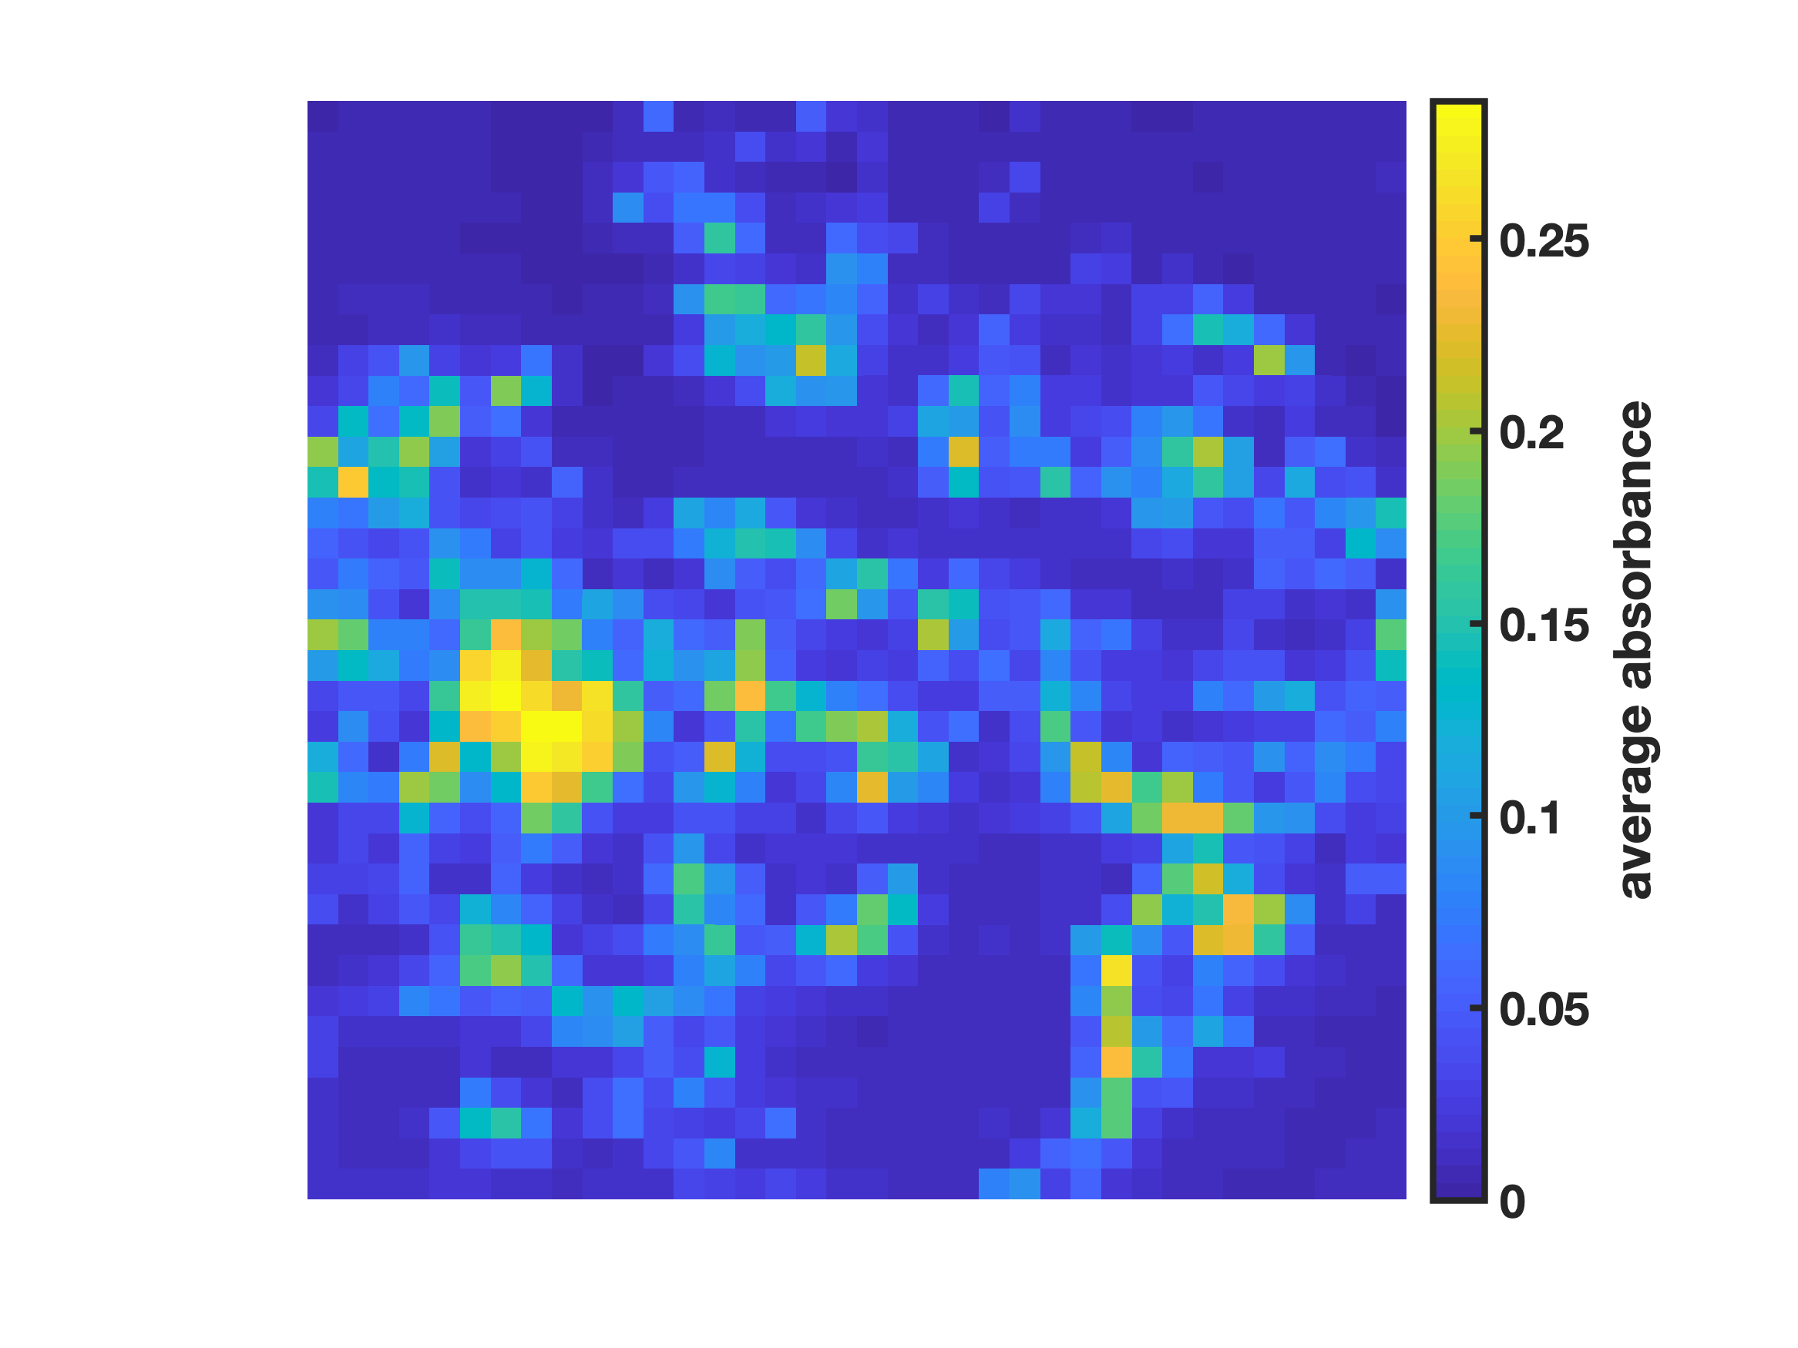
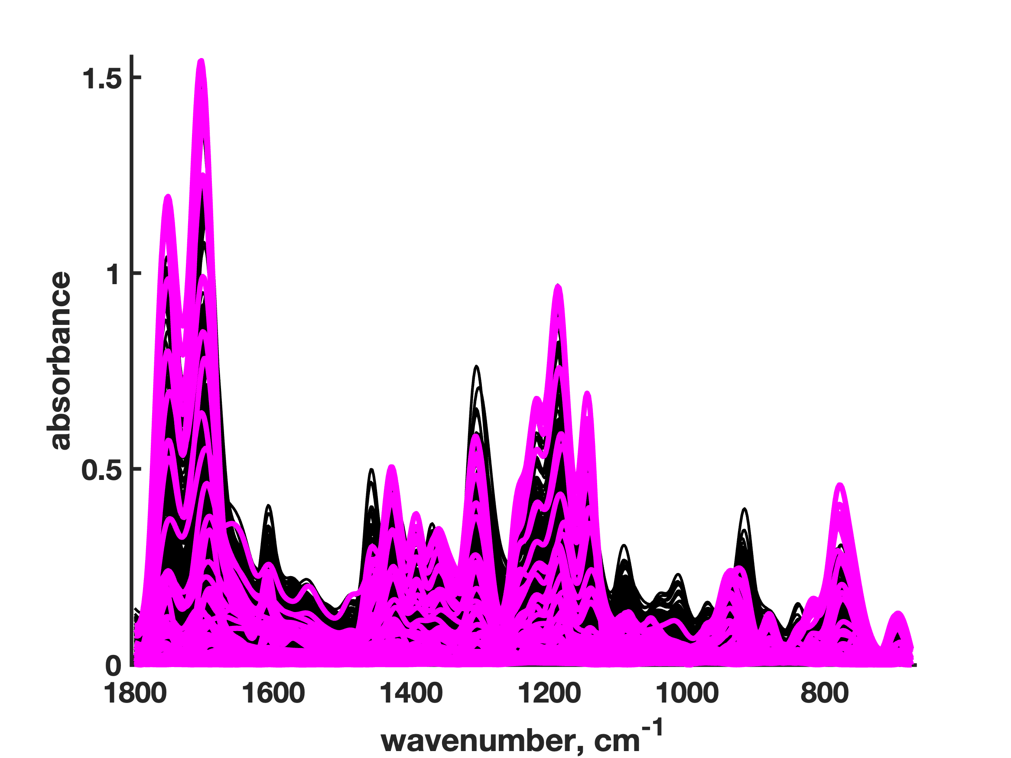
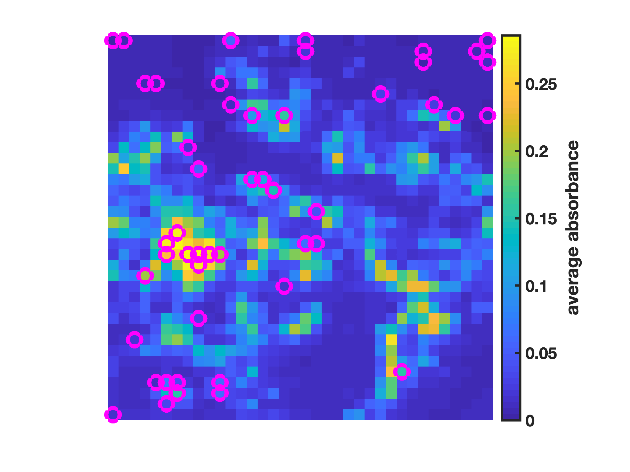
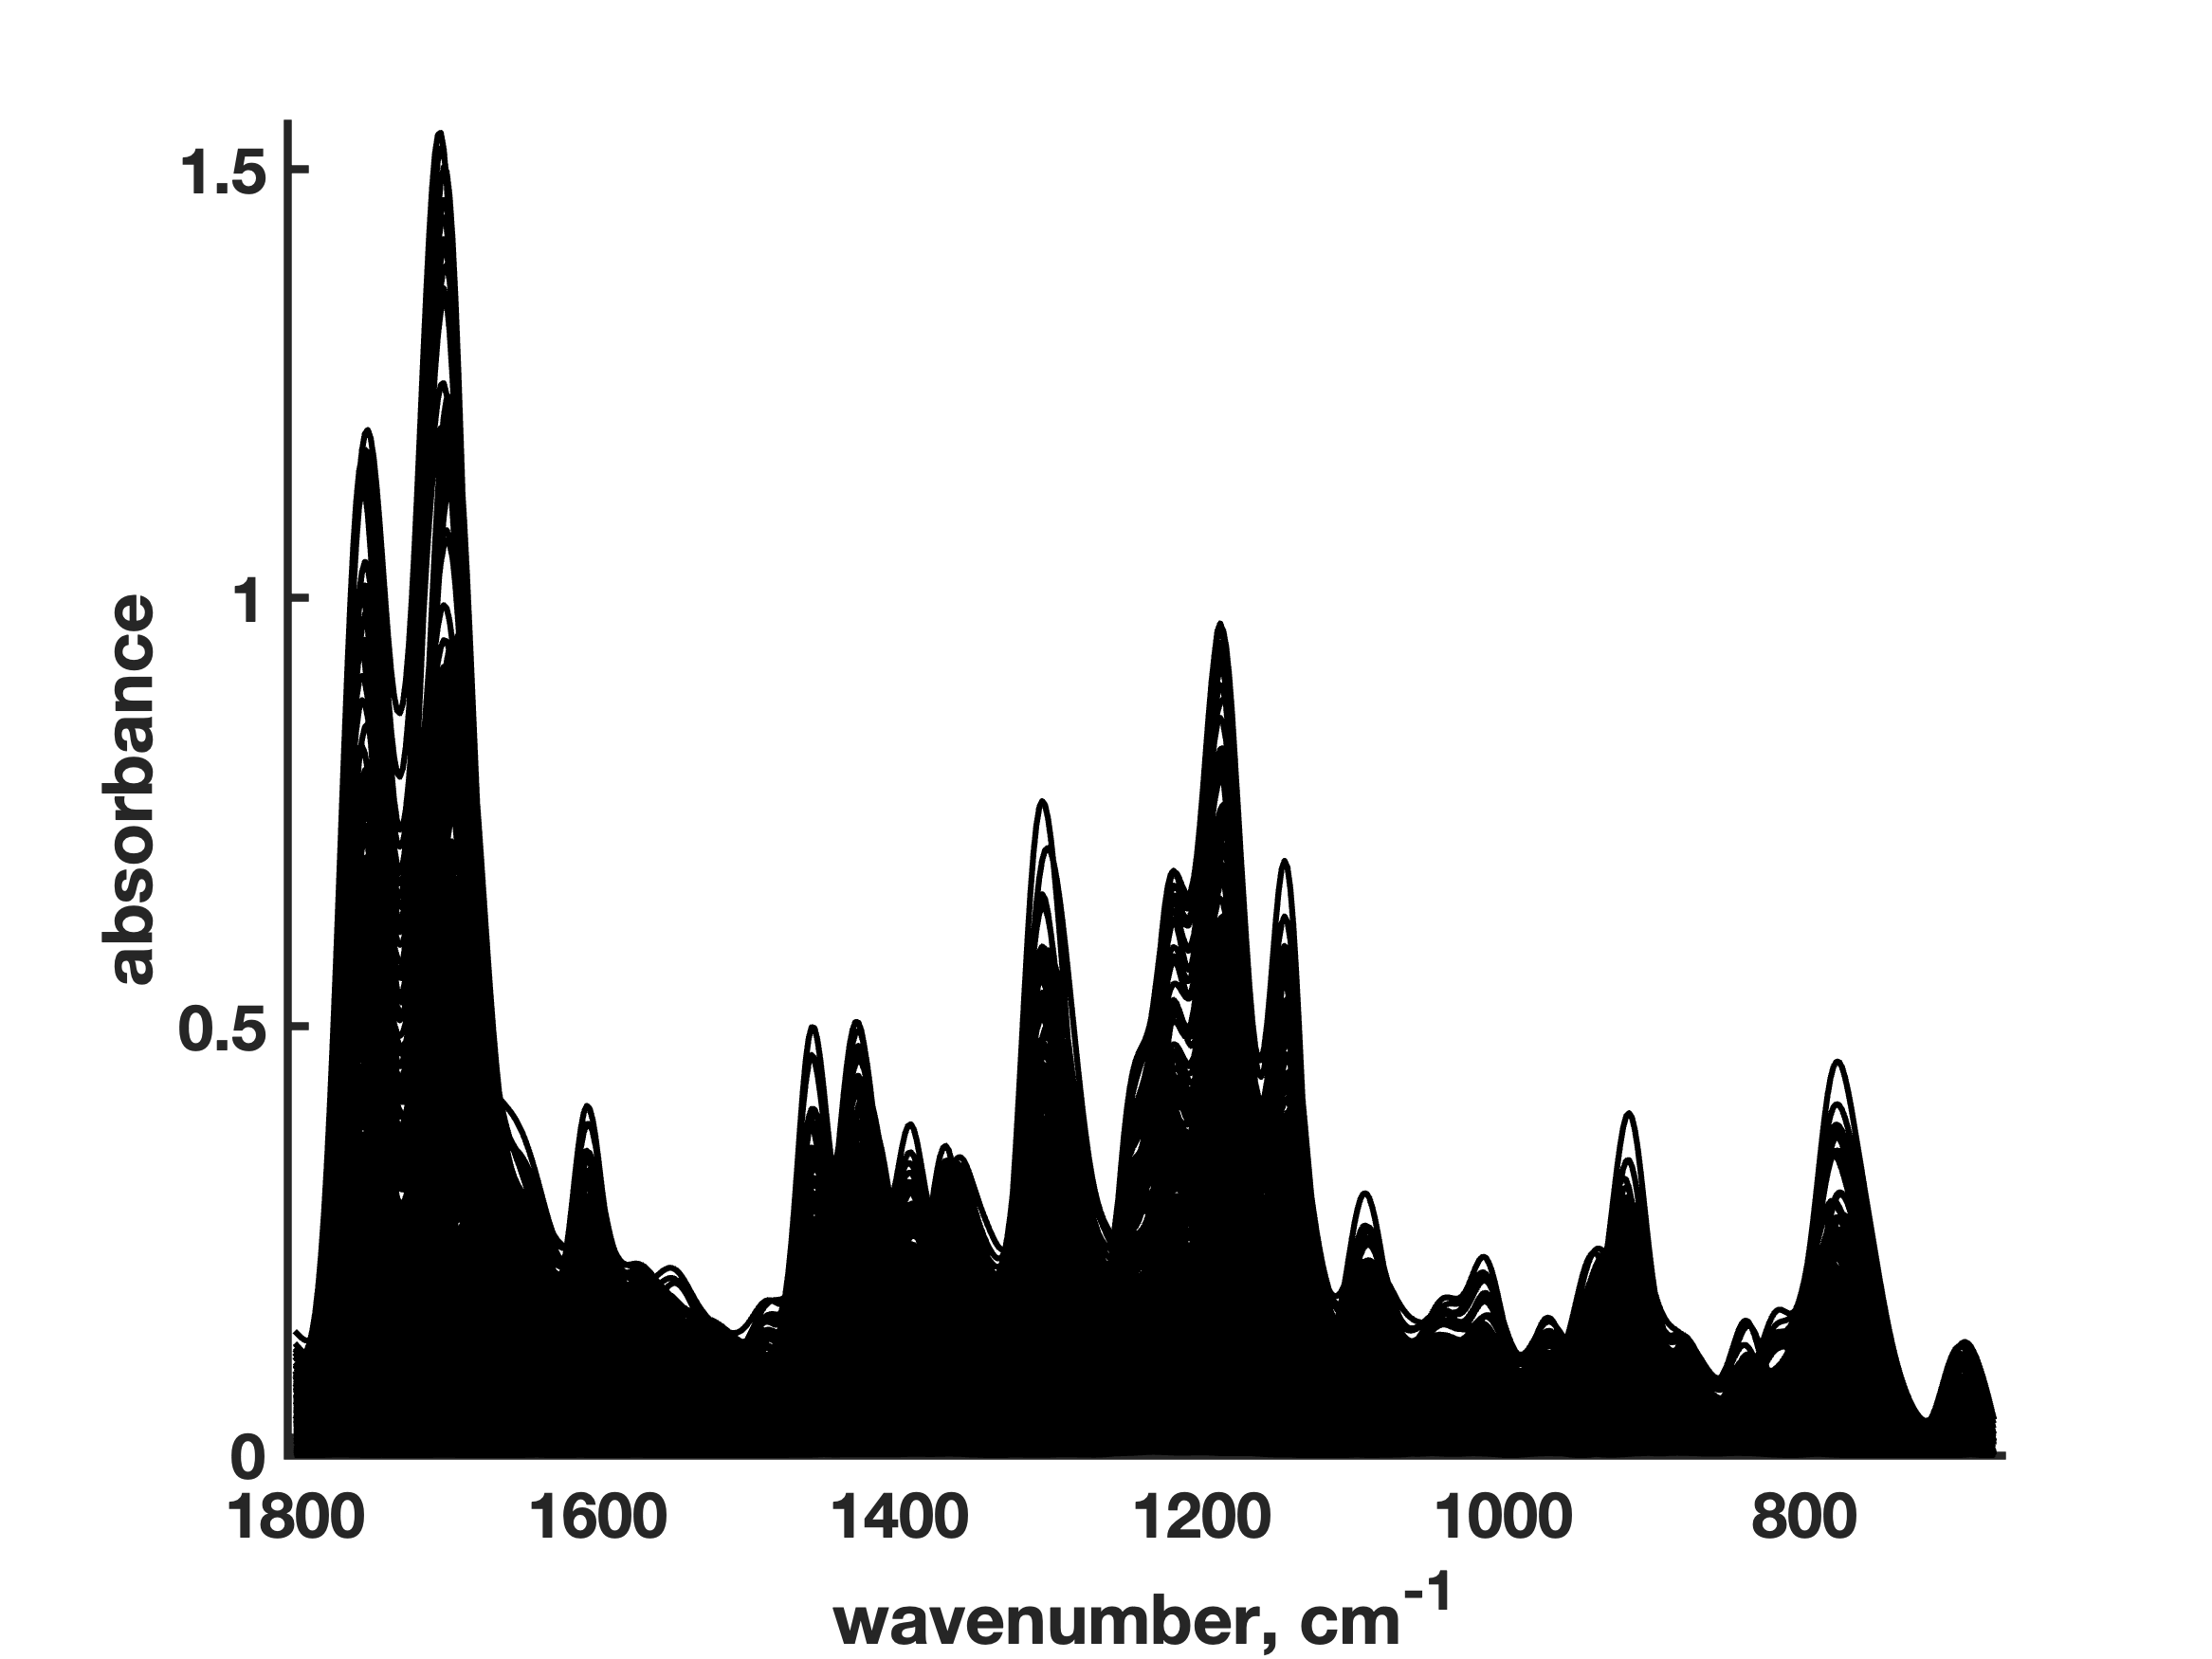
Example #1a: mid-infrared hyperspectral imaging
49 Essential Spectra
36×36 IR image of a pharmaceutical formulation composed by citric acid, acetylsalicylic acid and caffeine
5

Slide 8
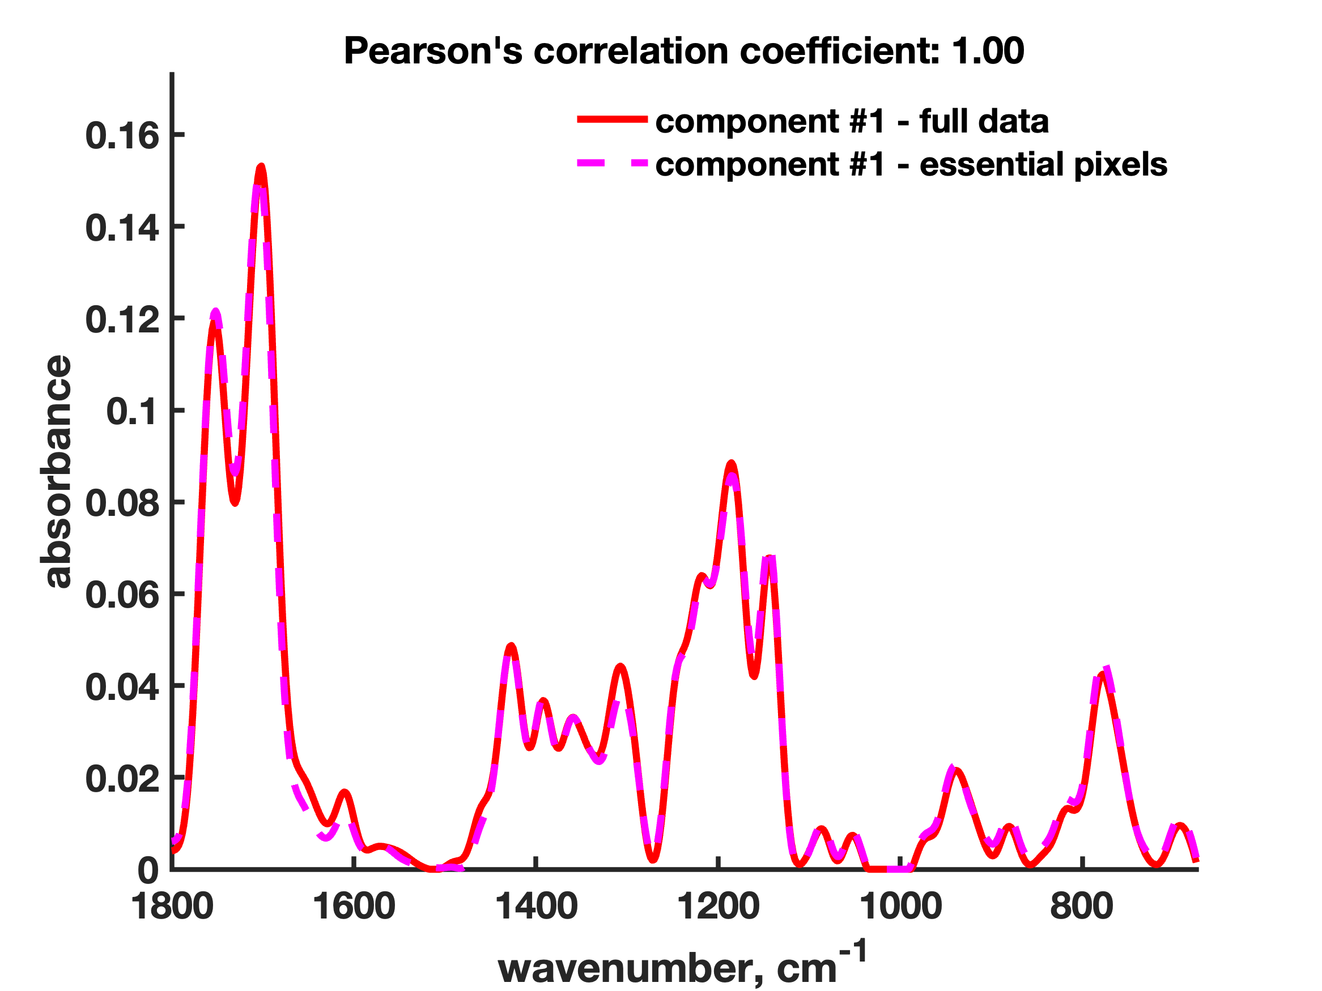
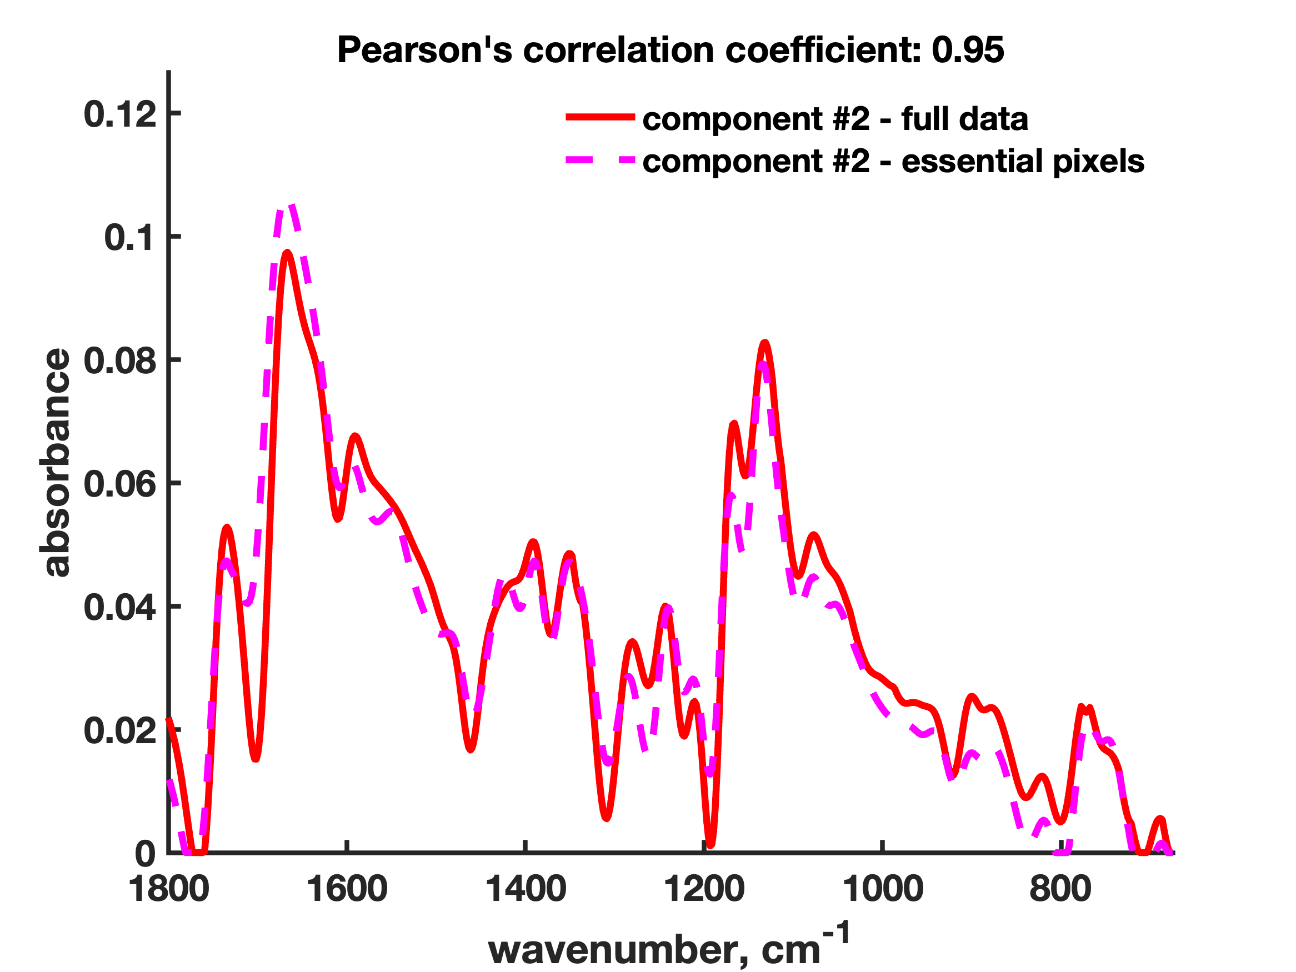
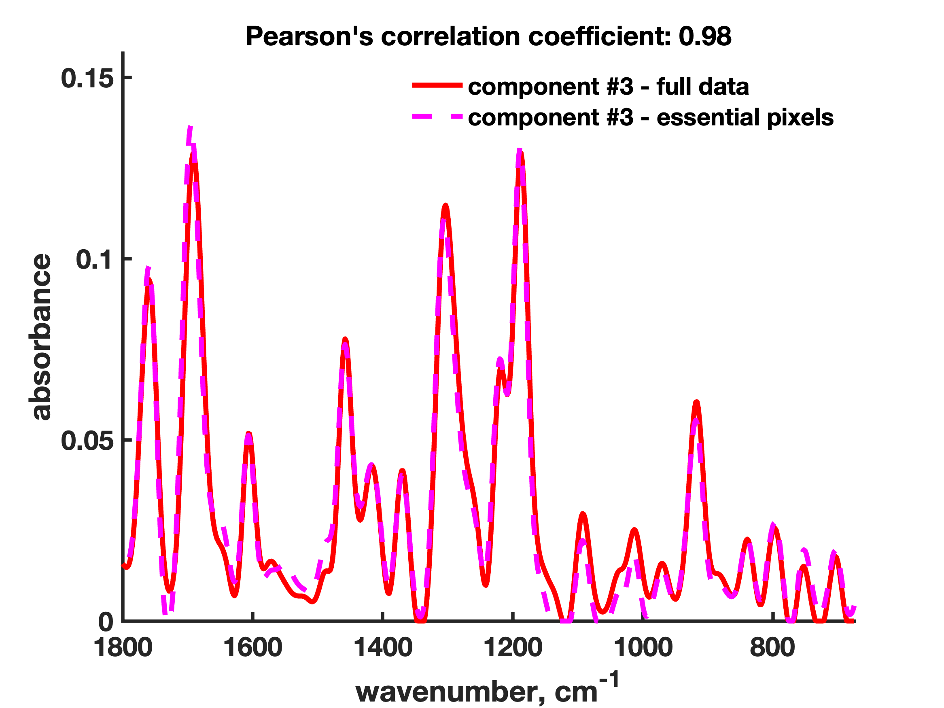
Example #1a: mid-infrared hyperspectral imaging
Tauler, R. et al., J. Chemometr., 1995 (9), 31-58
de Juan, A. et al., Trend. Anal. Chem., 2014 (6), 4964-4976
5

Slide 9
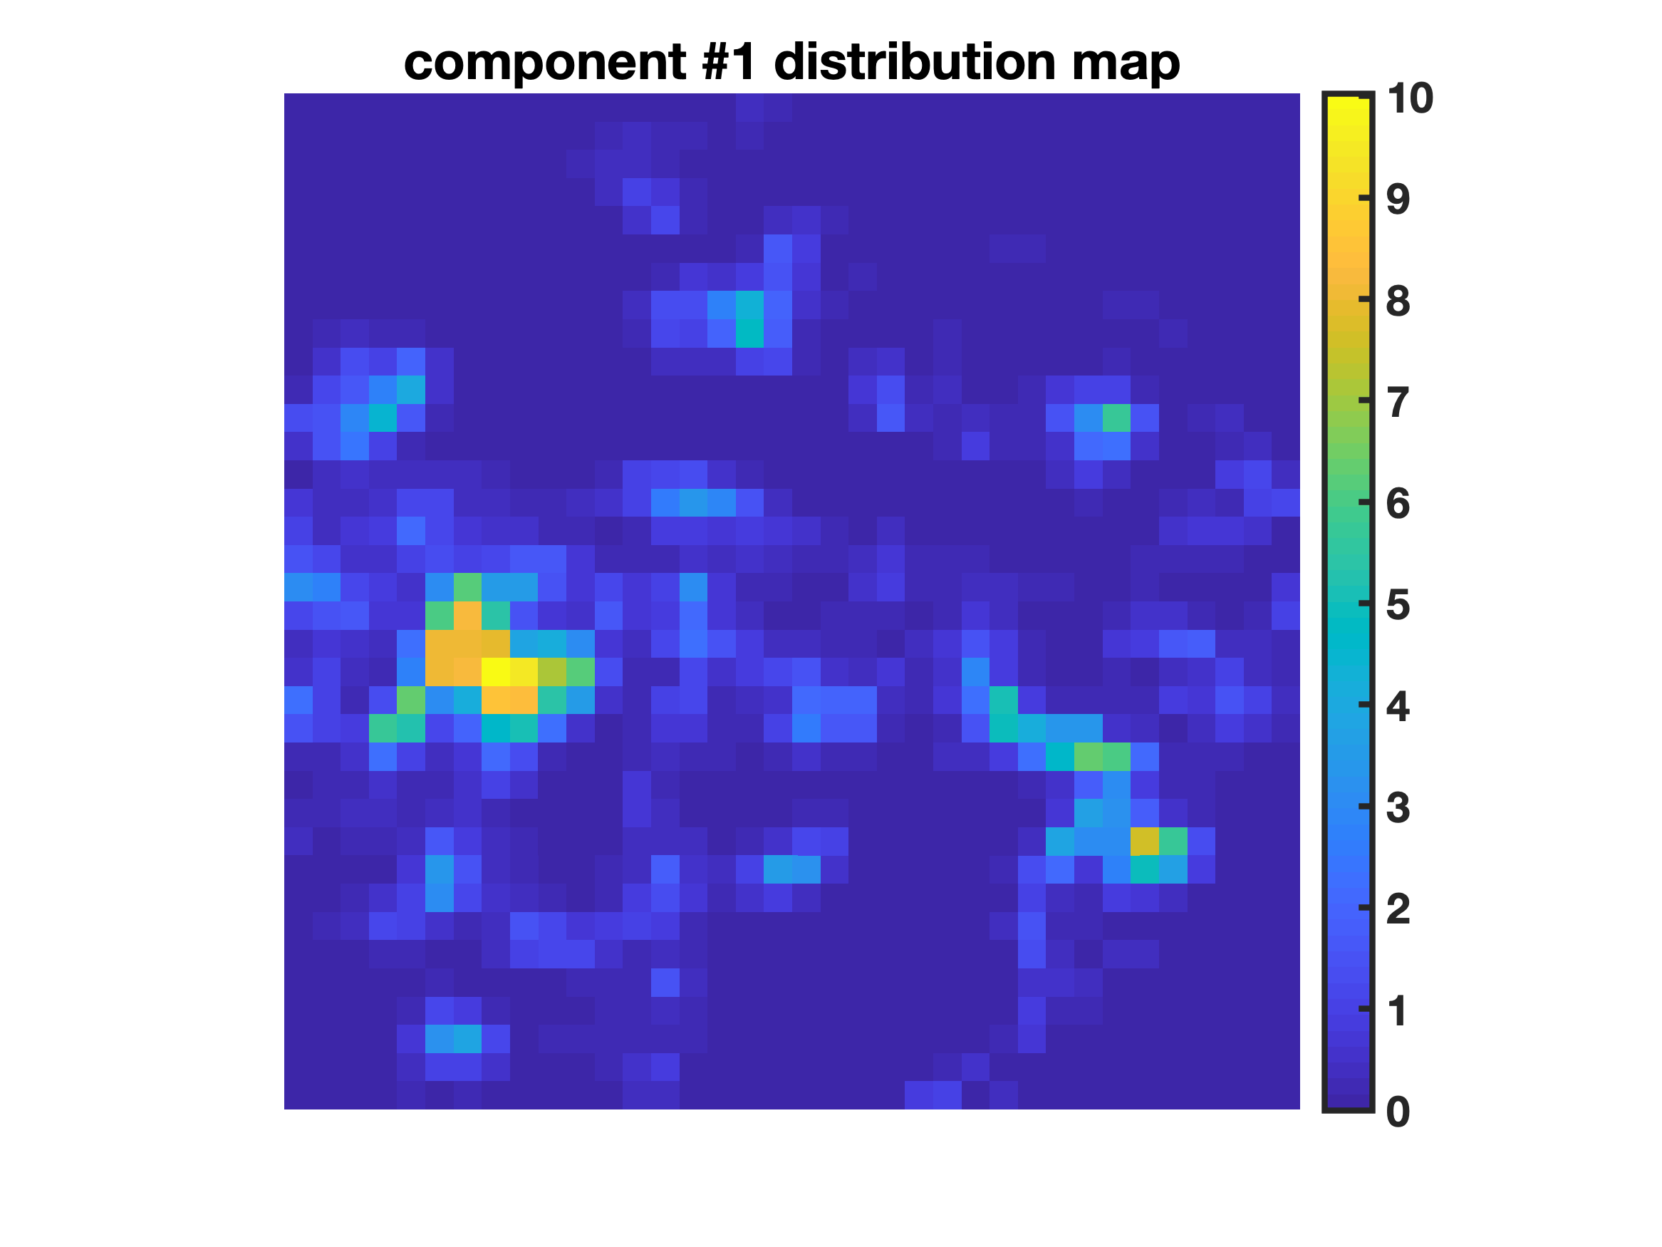
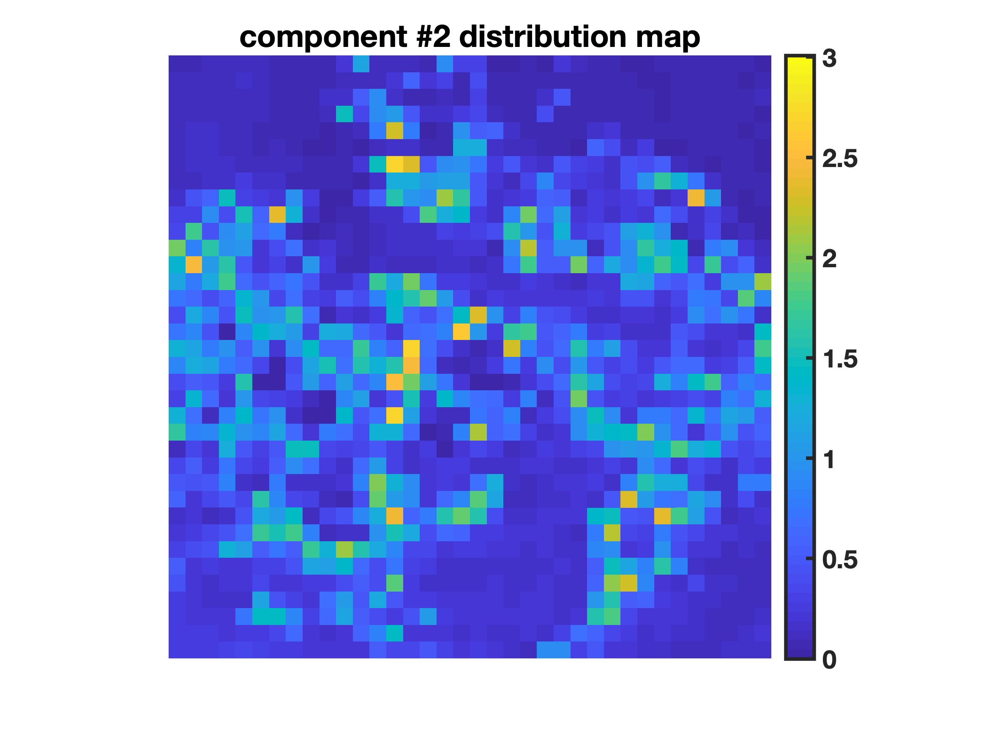
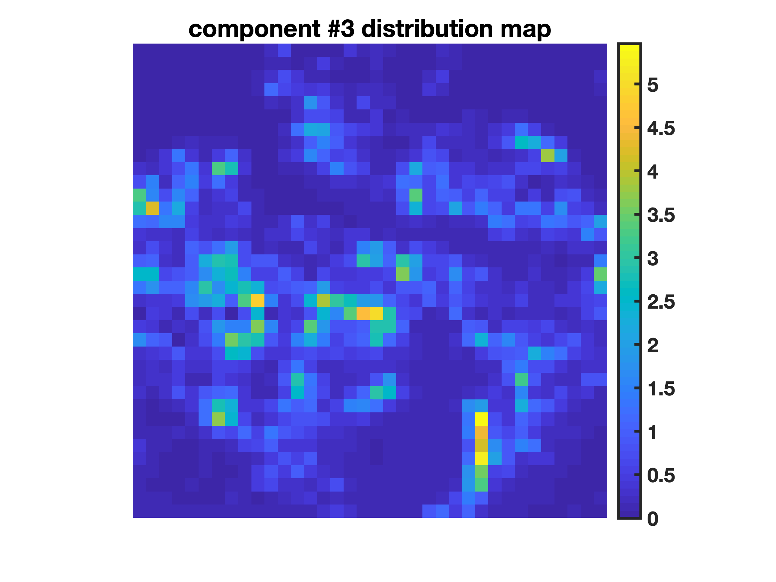
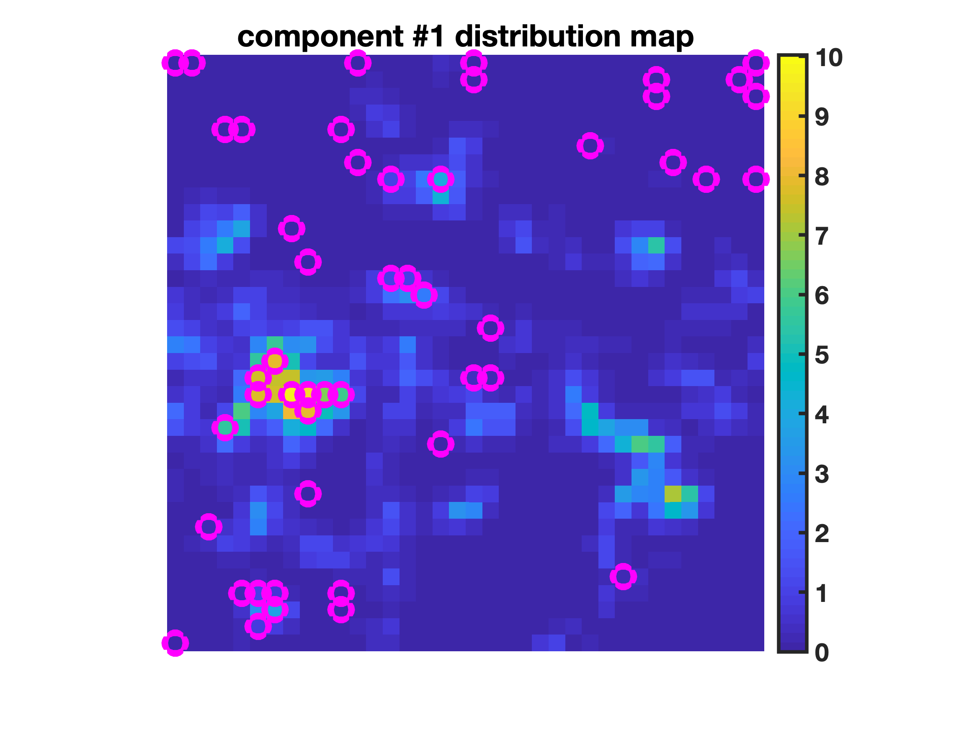
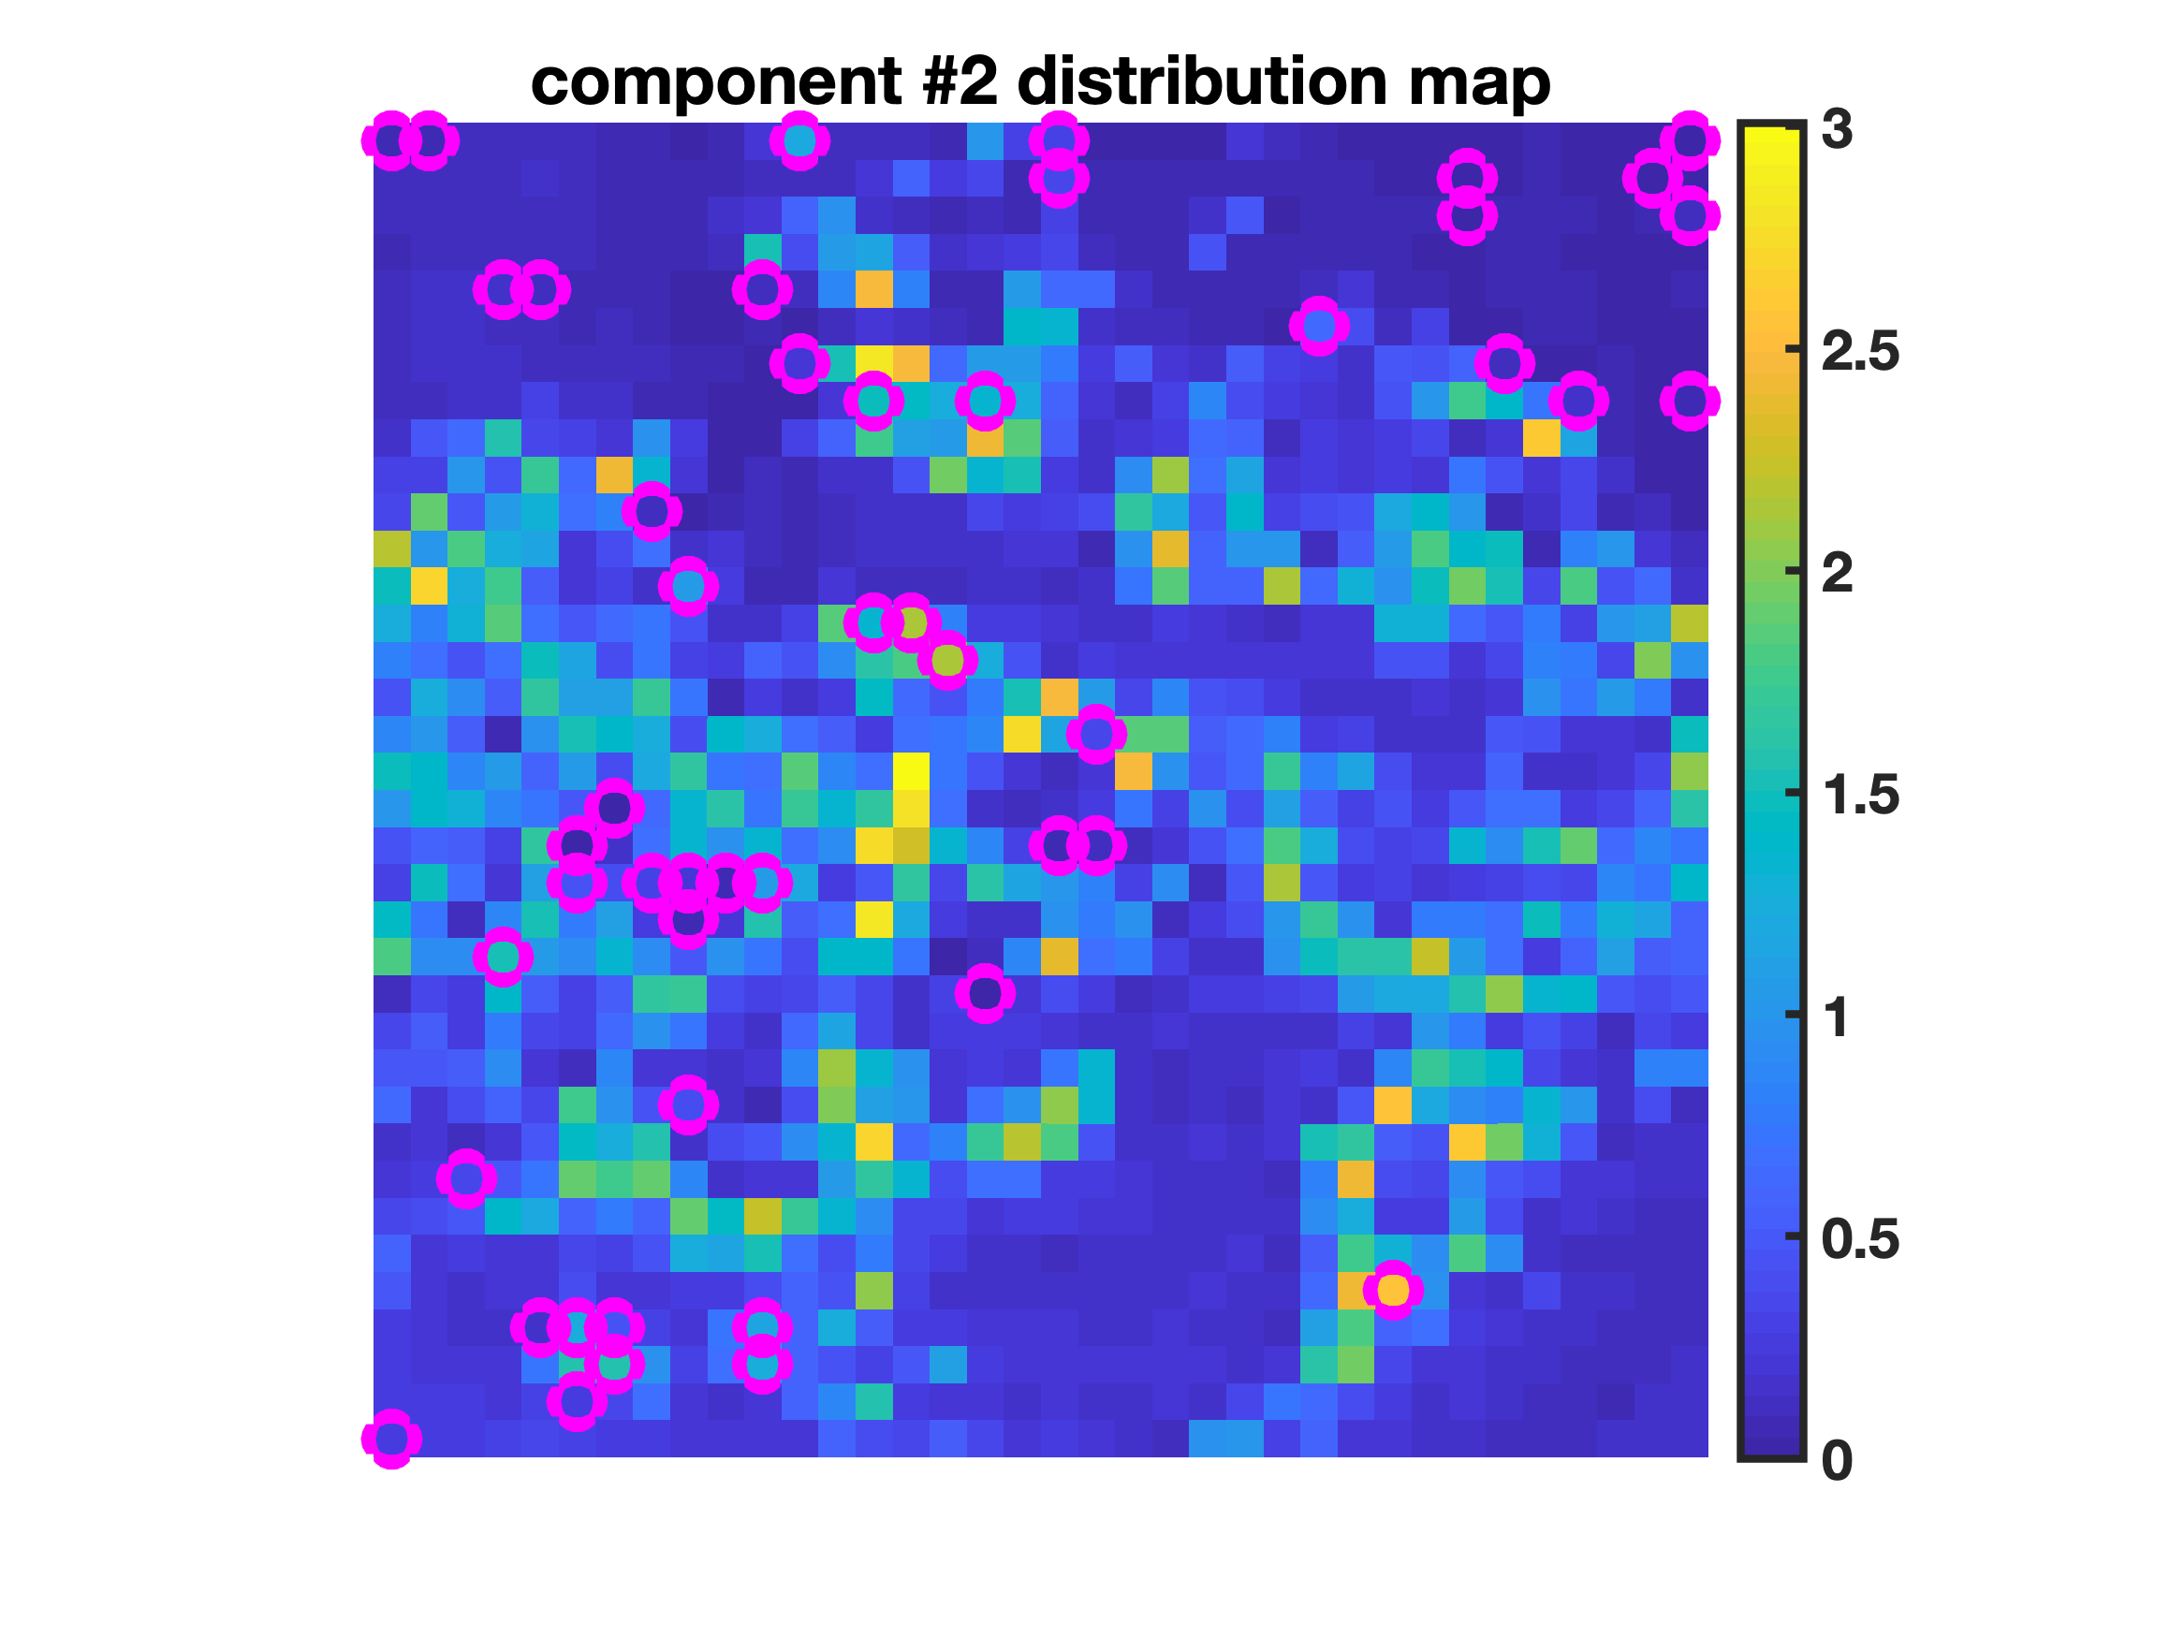
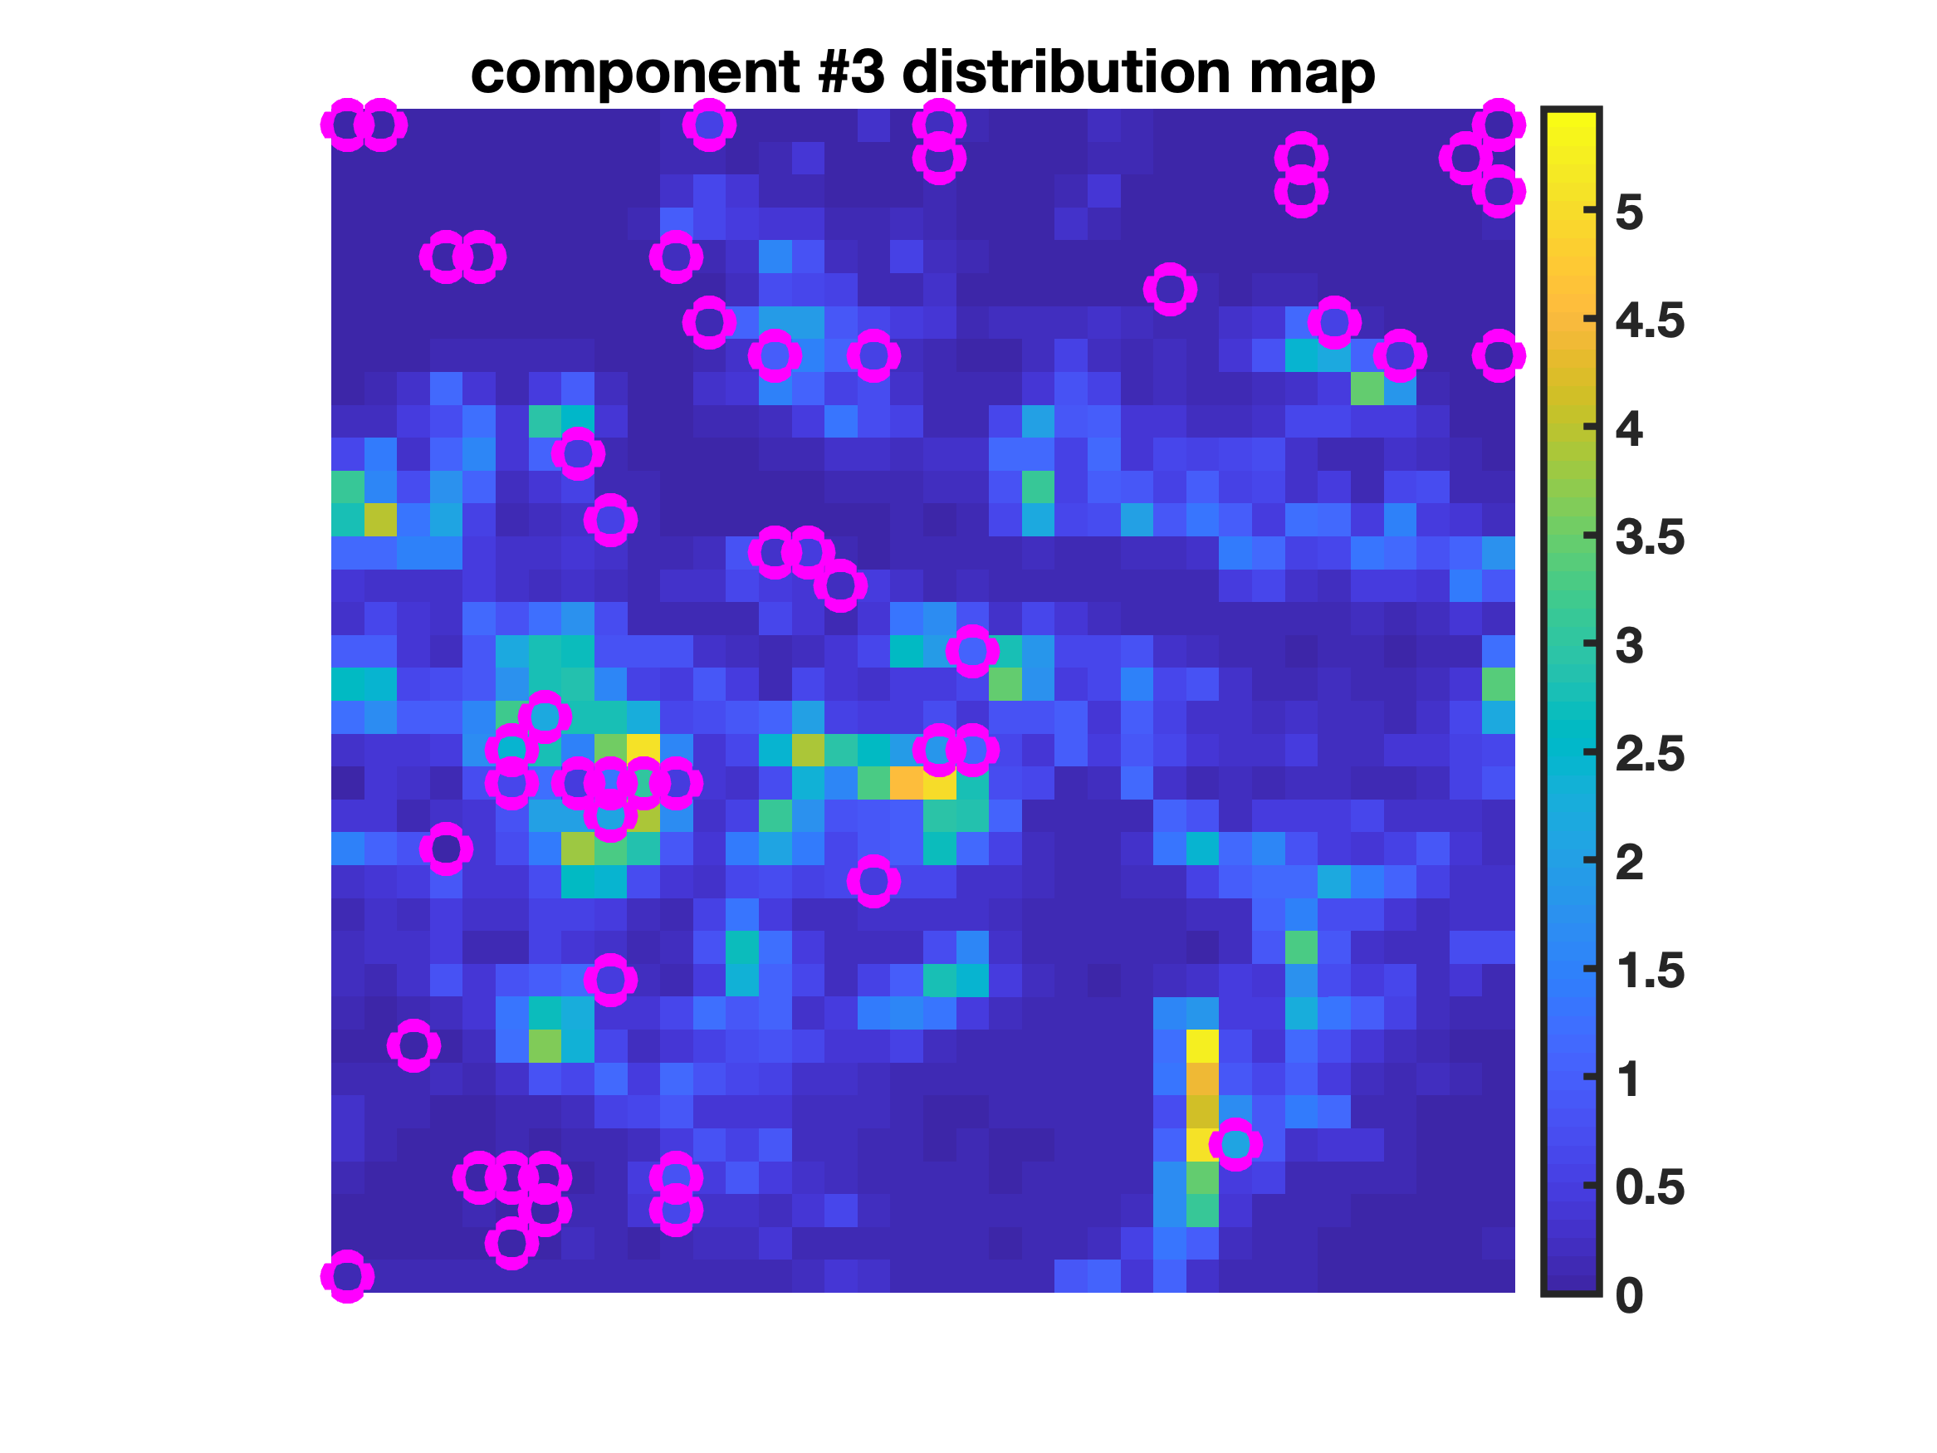
Example #1a: mid-infrared hyperspectral imaging
Full Dataset – Total Elapsed Time: 5.52 s
Reduced Dataset And Non-Negative Least Squares Projection – Total Elapsed Time: 1.86 s
5

Slide 10
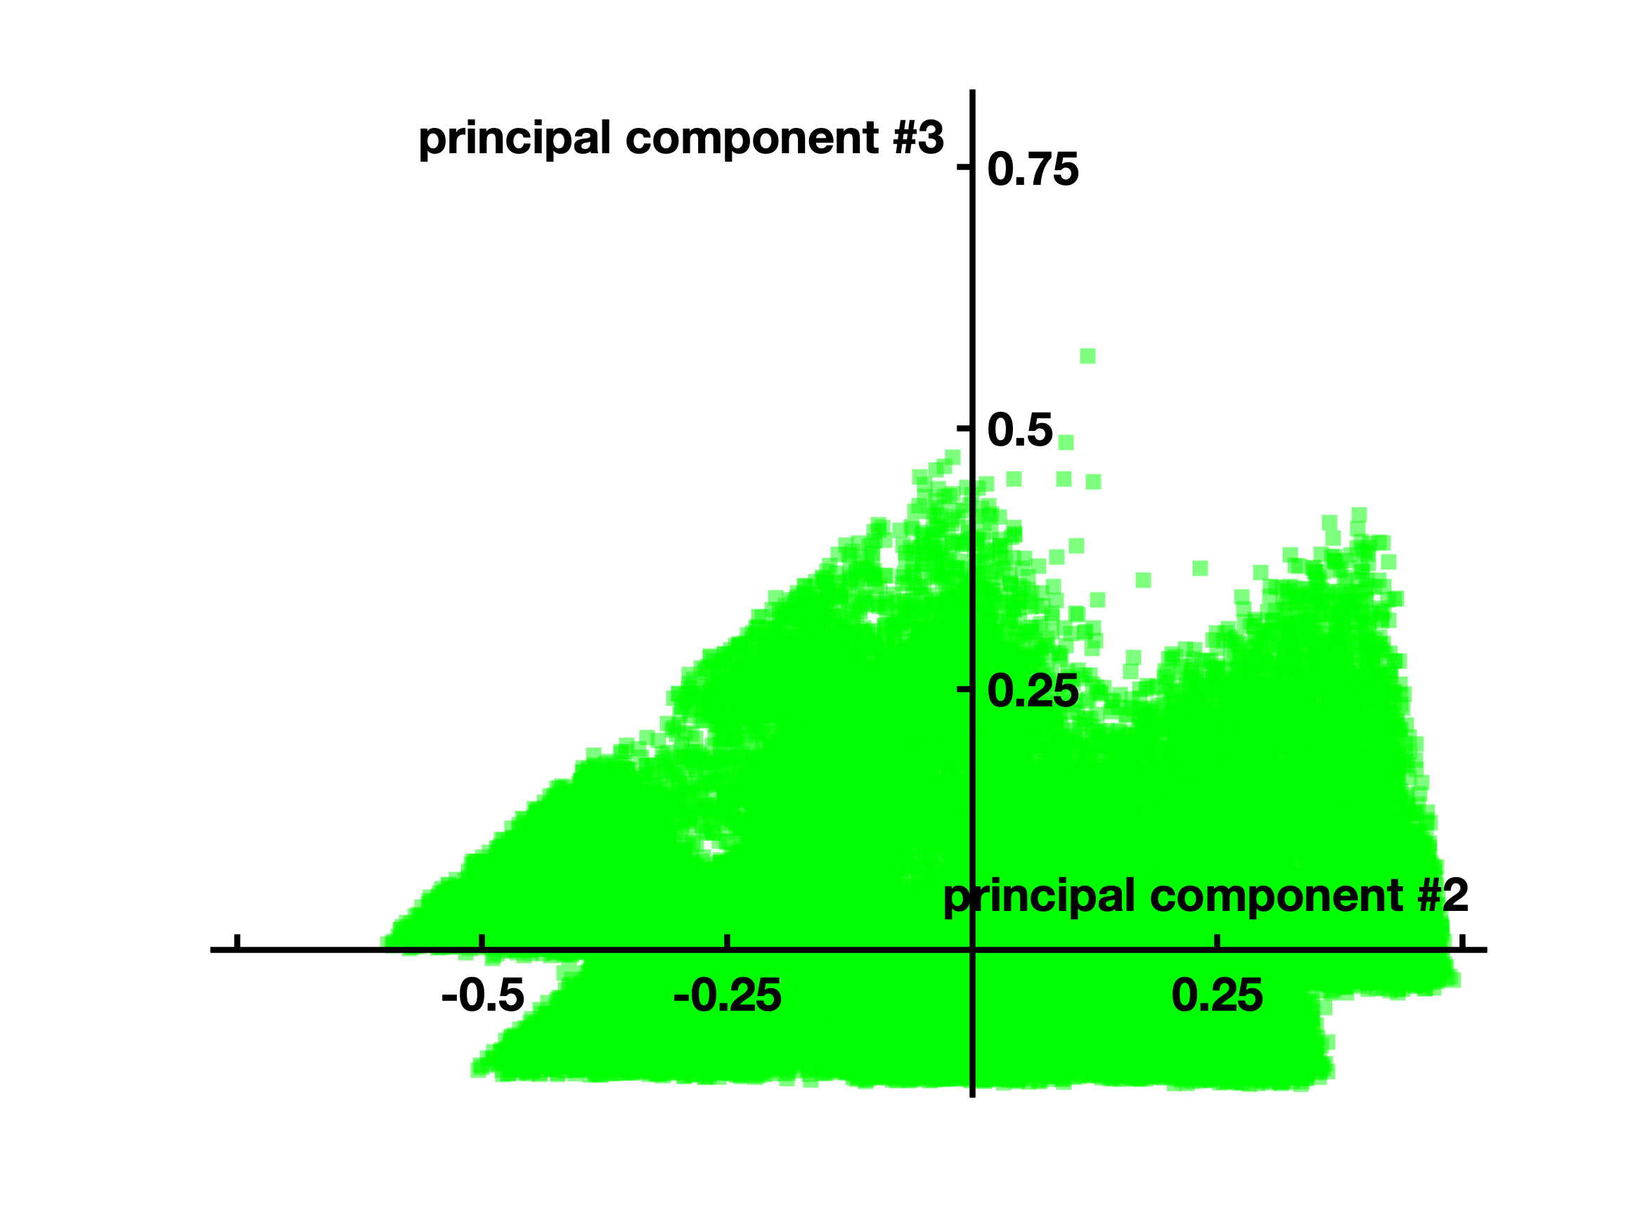
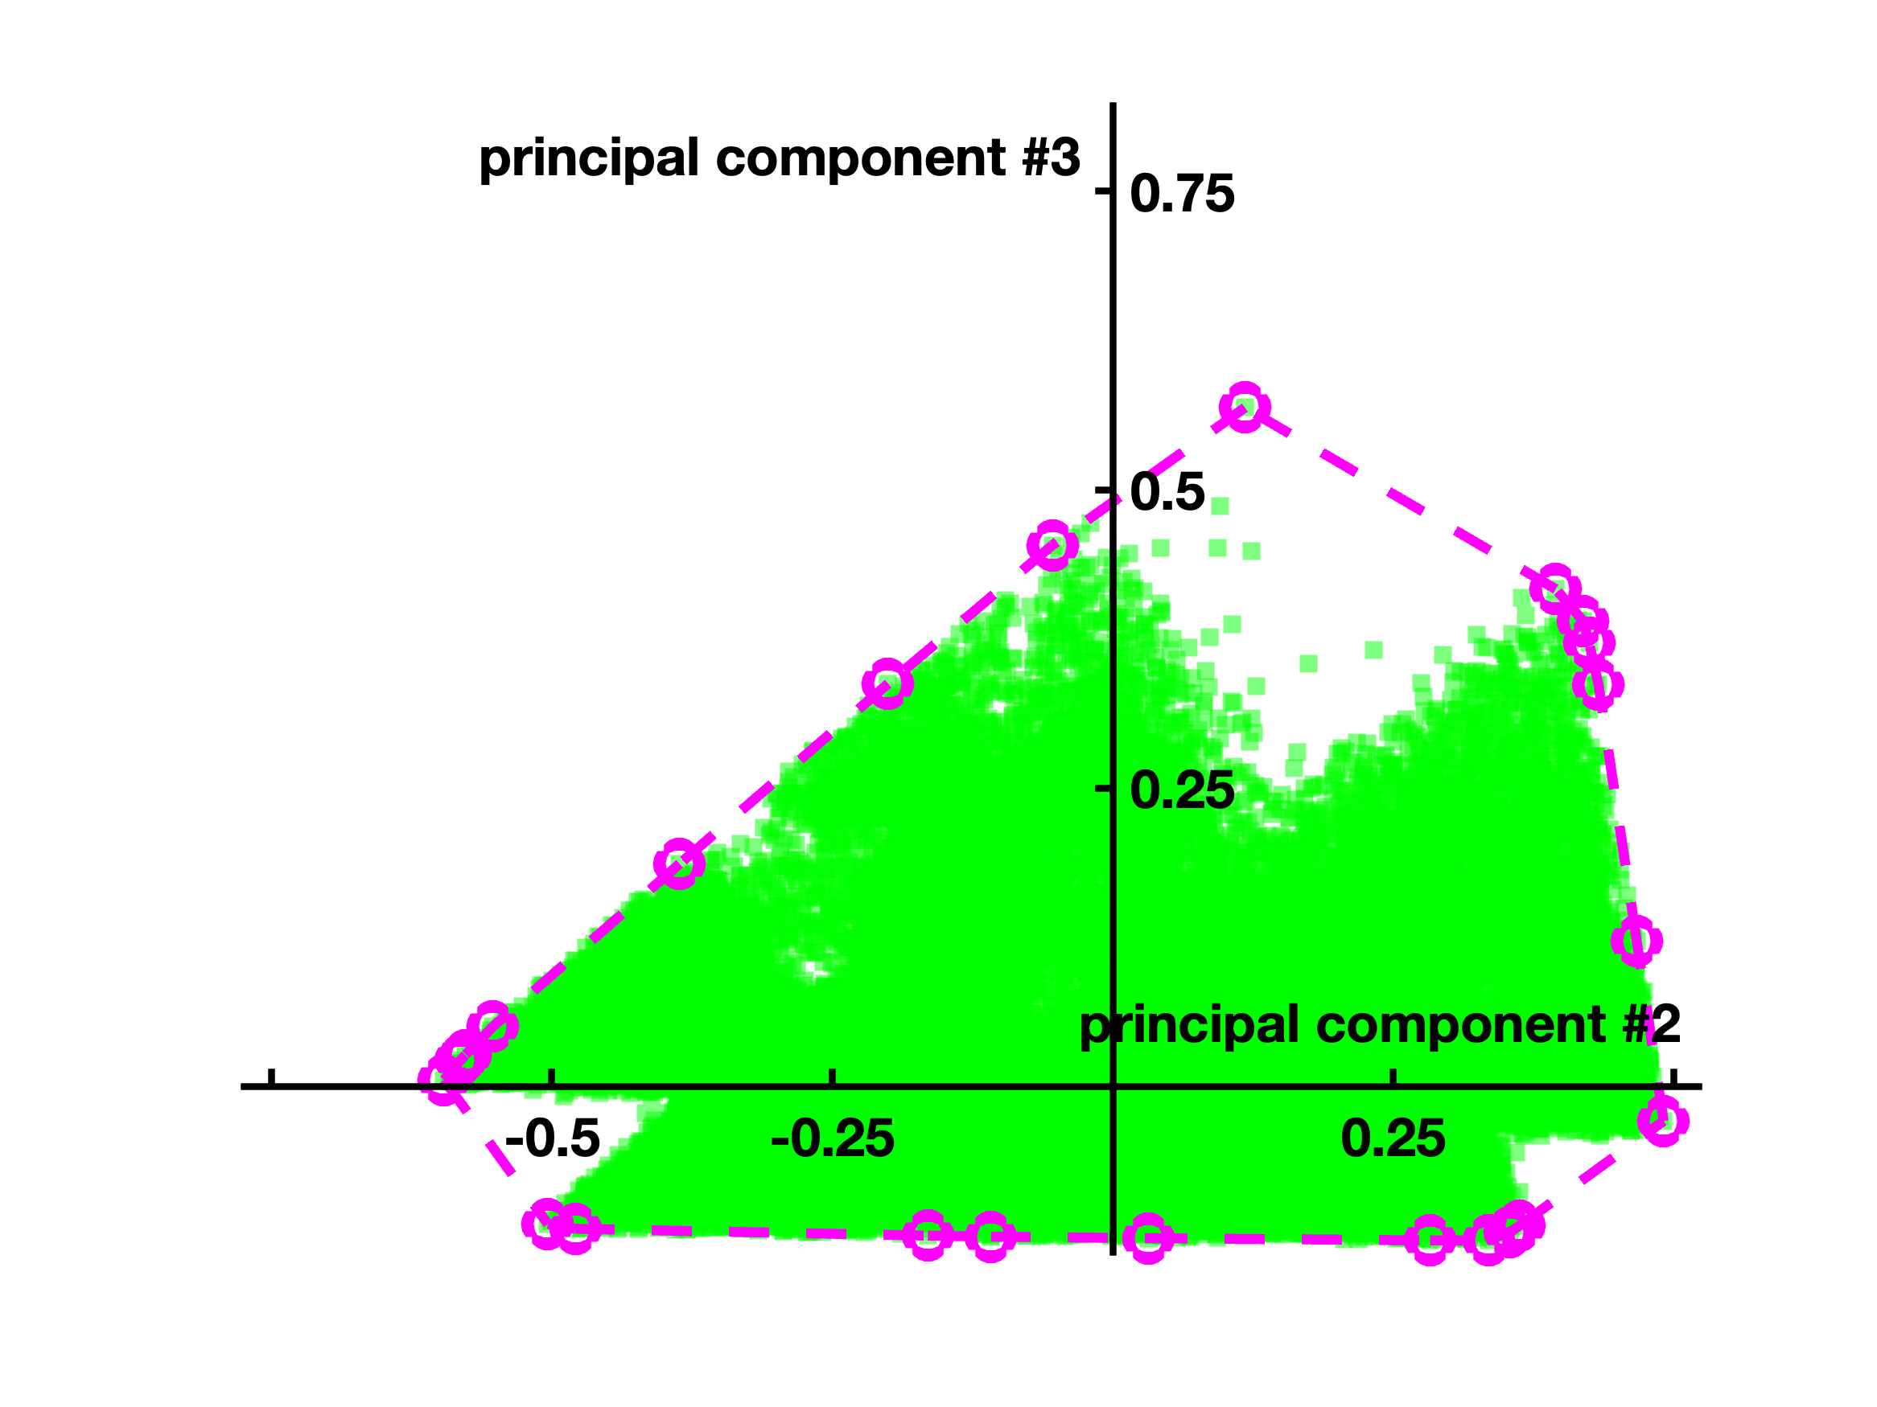
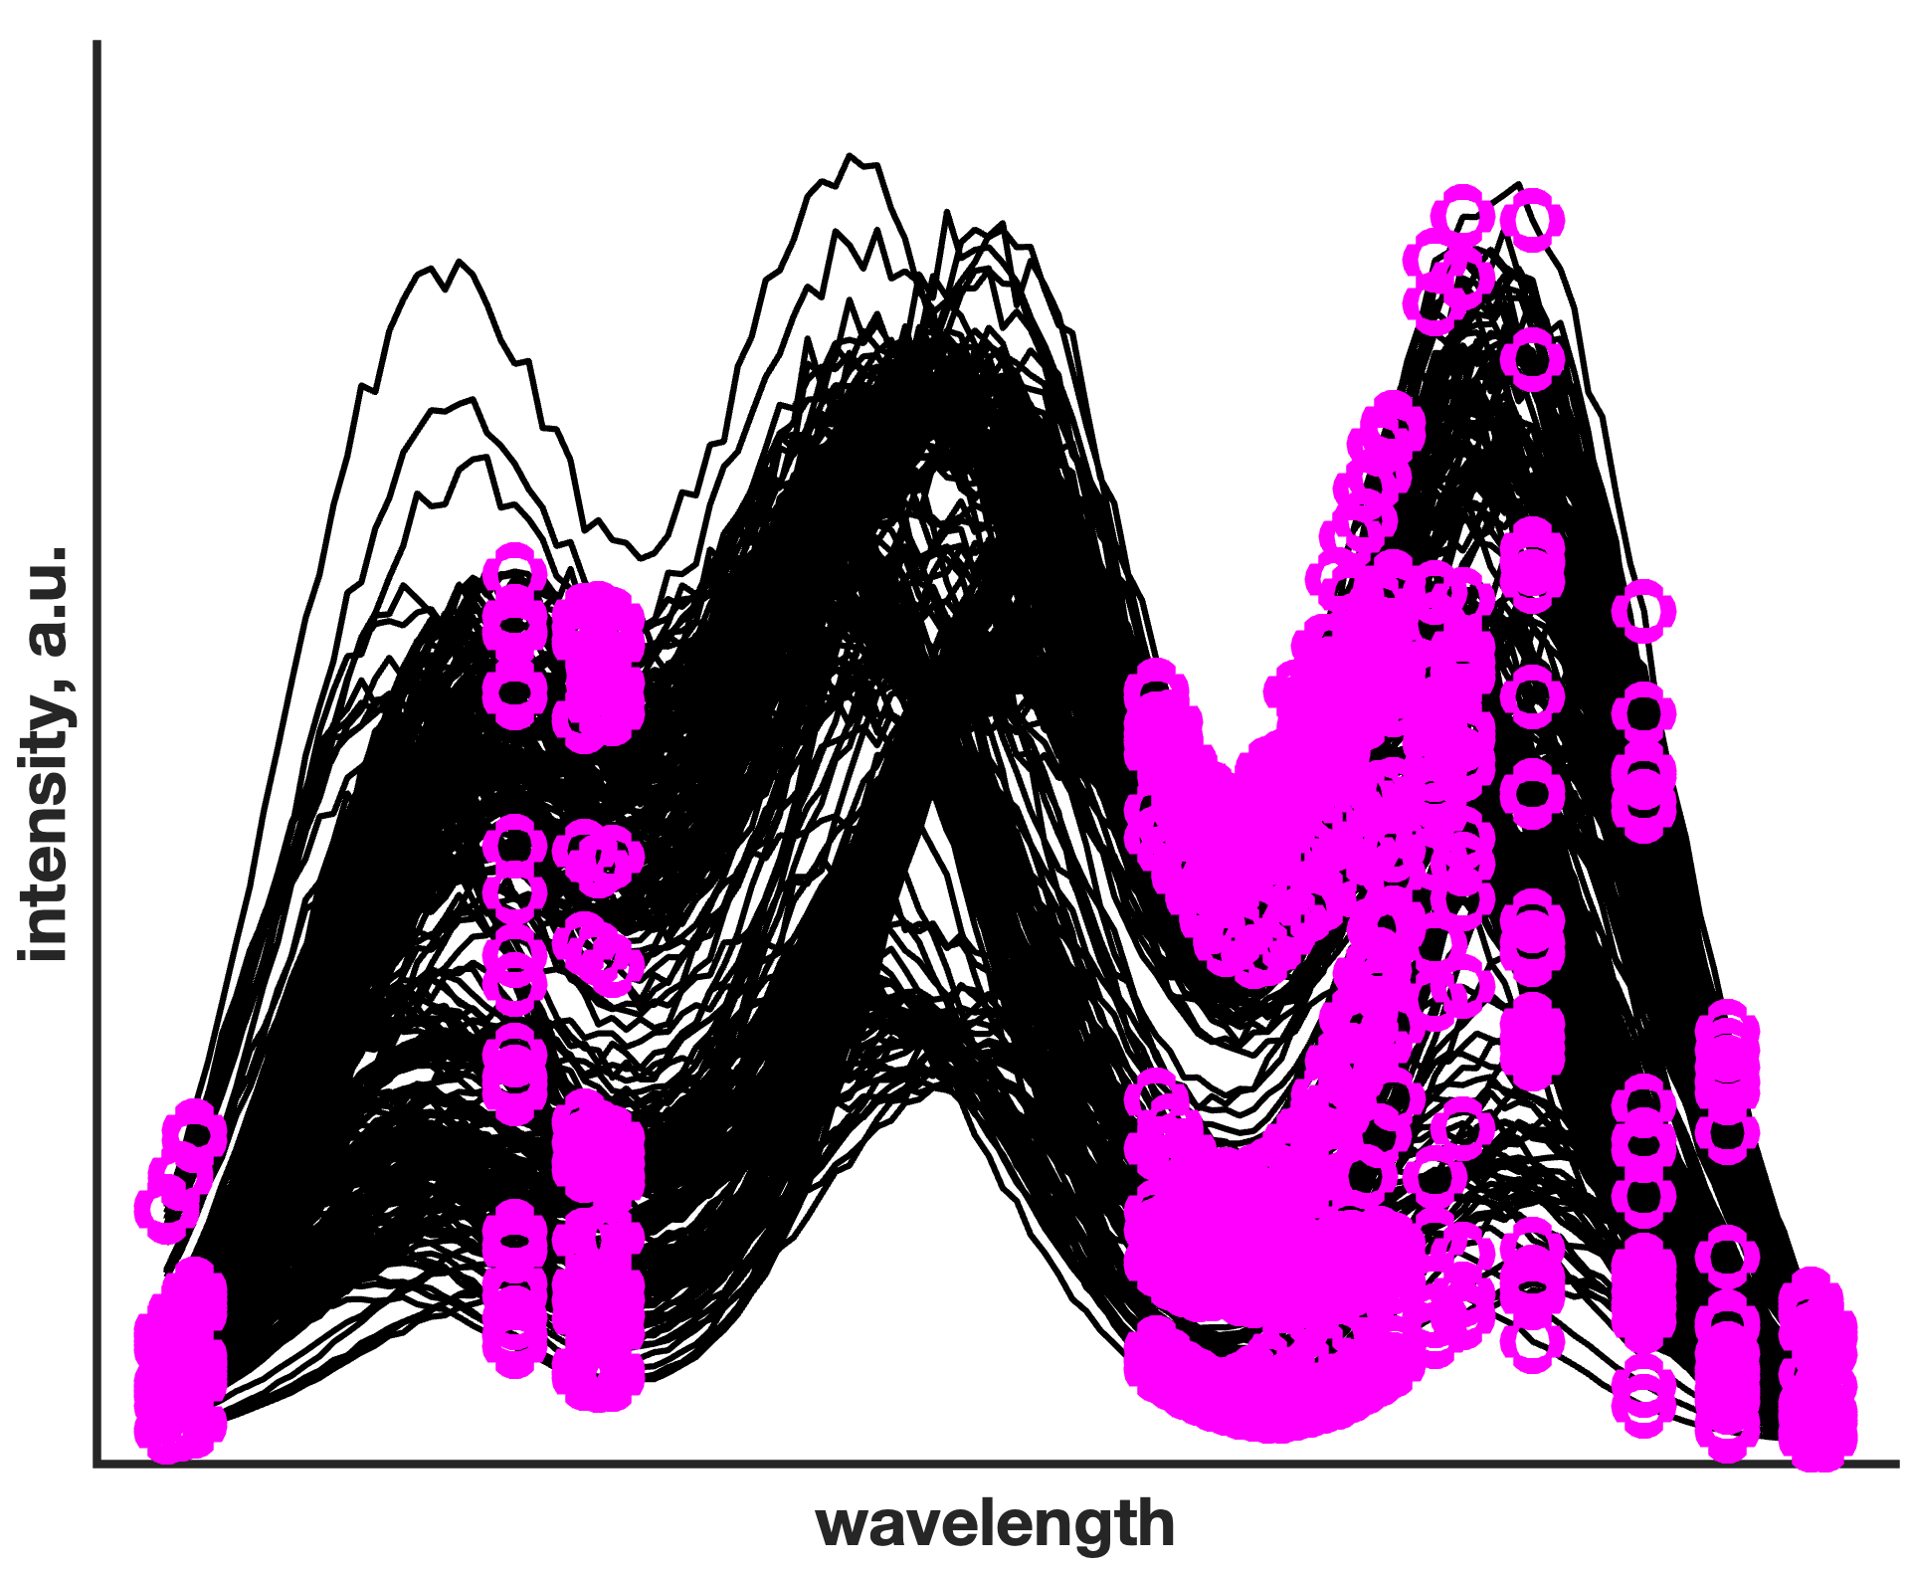
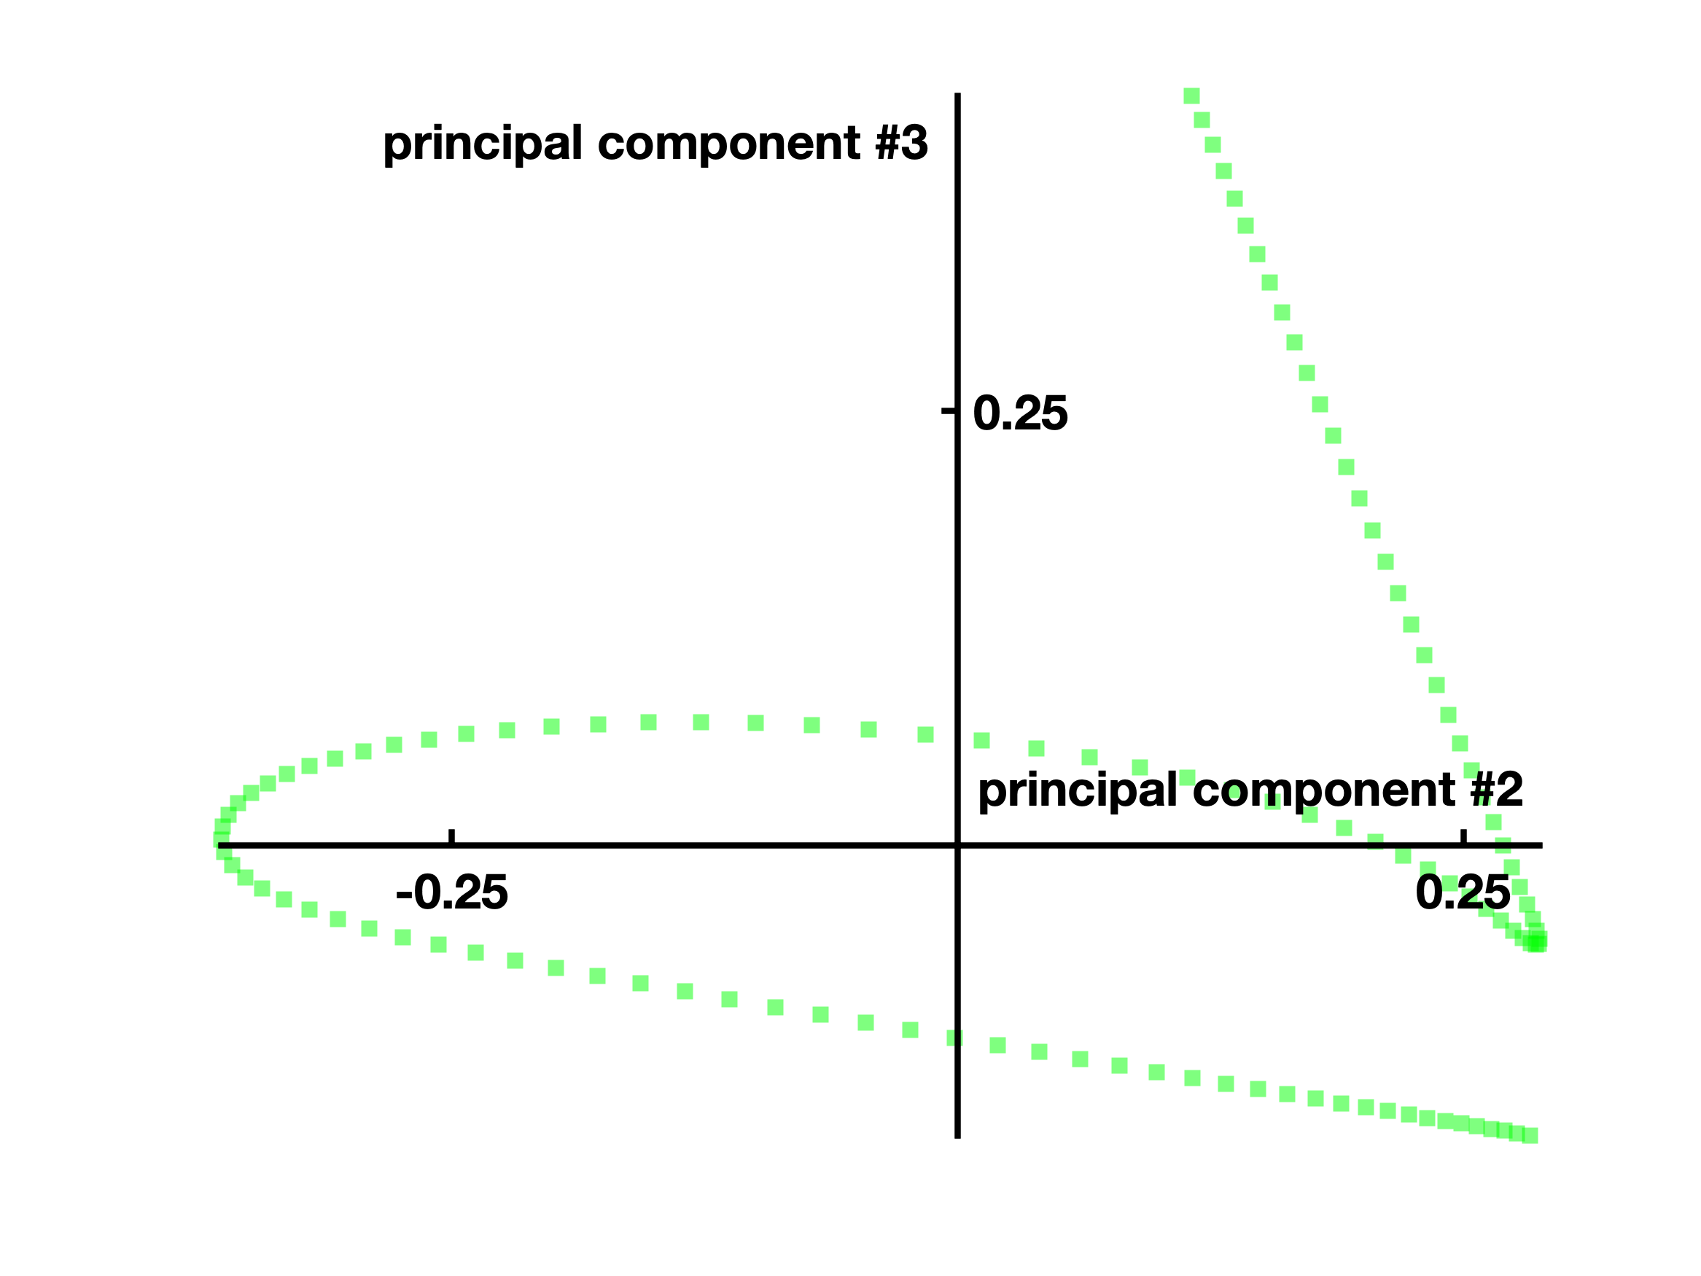
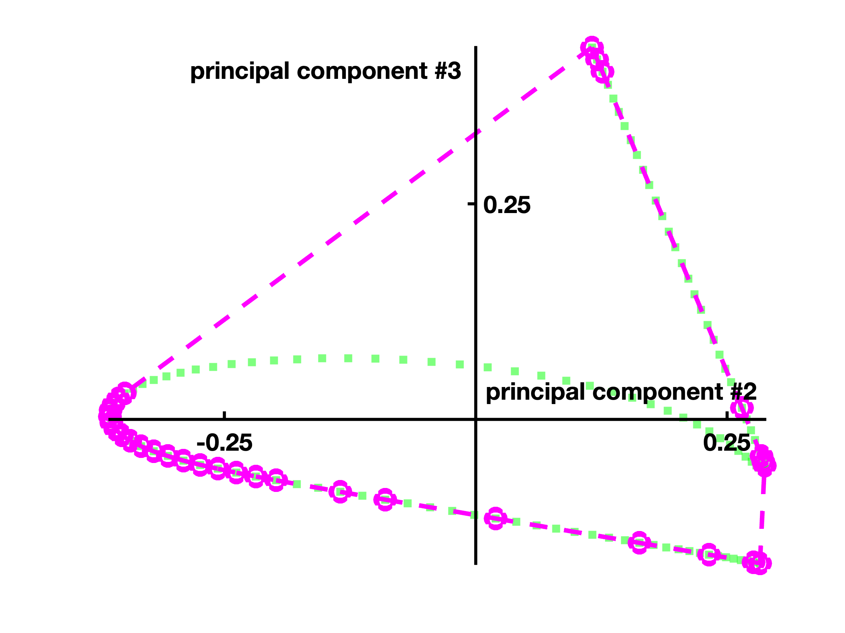
Essential spectra (rows) and variables (columns)
Normalised scores of D
Normalised scores of D^{T}
Ghaffari, M. et al., Anal. Chim. Acta., 2021 (1141), 36-46
6

Slide 11
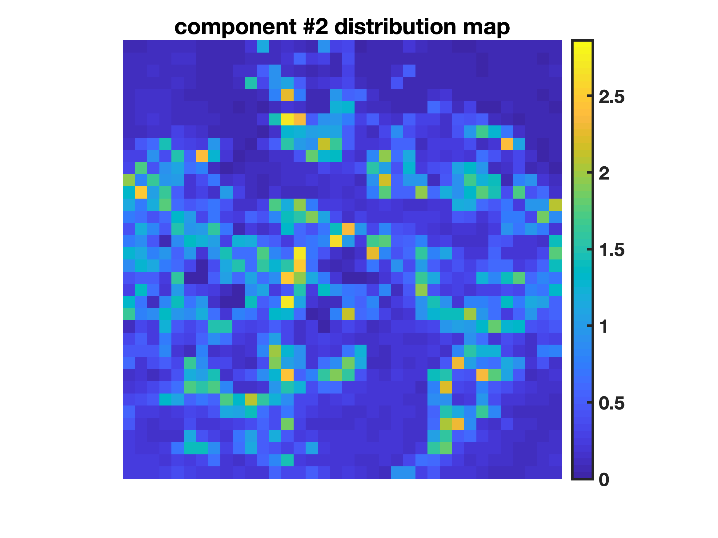
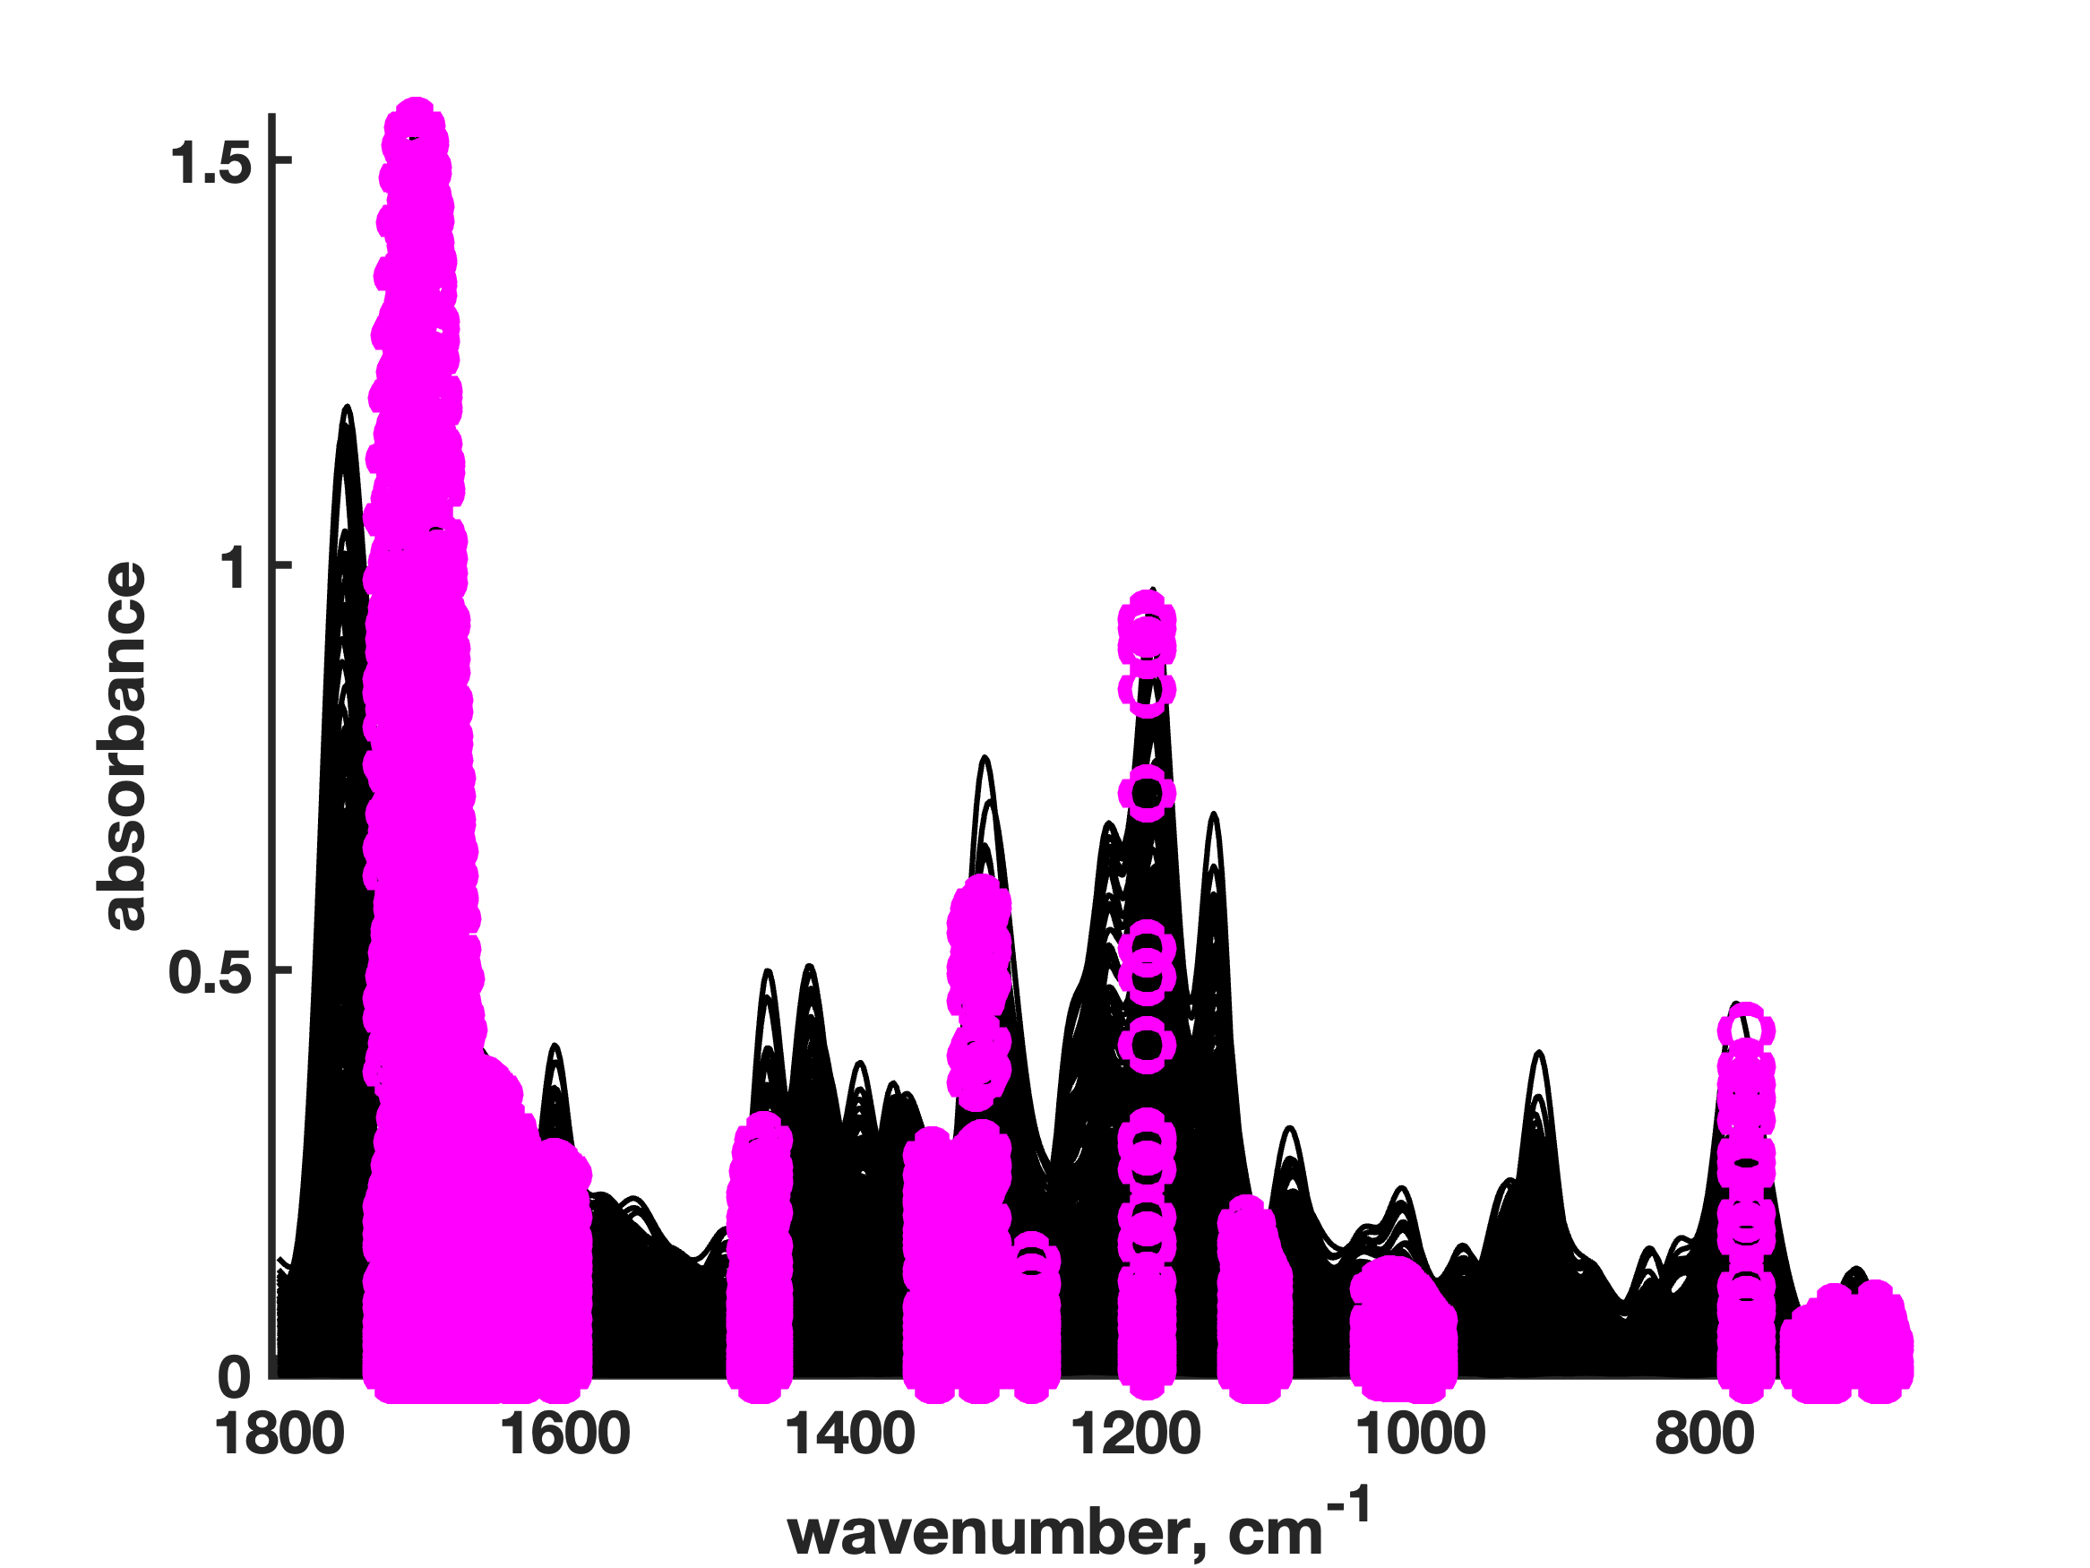
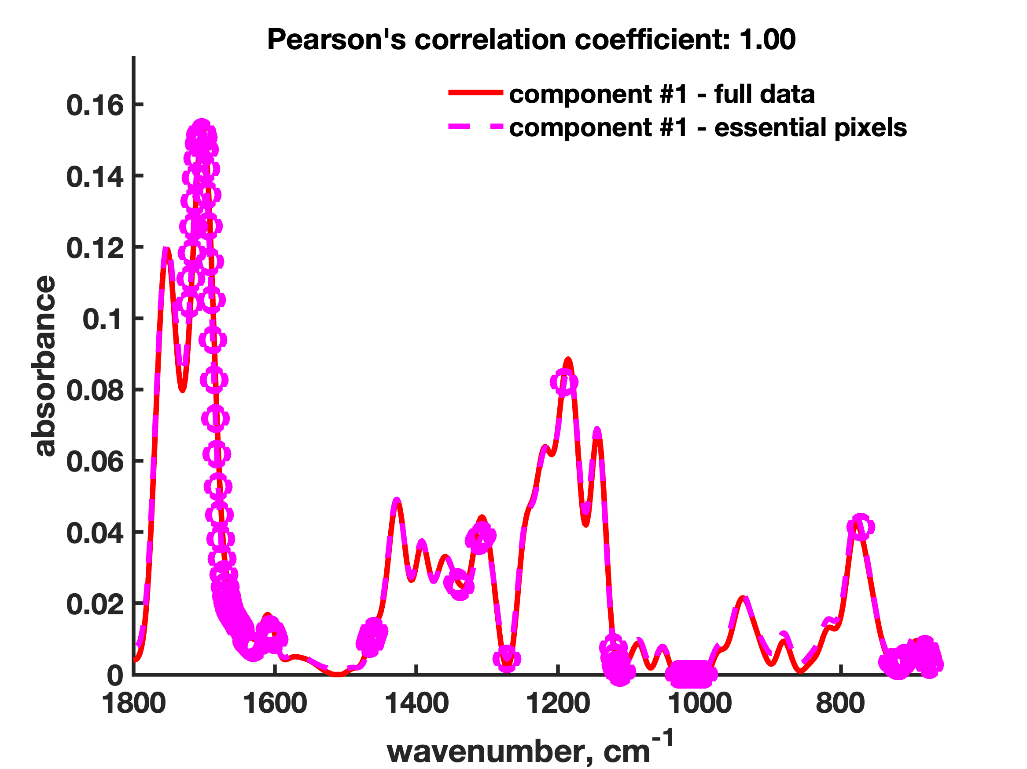
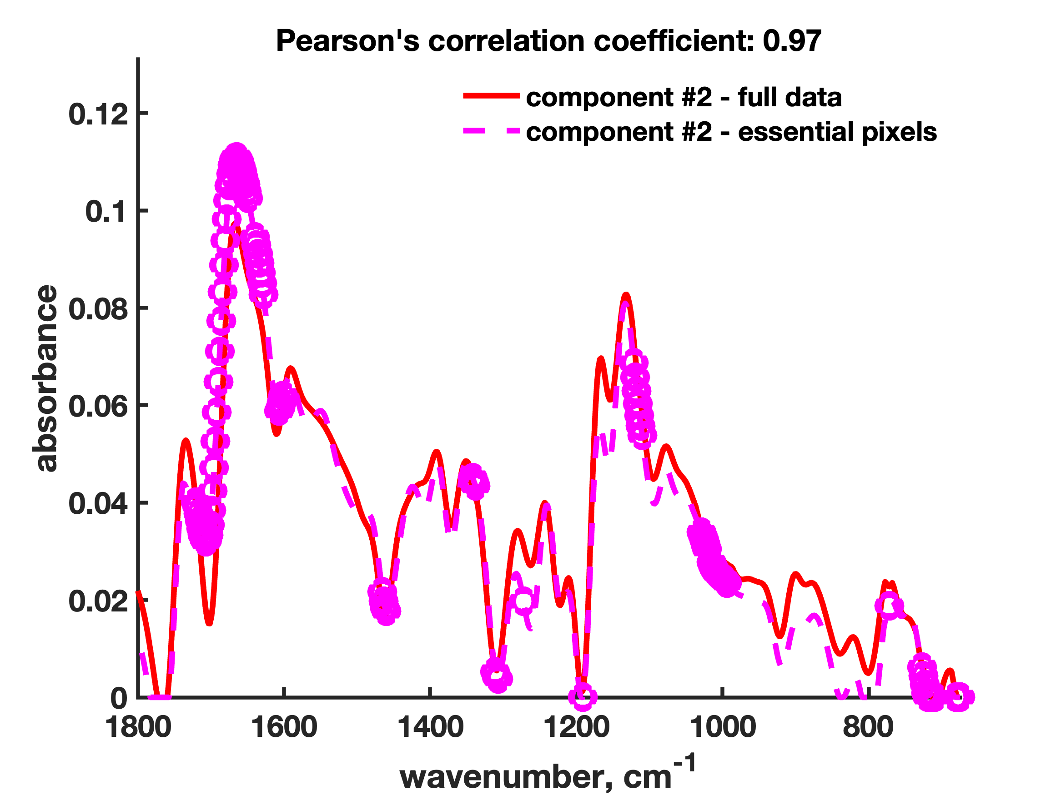
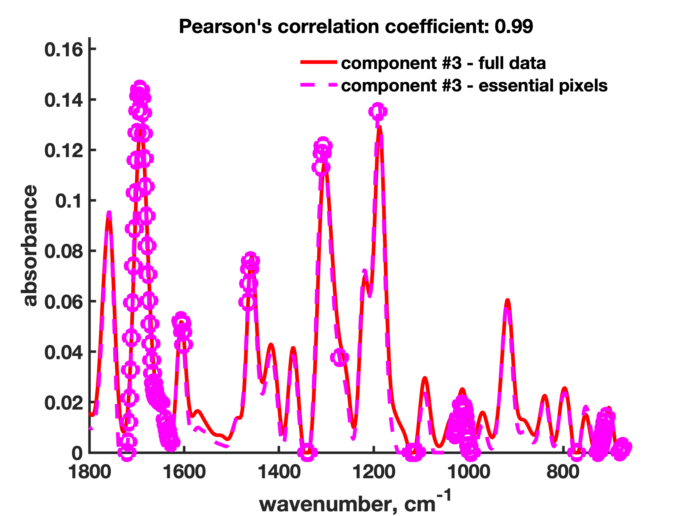
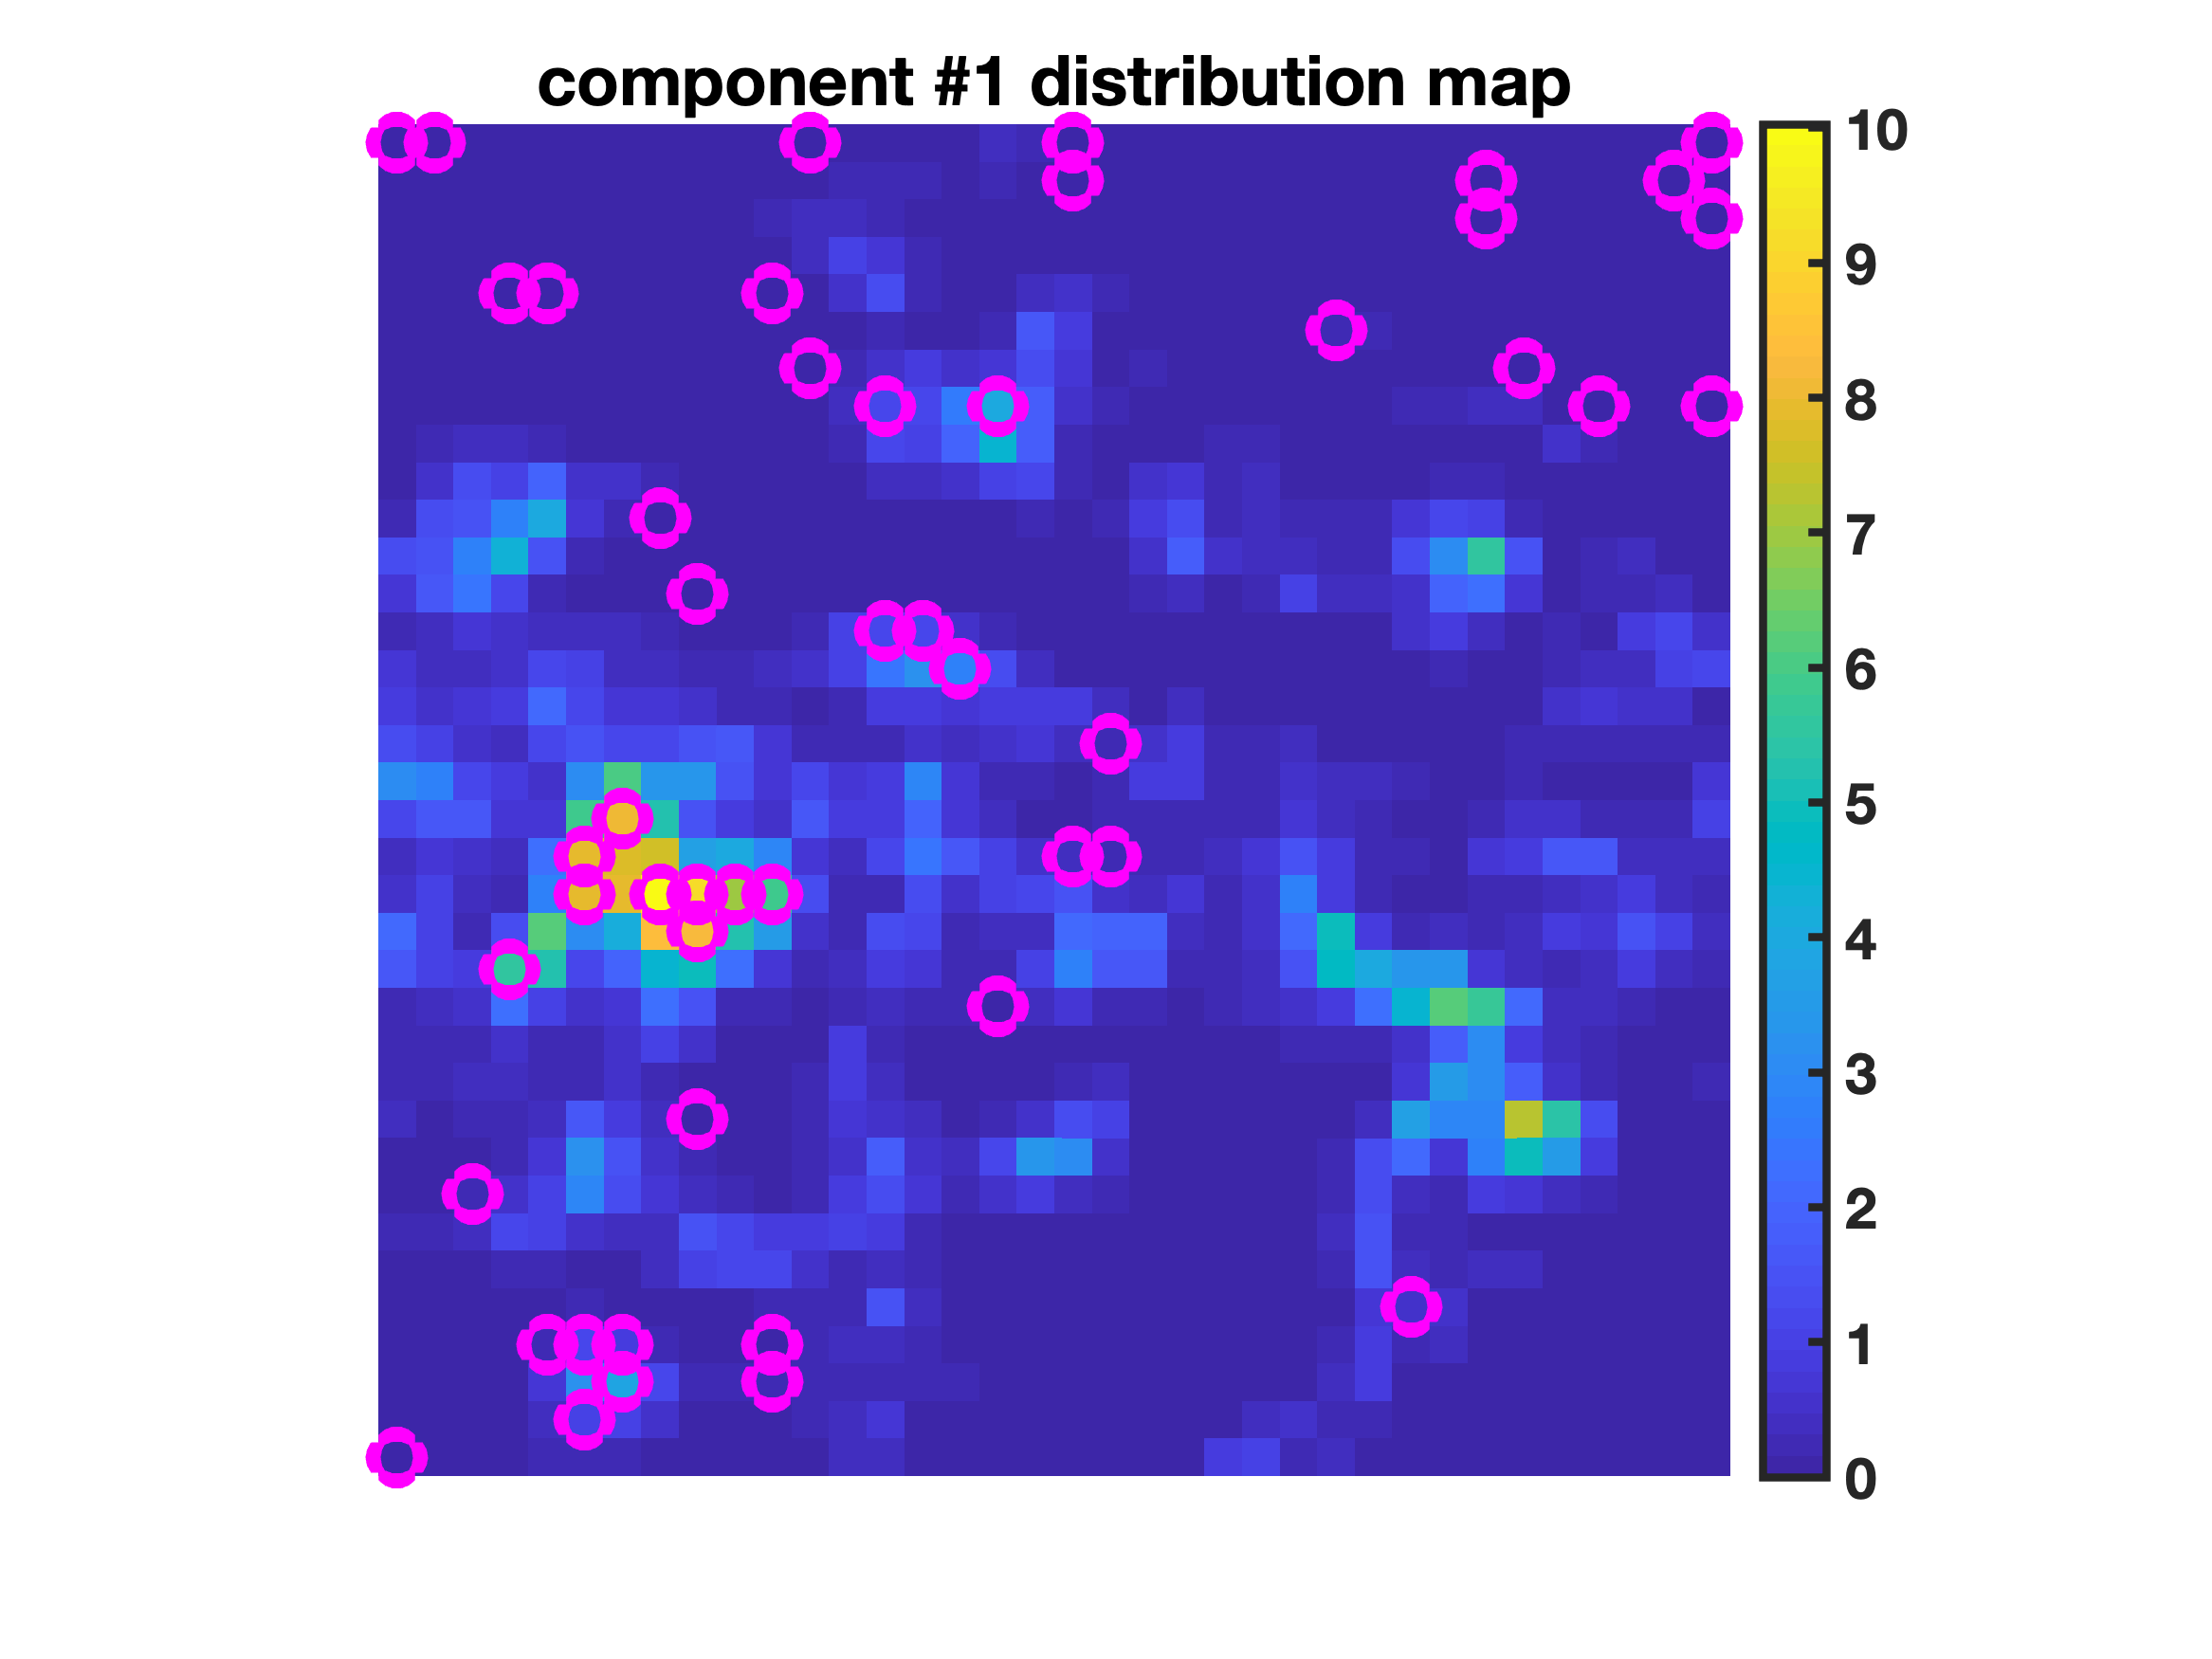
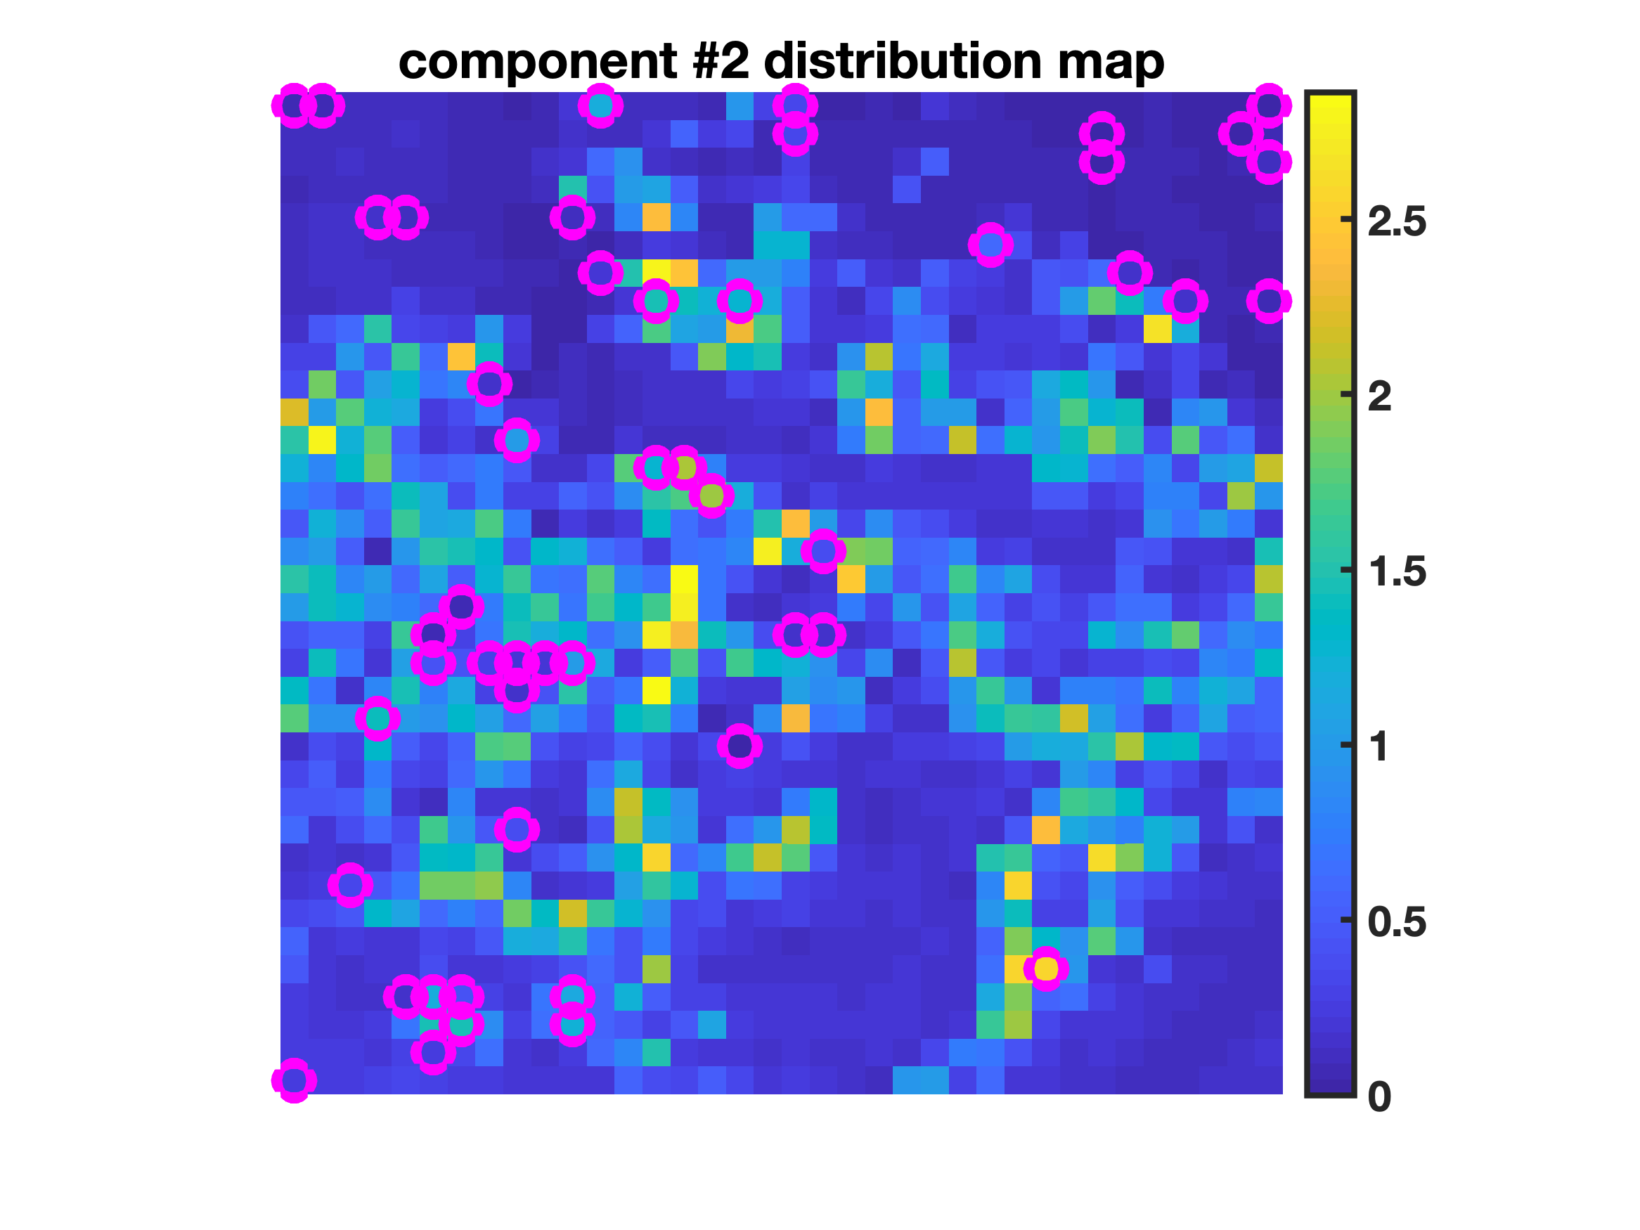
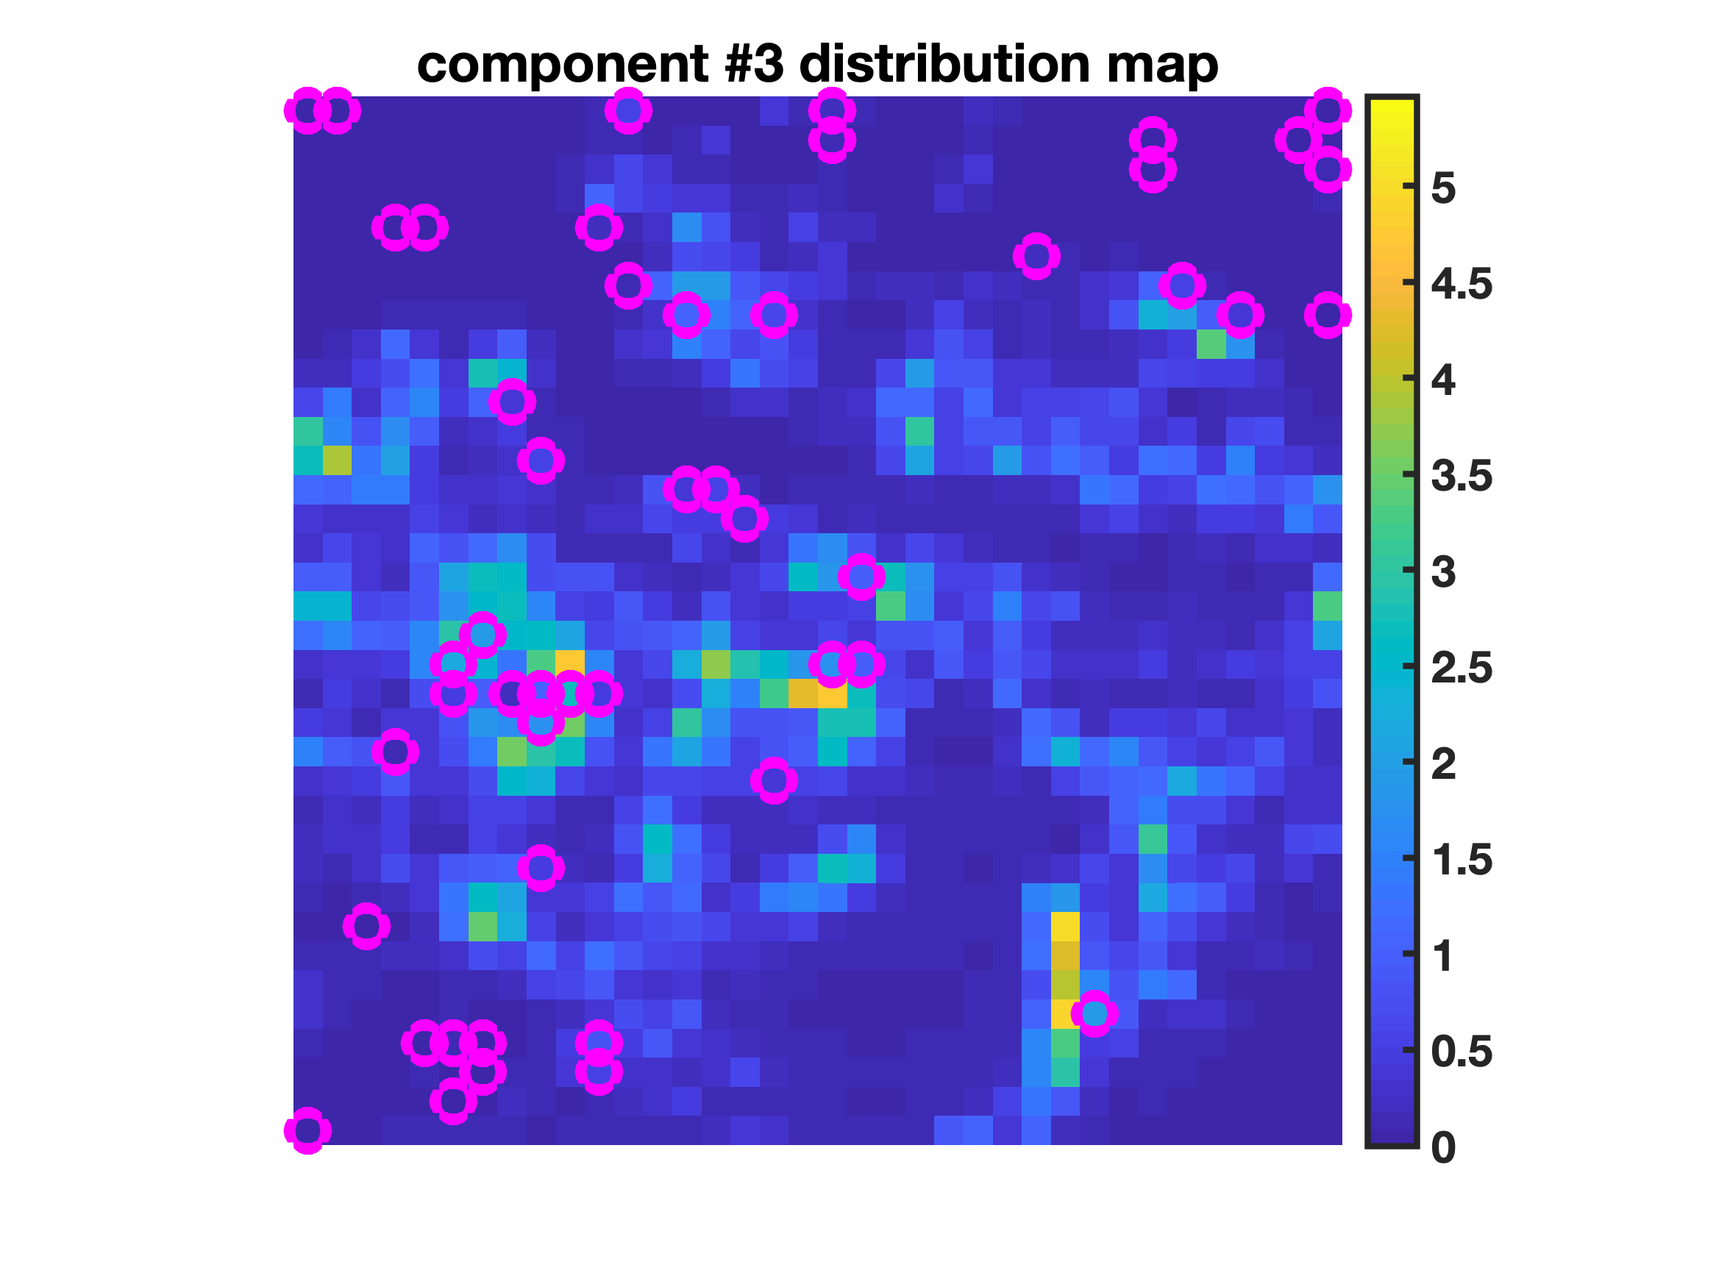
Example #1b: mid-infrared hyperspectral imaging
Full Dataset – Total Elapsed Time: 5.52 s
Reduced Dataset And Non-Negative Least Squares Projection – Total Elapsed Time: 0.57 s
49 Essential Spectra and 100 Essential Spectral Variables
7

Slide 12
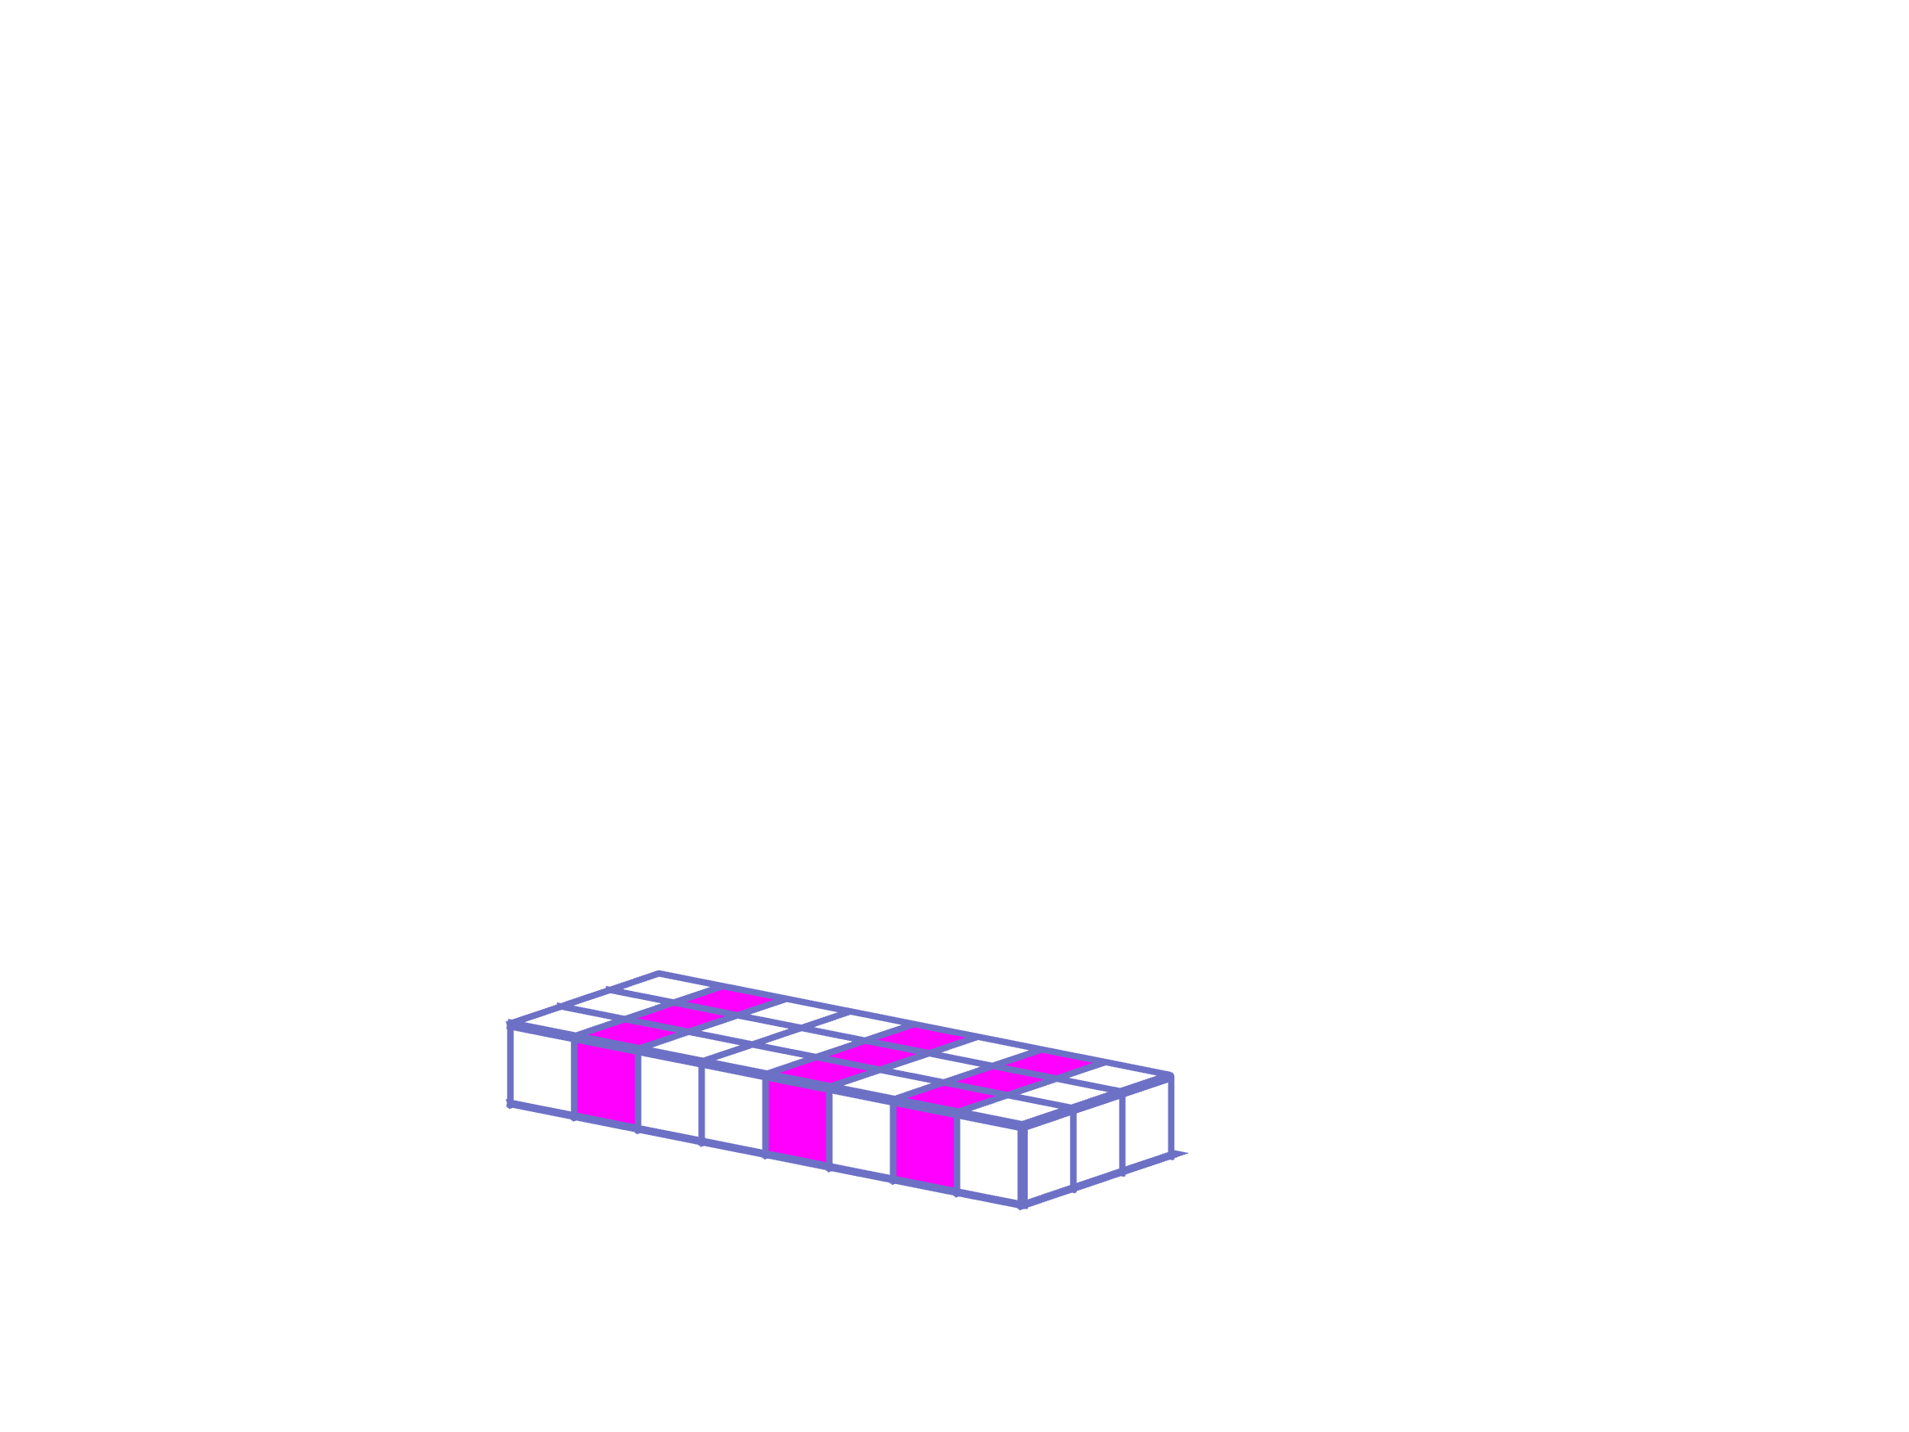
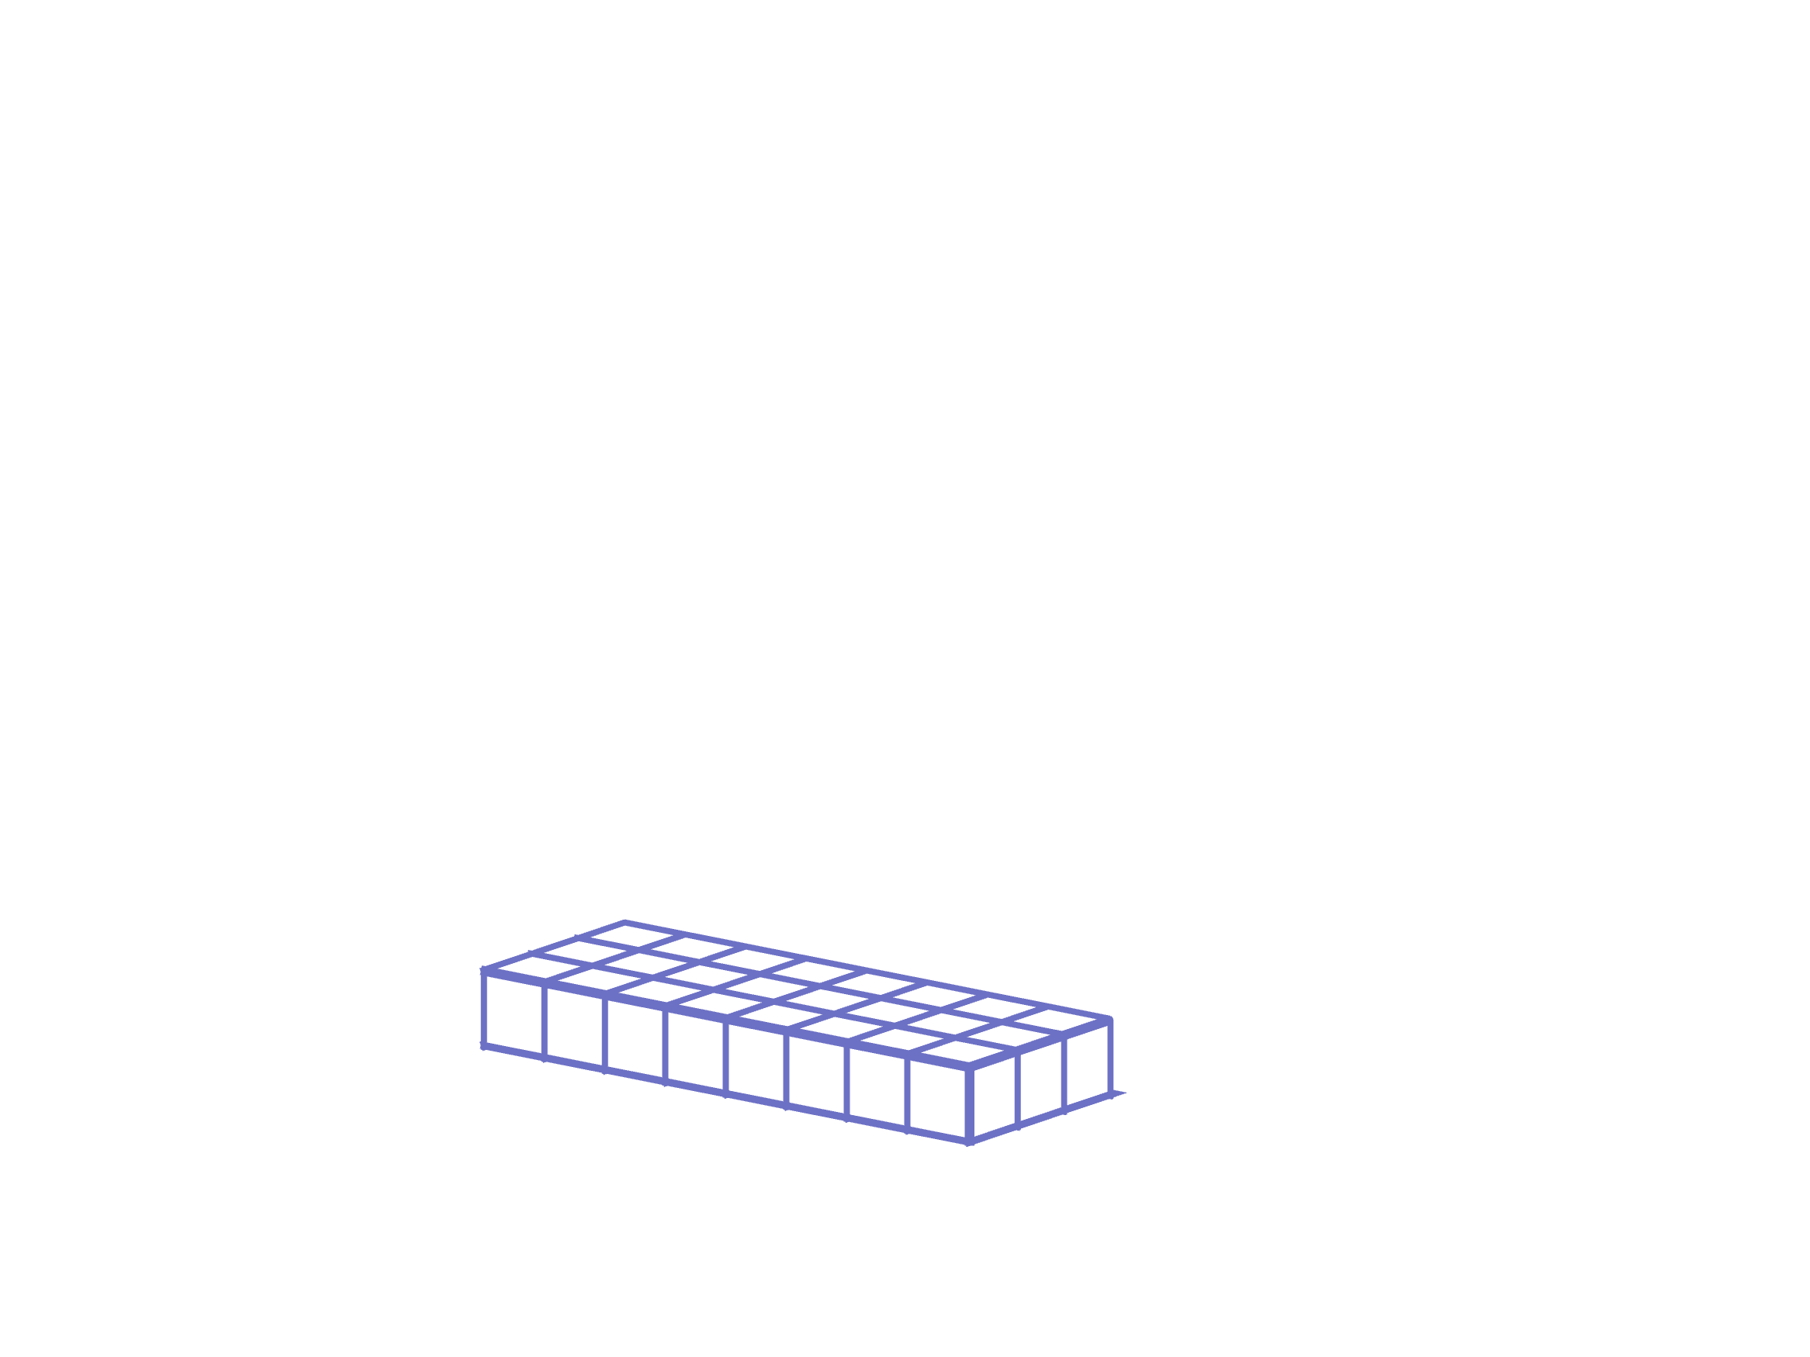

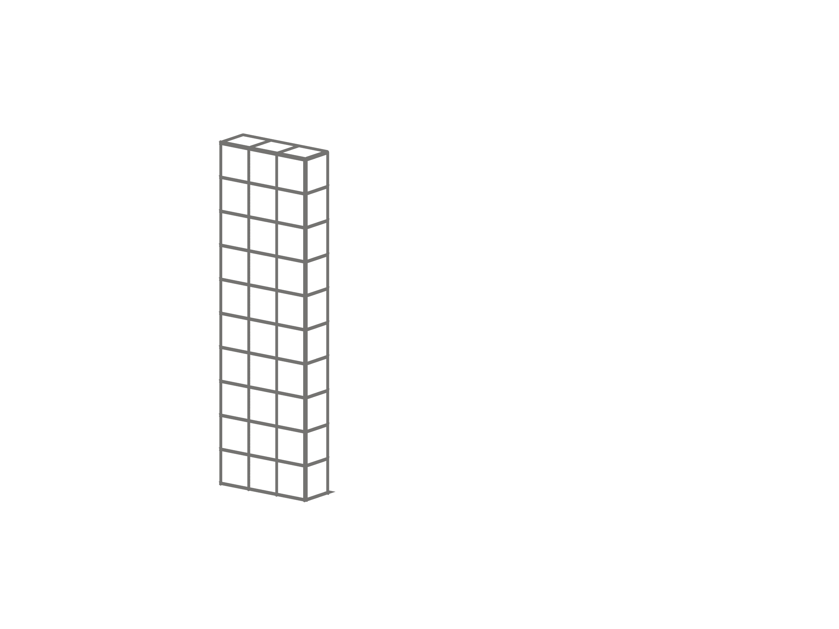
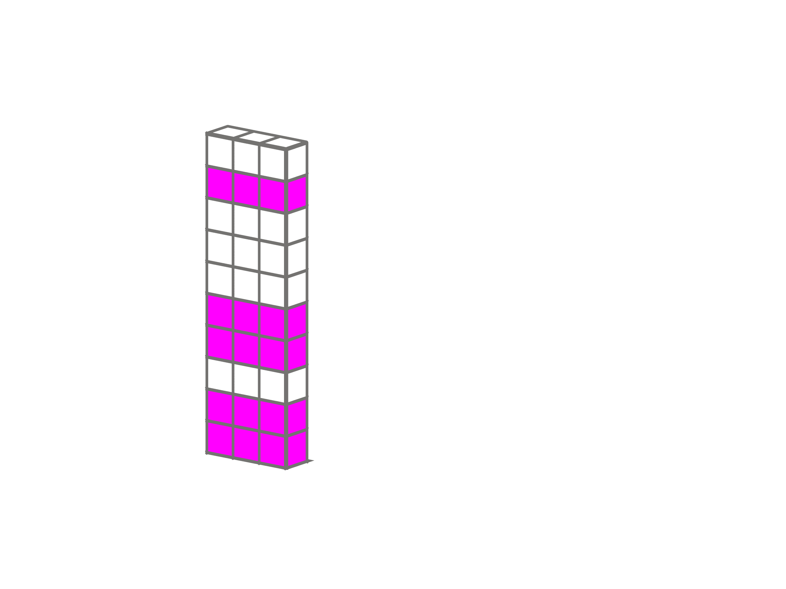
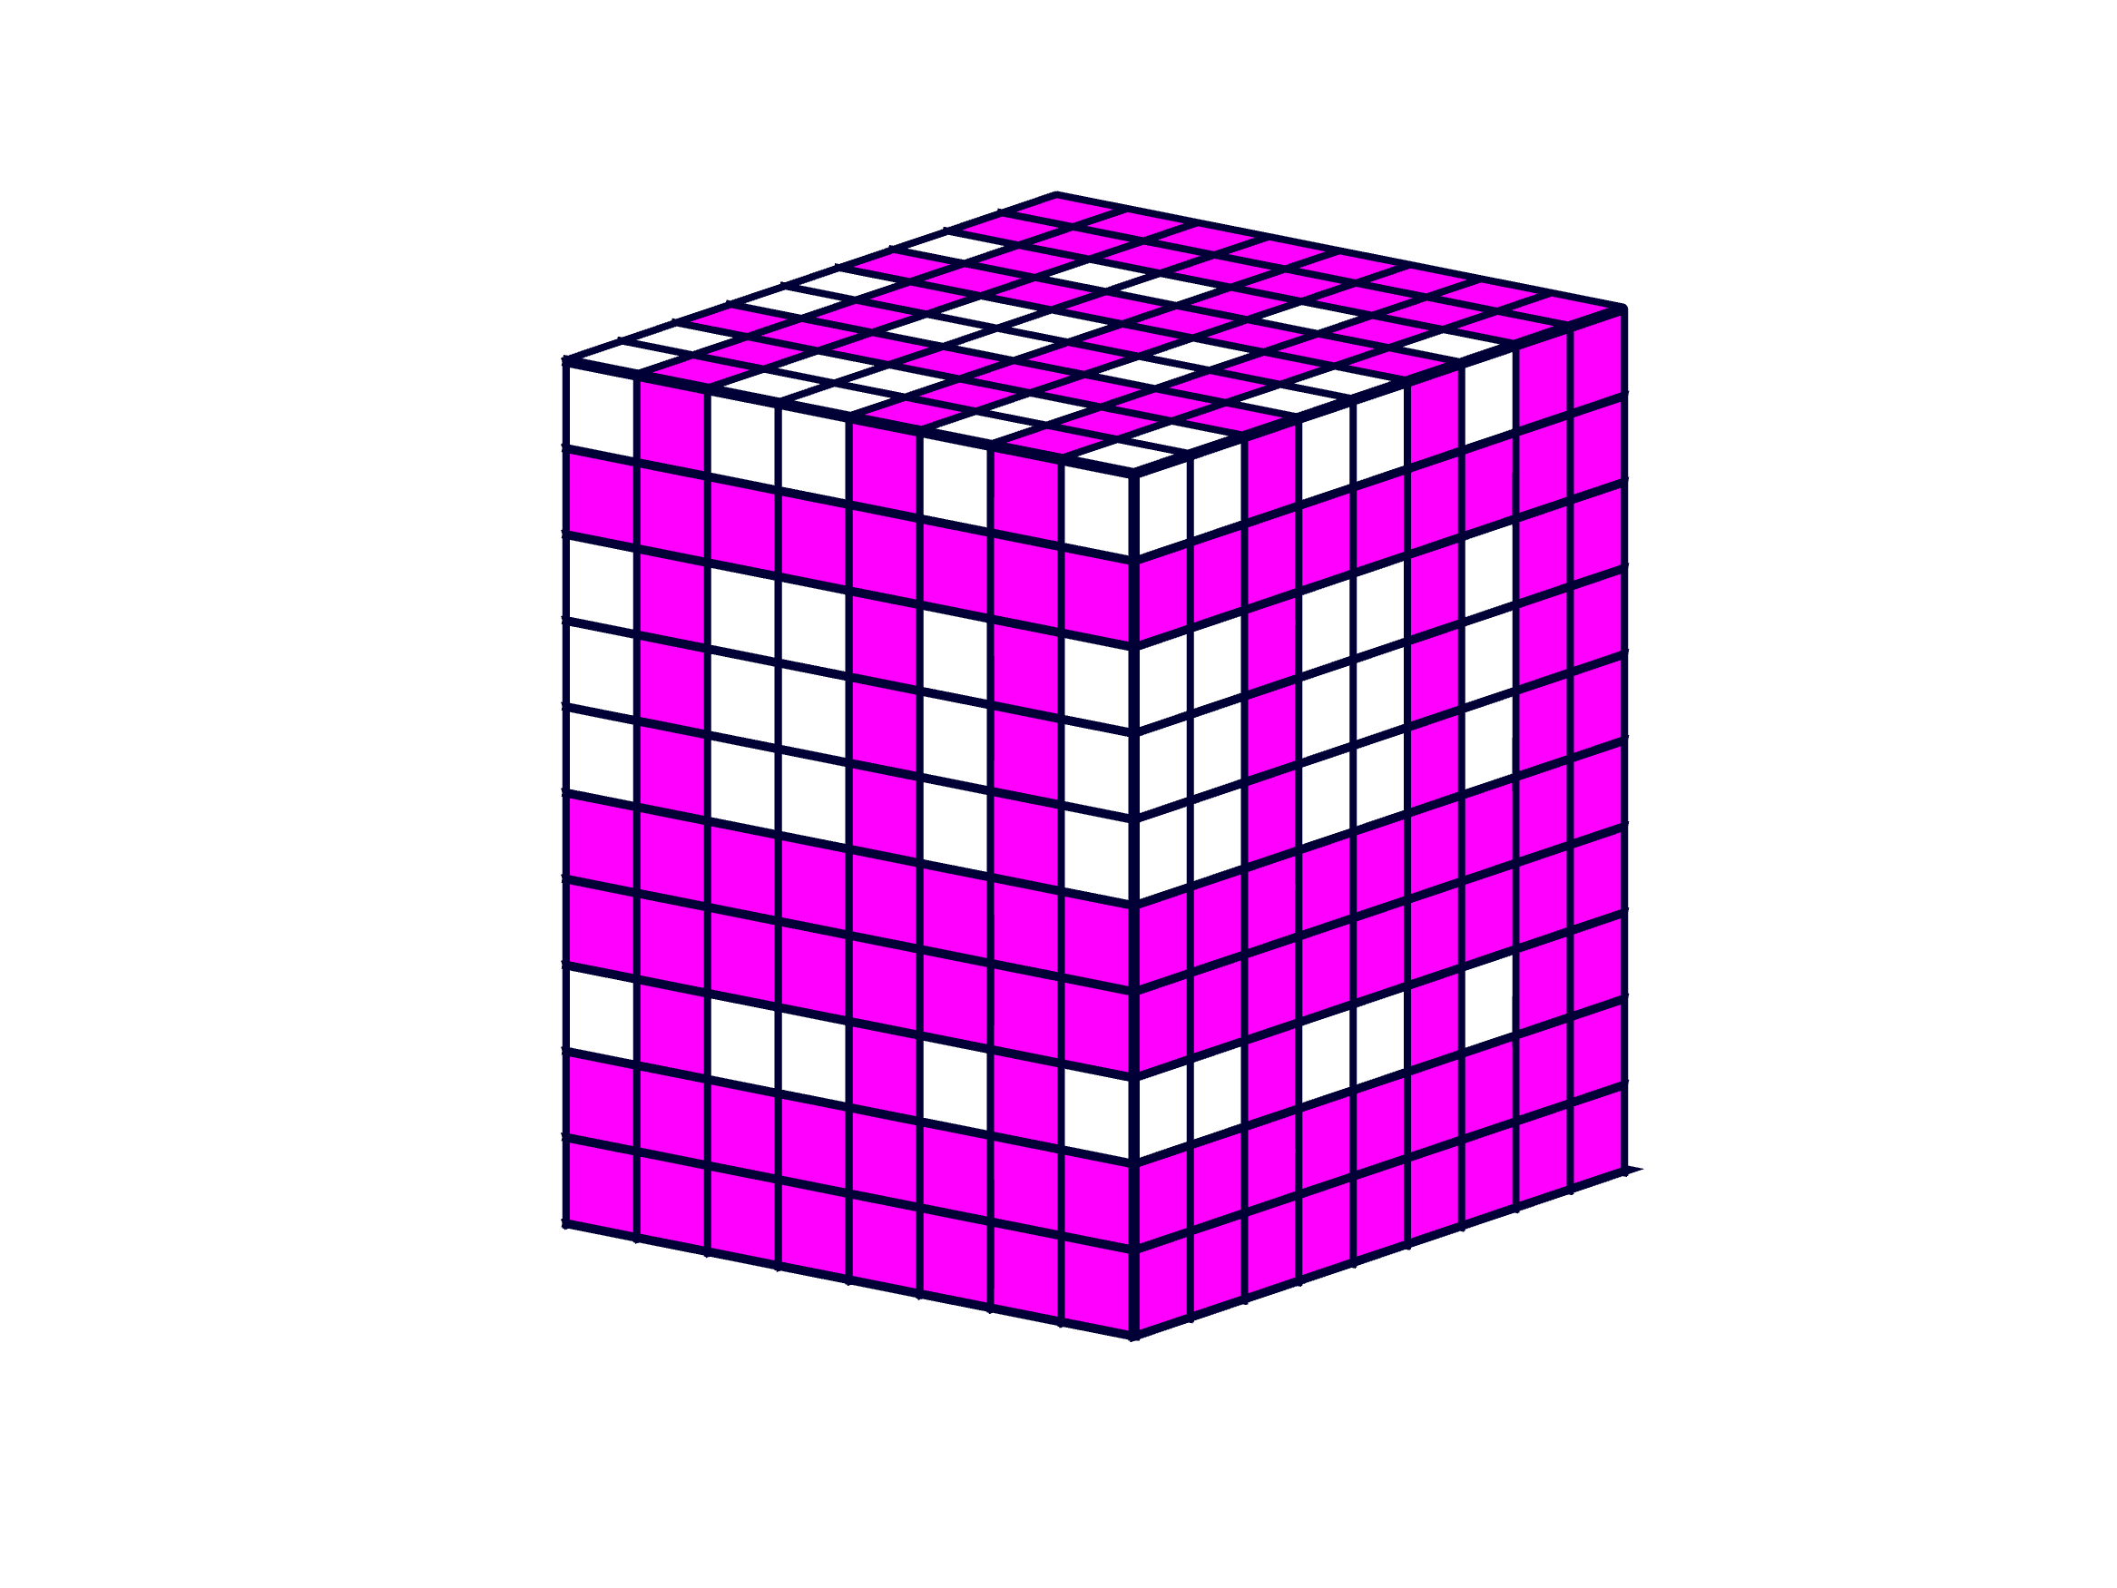
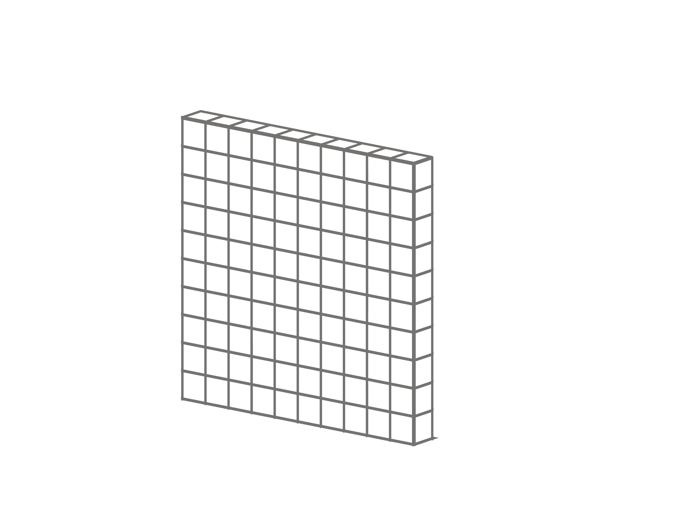
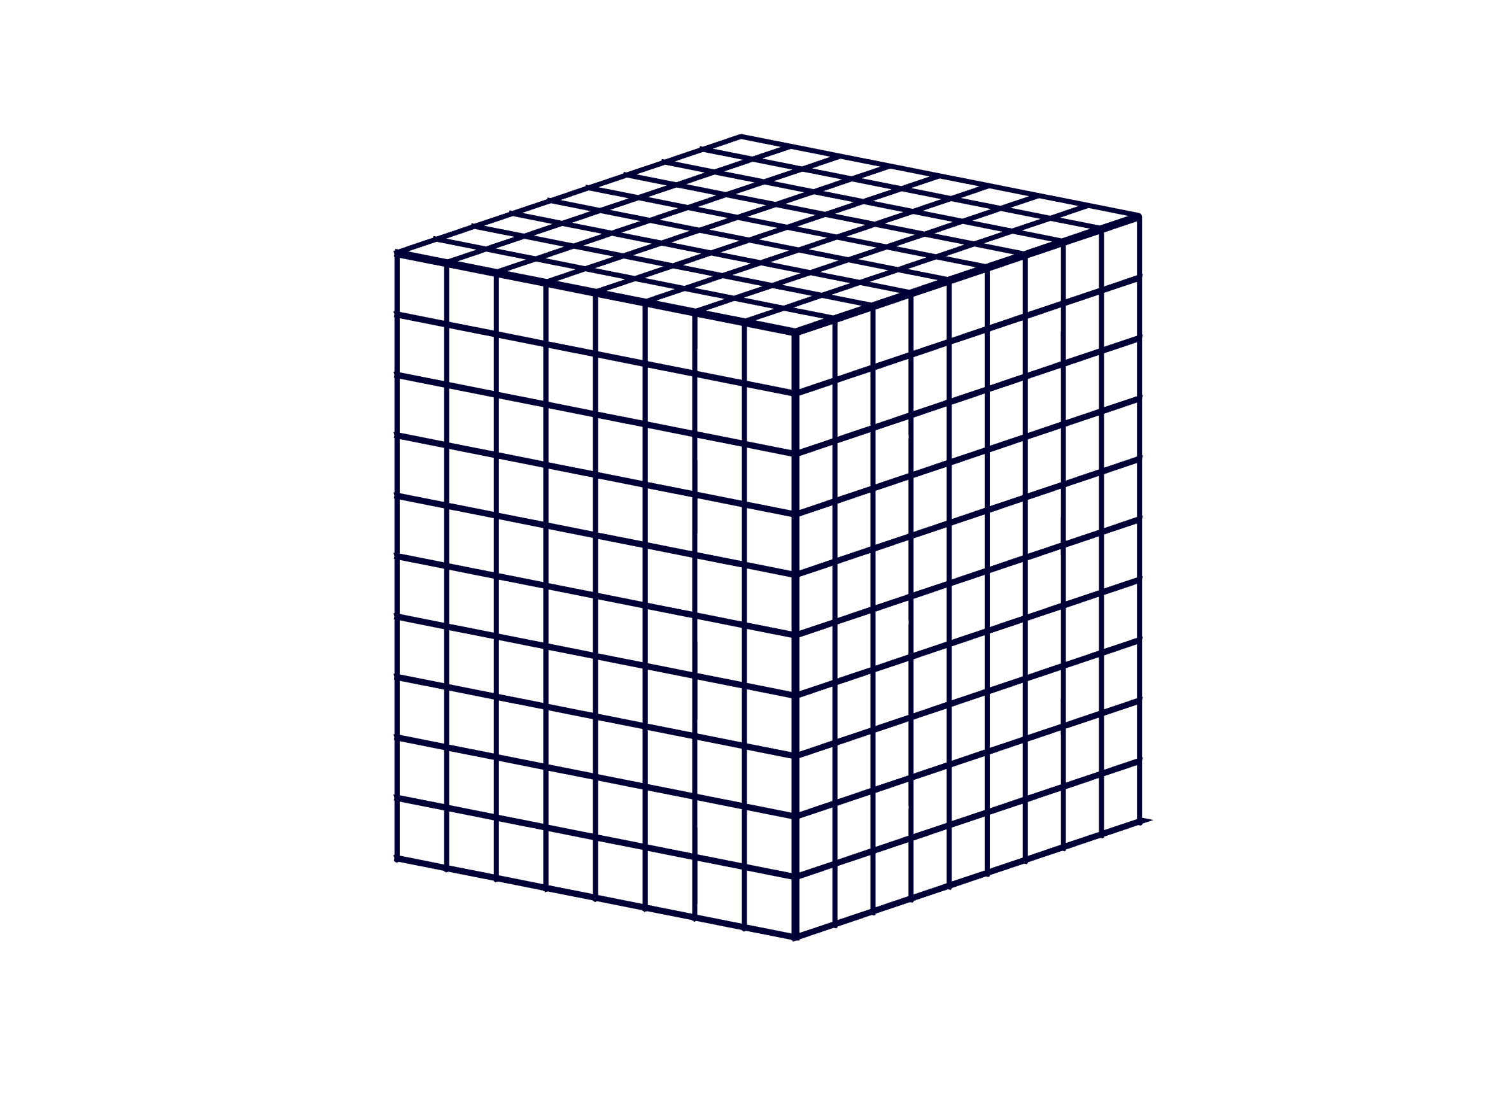
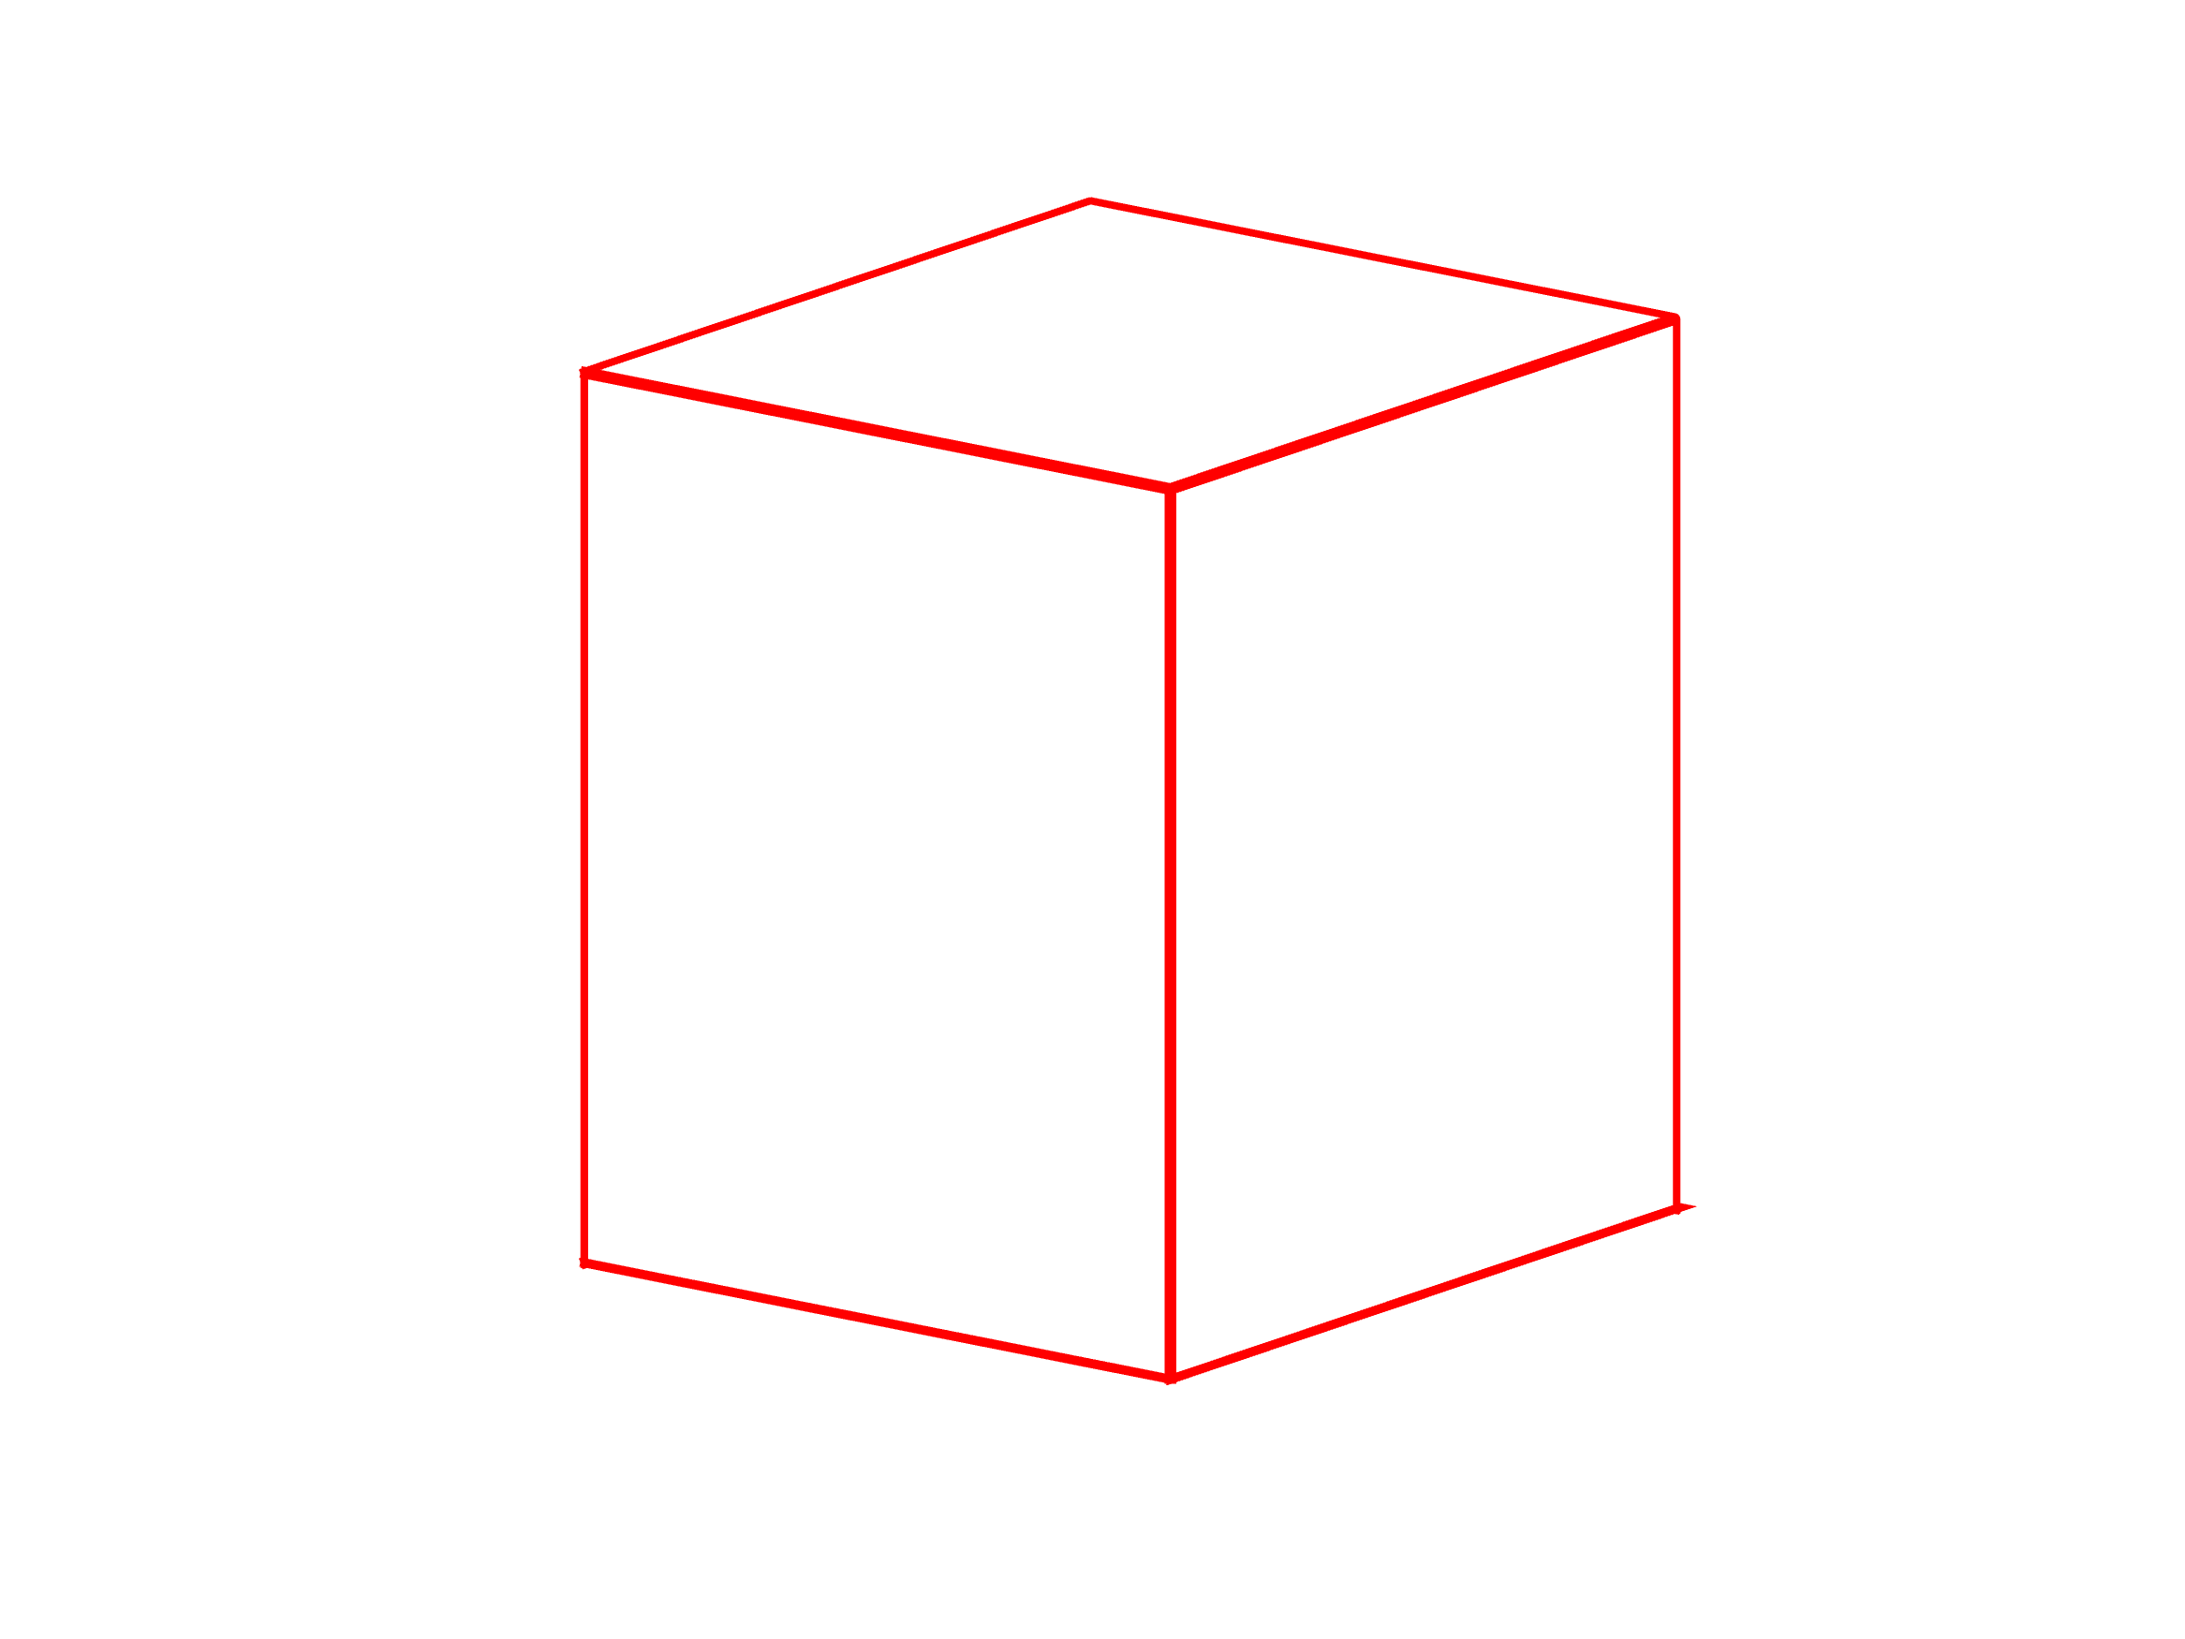
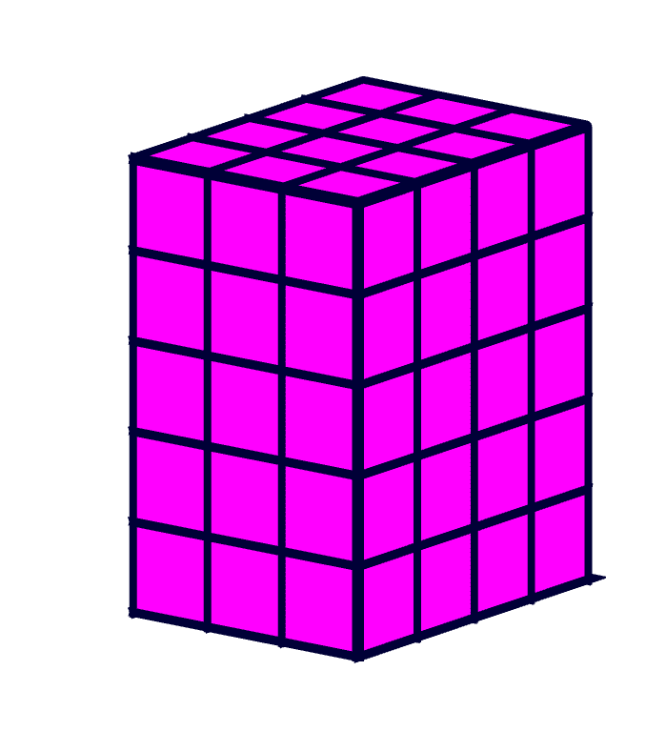
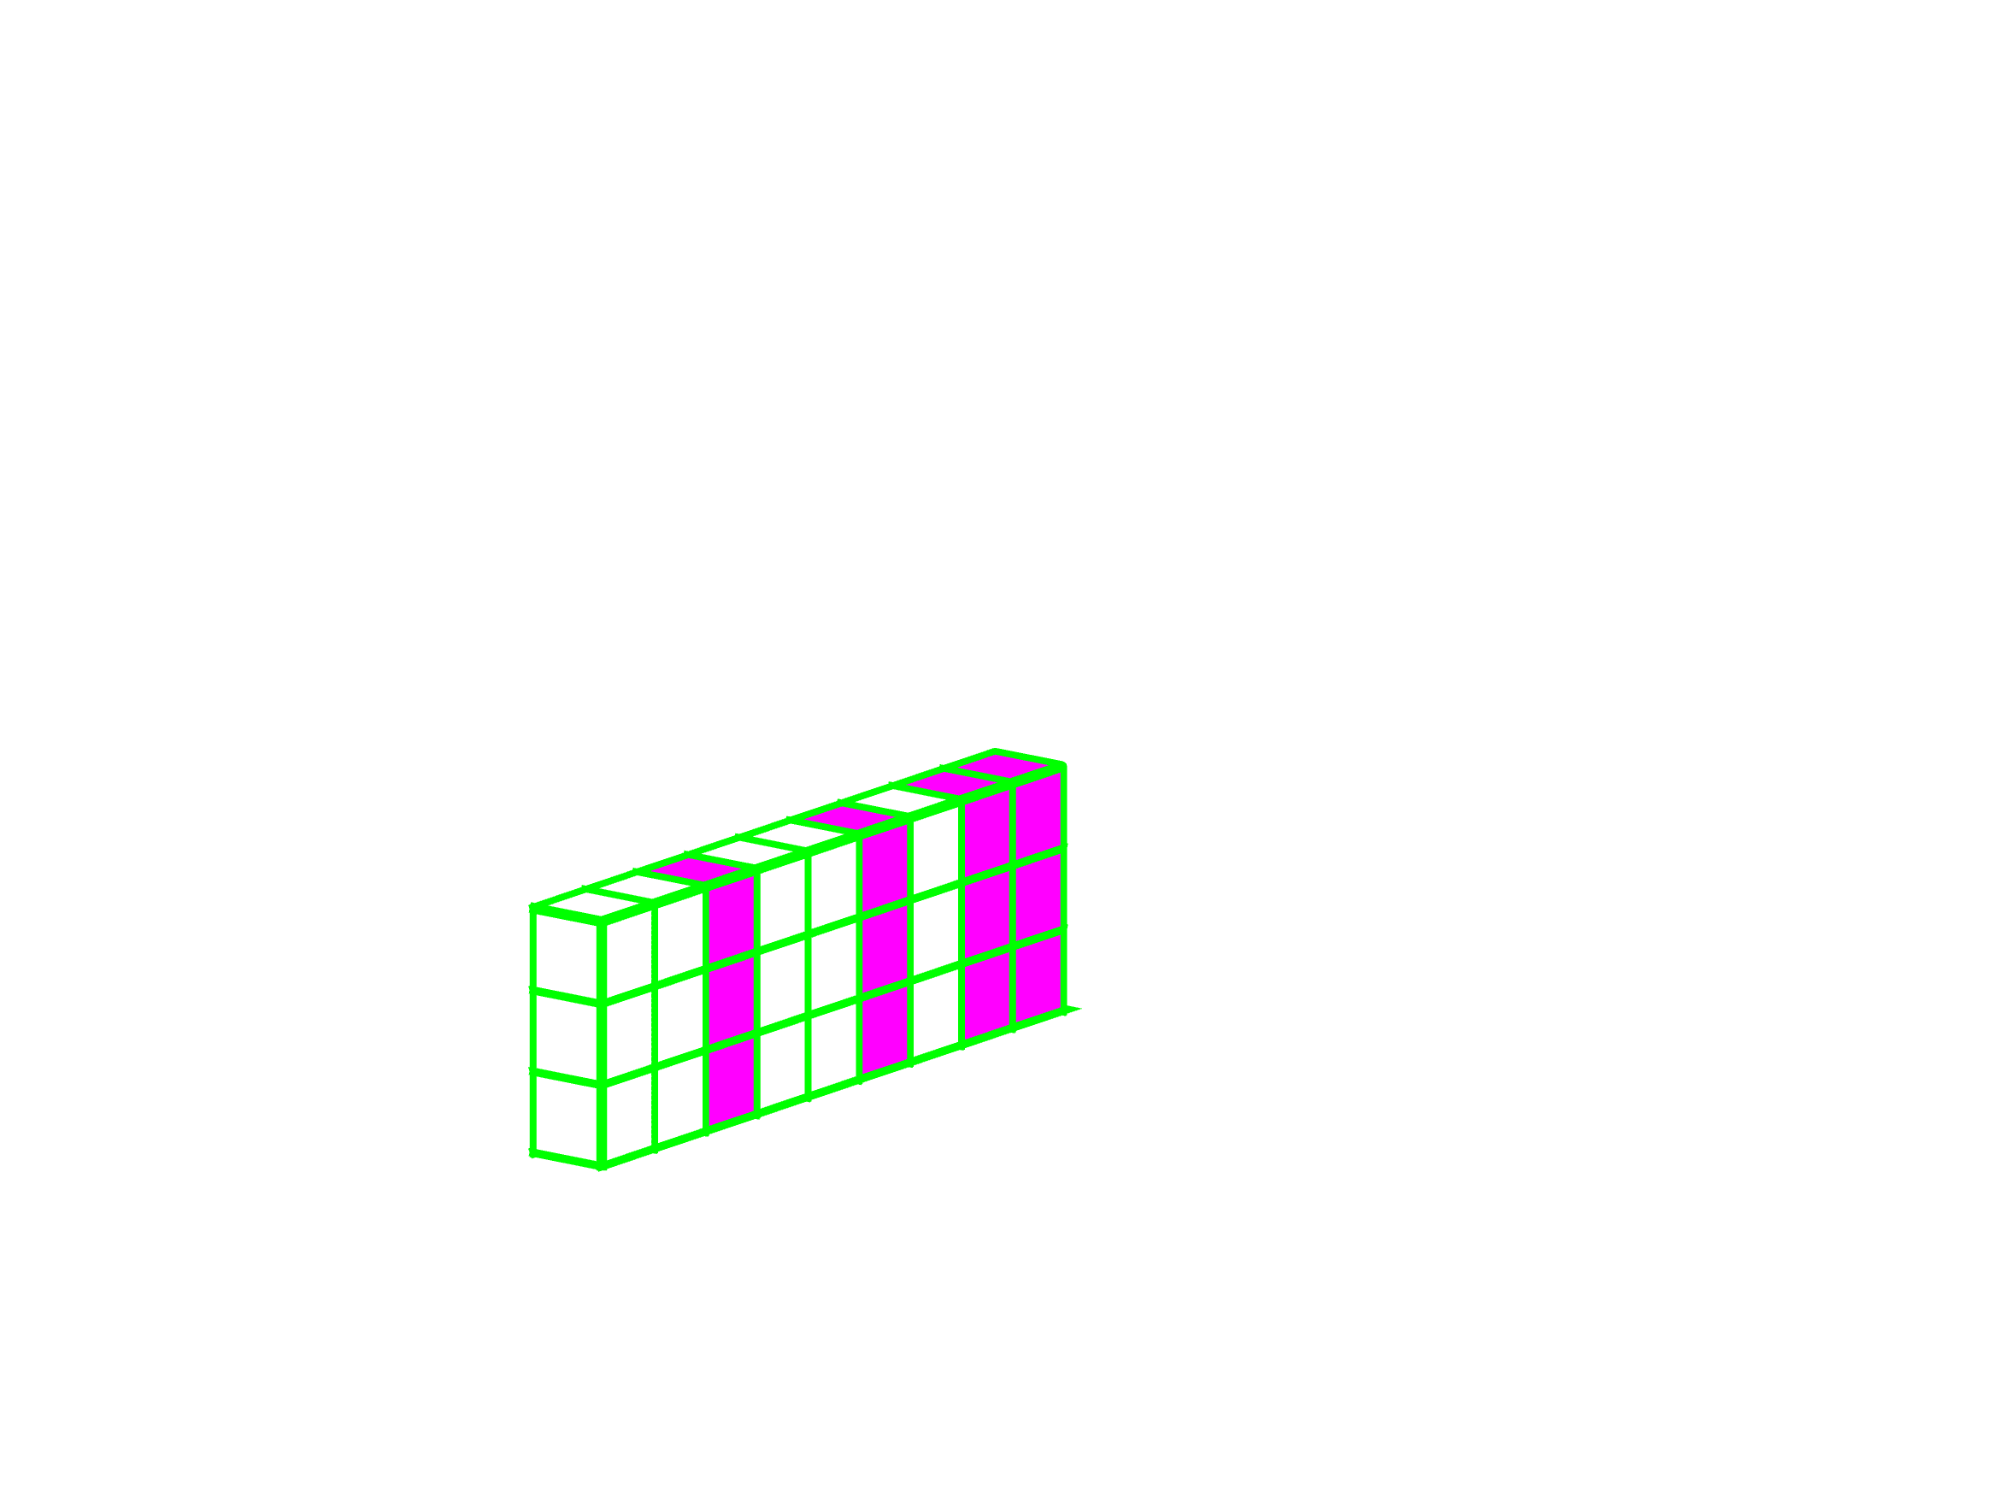
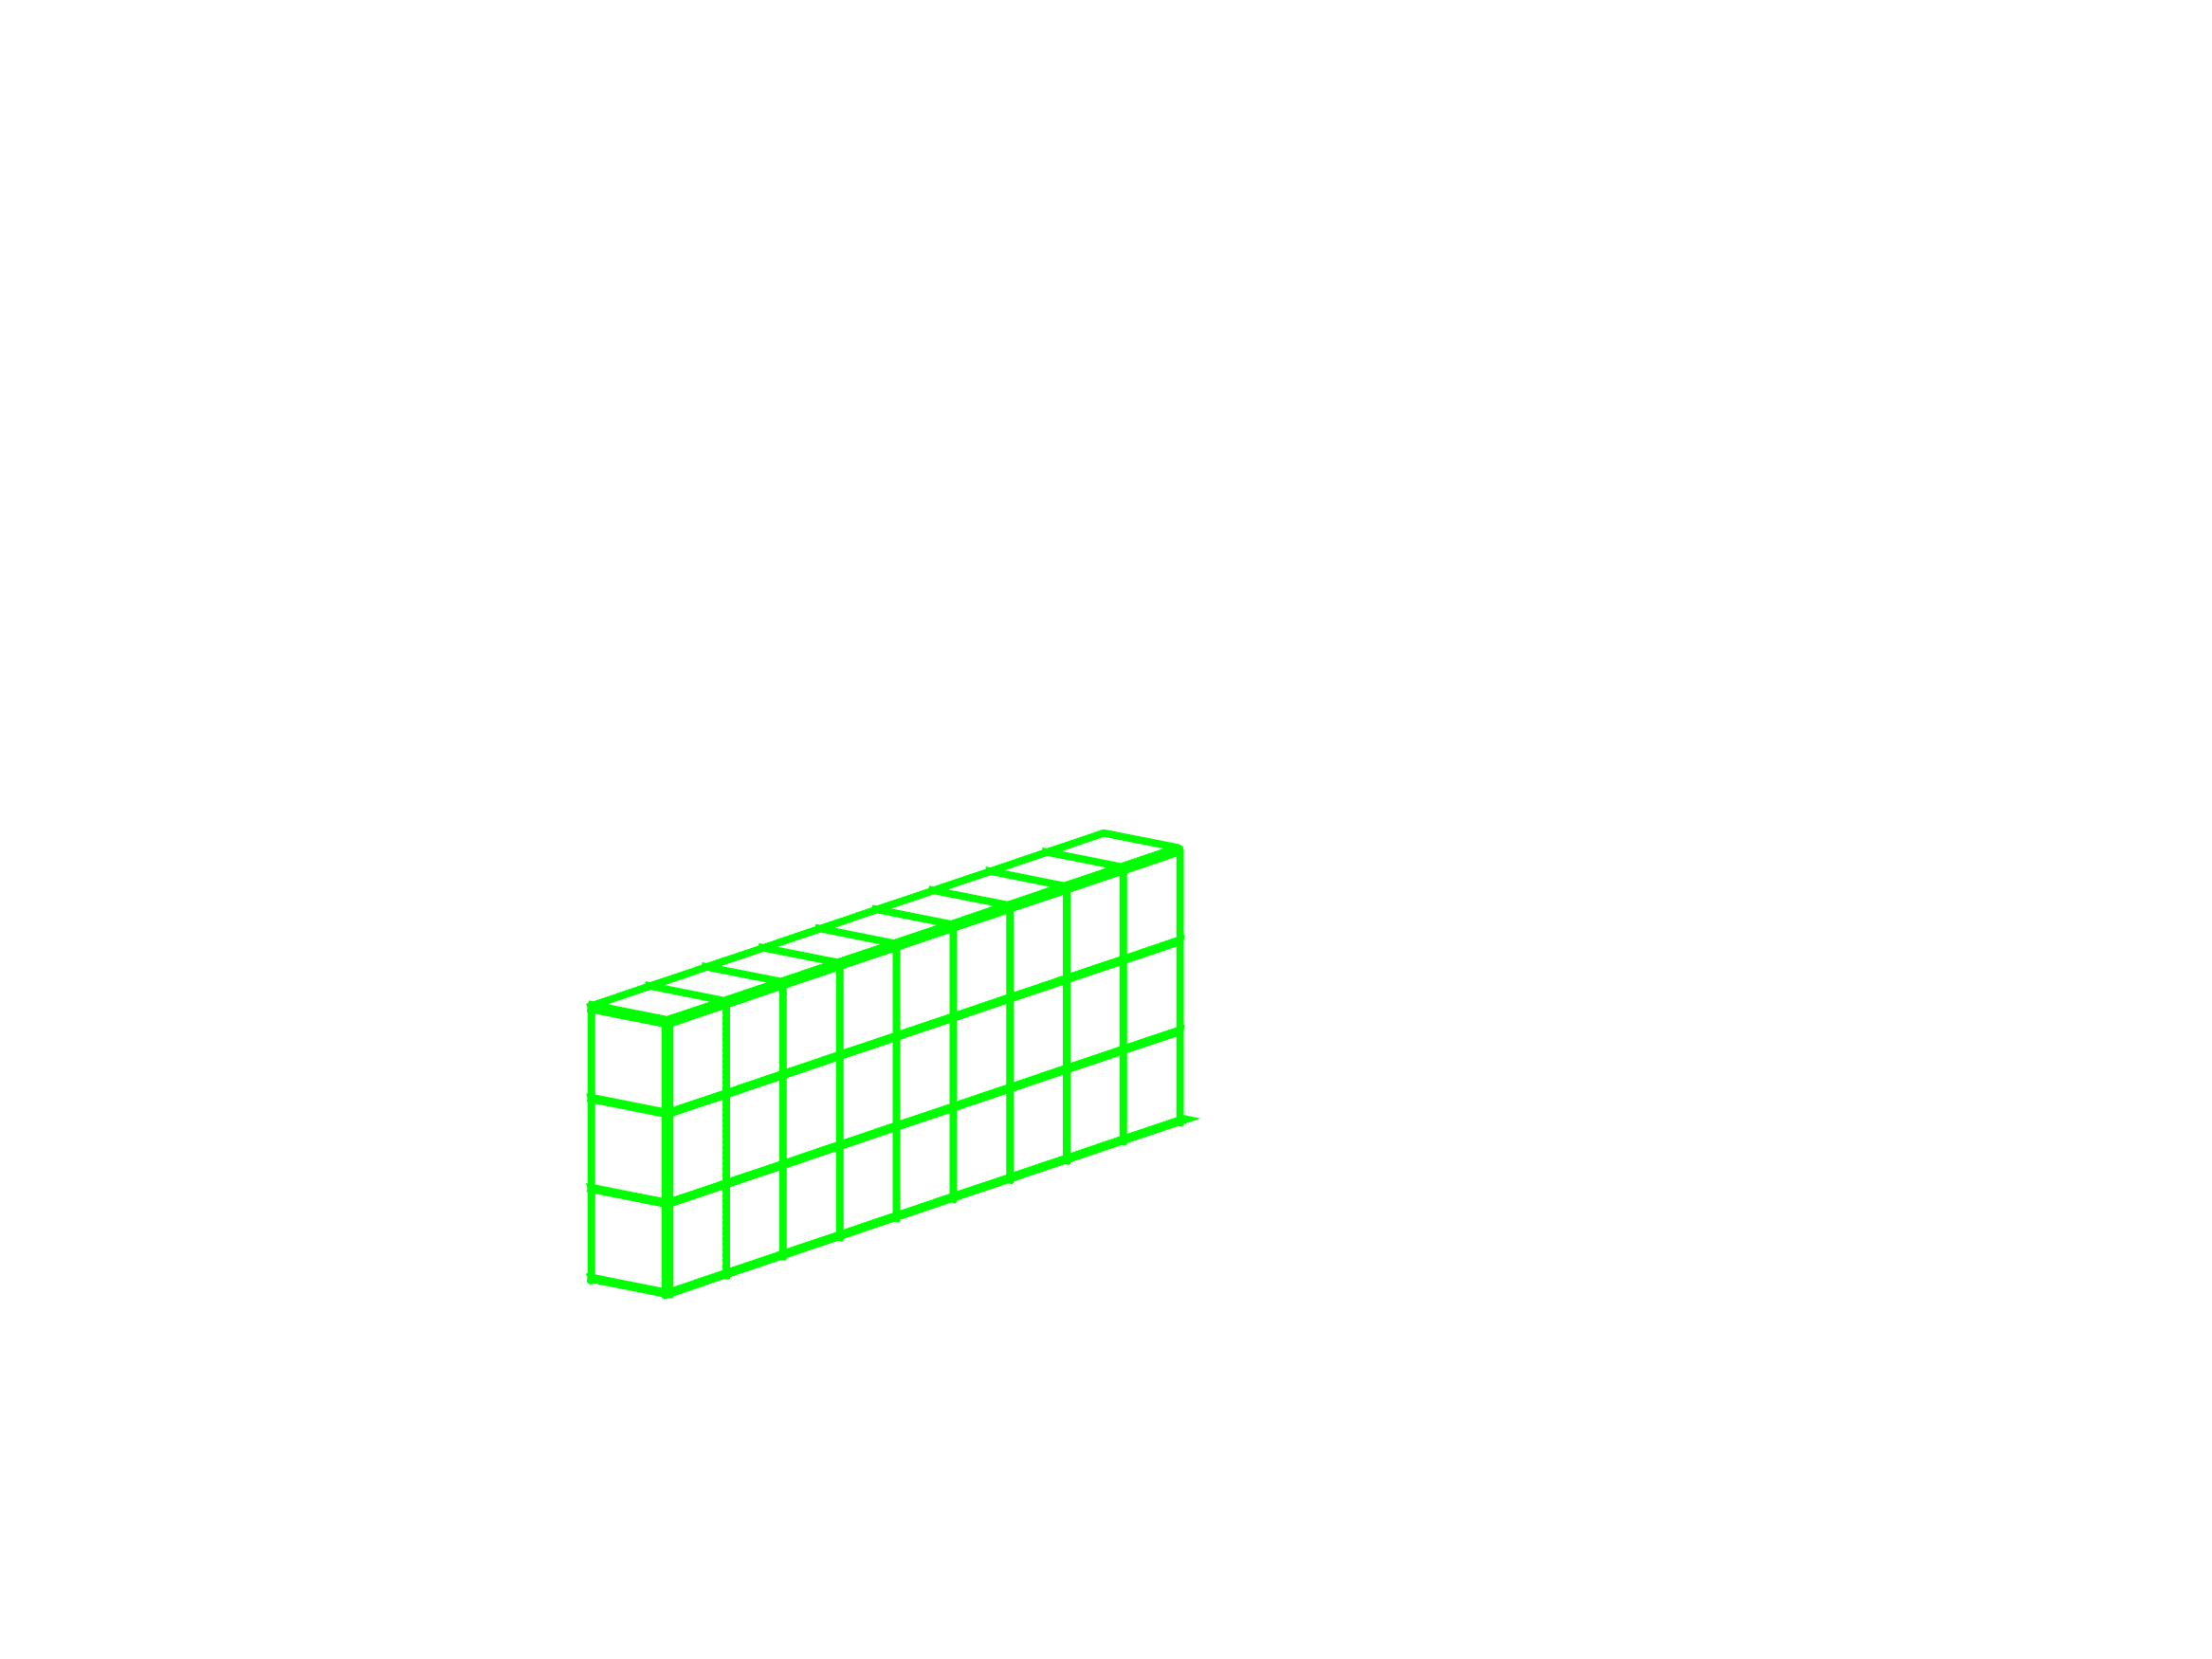
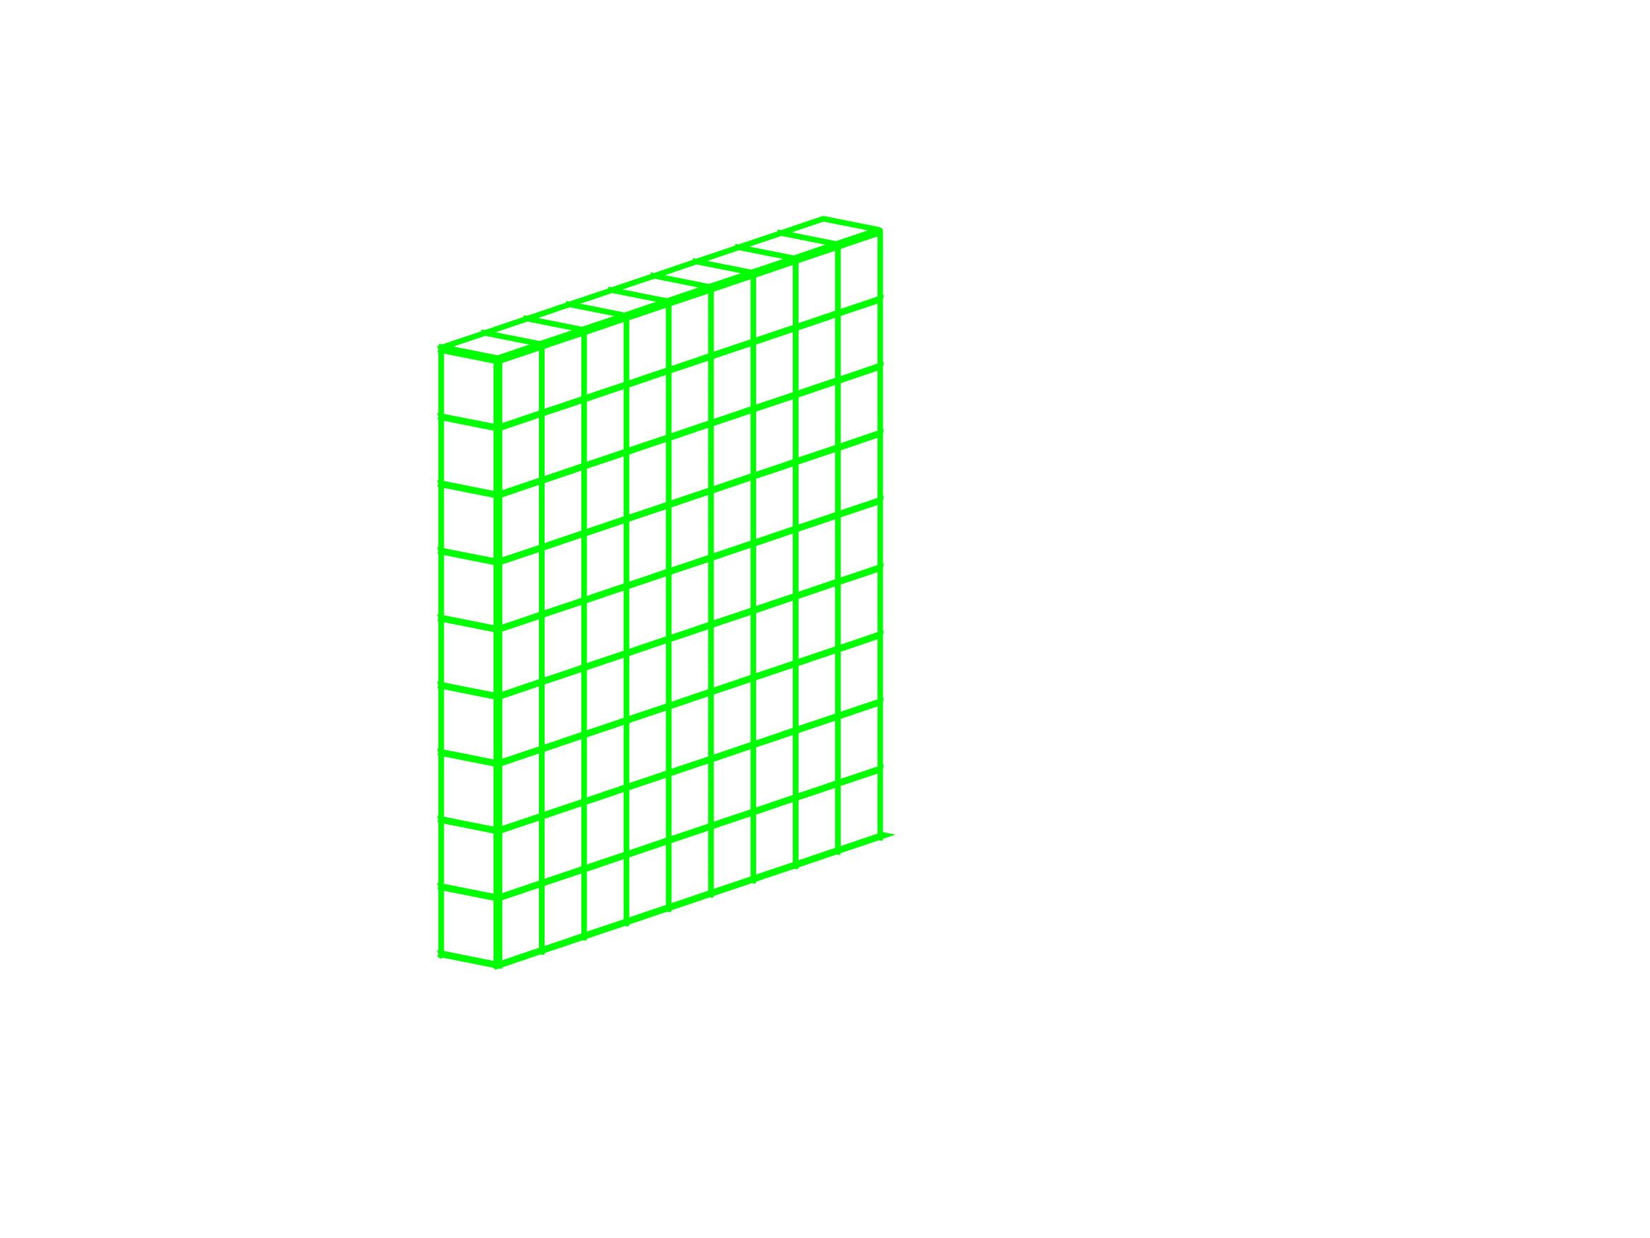
Essential rows, columns and tubes
=
Essential Information-Based Three-Way Data Reduction
Higher Order Singular Value Decomposition (HOSVD)
D = S ×₁ U ×₂ V ×₃ W
Tucker, L.R., Psychometrika, 1966 (31), 279-311
De Lathauwer, L. et al., SIAM J. Matrix Anal. A, 2000 (21), 1253-1278
Vitale, R. et al., J. Chemometr., 2024 (38), e3617
8

Slide 13
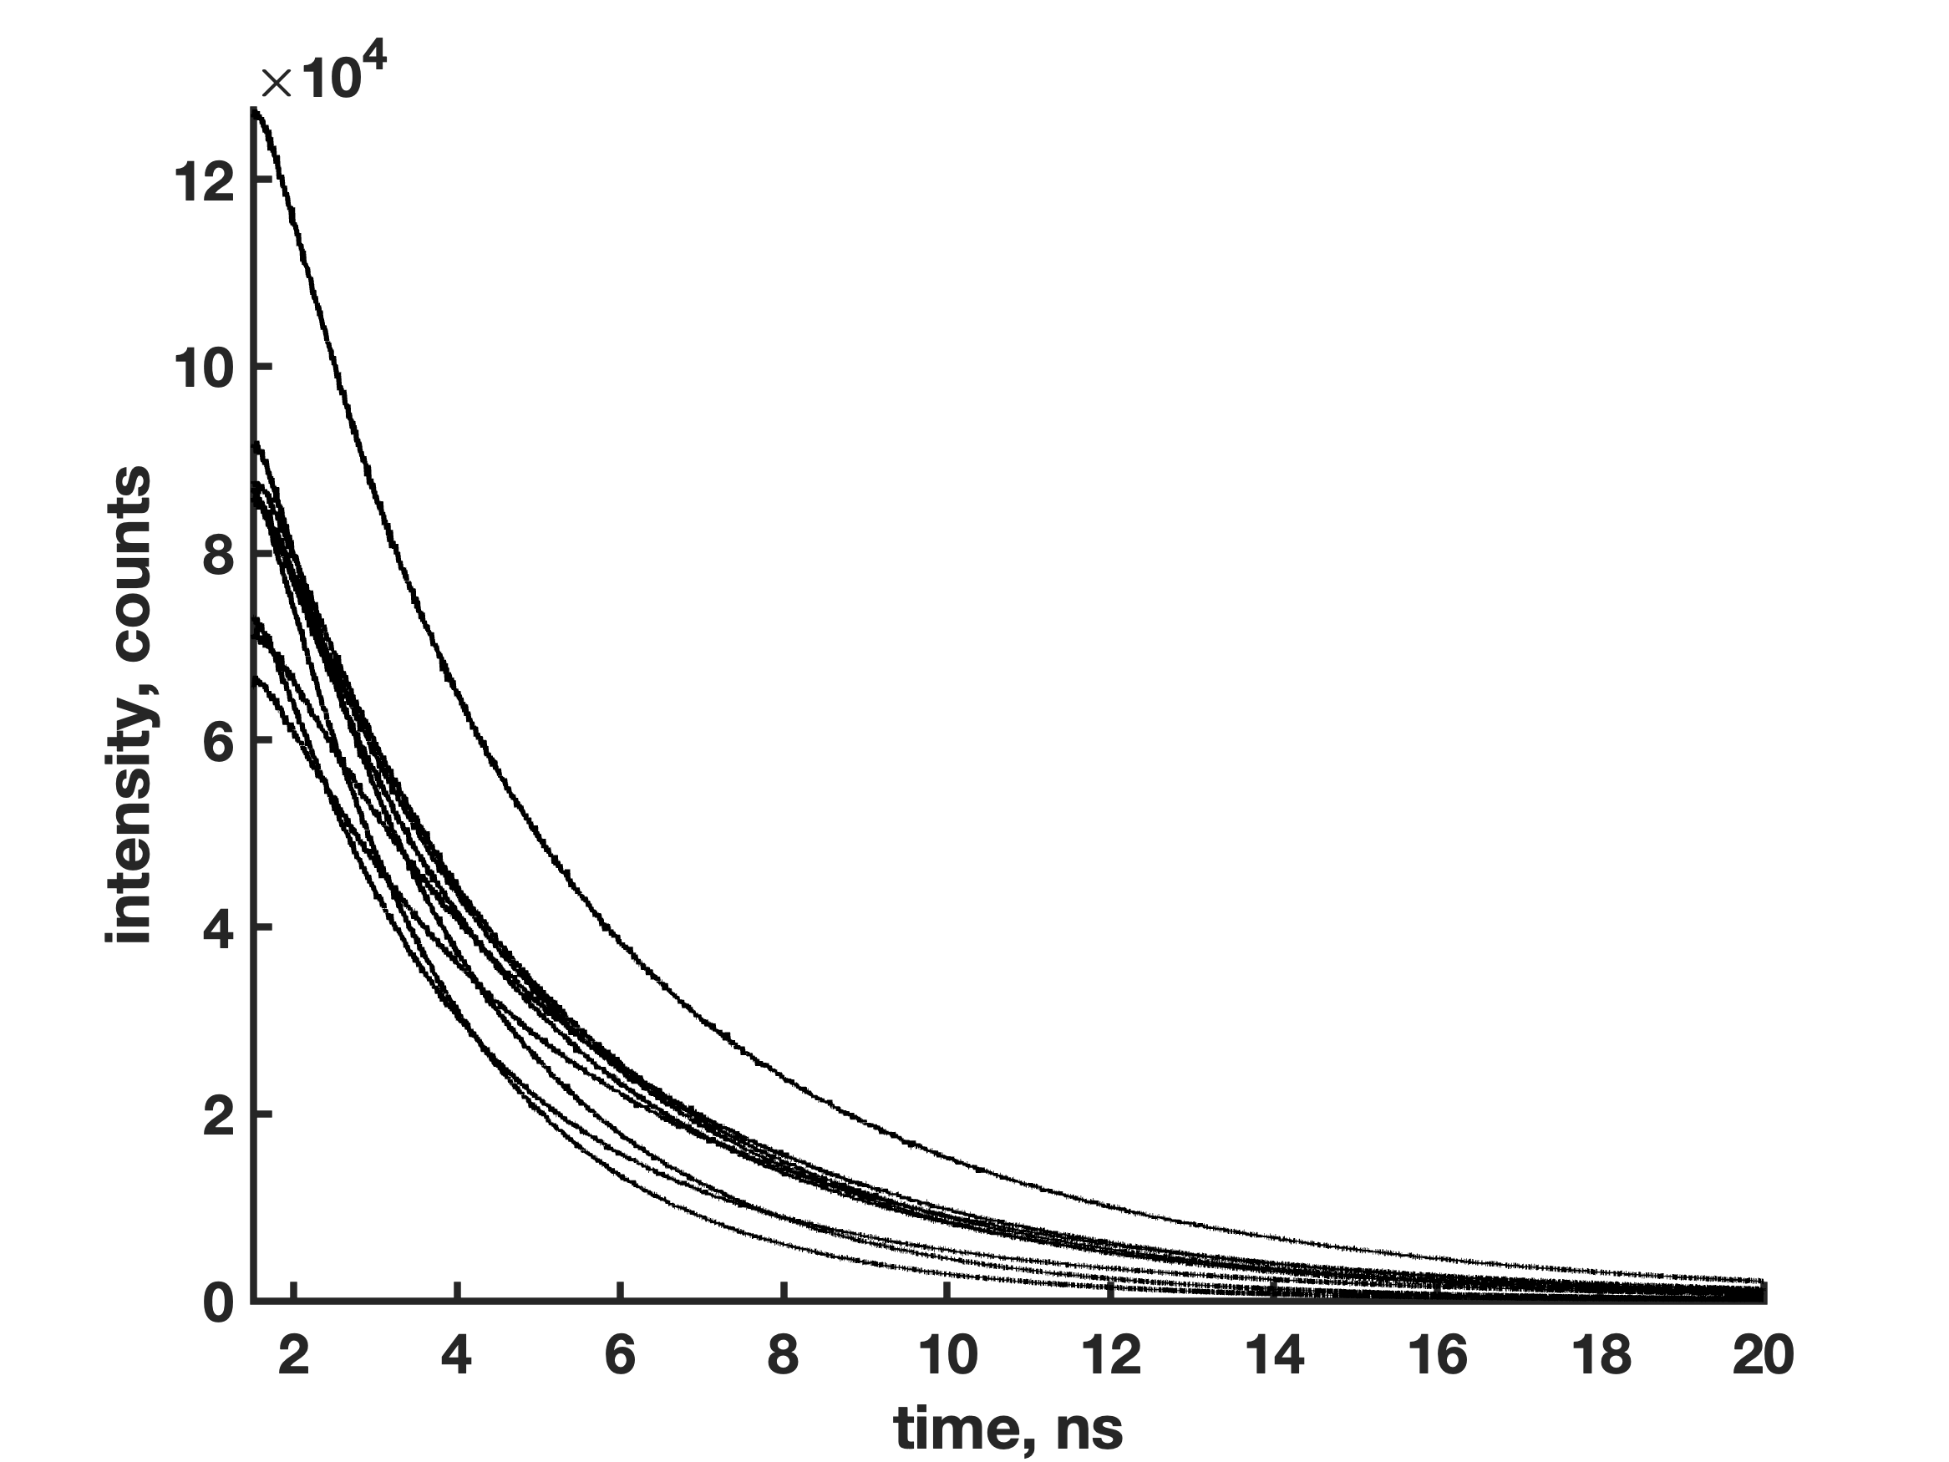



Example #2: time-resolved fluorescence spectroscopy
6 (out of 9) Essential Samples, 24 (out of 2500) Essential Time Points, 5 (out of 8) Essential Emission Wavelengths
Time-resolved fluorescence spectra of nine mixtures of Alexa 647, Alexa 655 and Atto 665
9

Slide 14






Example #2: time-resolved fluorescence spectroscopy
Full Dataset – Total Elapsed Time: 881.33 s
Reduced Dataset And Non-Negative Least Squares Projection – Total Elapsed Time: 1.12 s
9
Harshman, R.A., UCLA Working Papers in Phonetics, 1970 (16), 1-84
Carroll, J.D., Chang, J.J., Psychometrika, 1970 (35), 283-319
Bro, R., Chemometr. Intell. Lab., 1997 (38), 149-171

Slide 15




Example #3: sequential illumination fluorescence imaging
246×238 sequential illumination fluorescence image of osteosarcoma-affected bone tissue cells stained with DiBAC₄(3) and Concavalin A-Alexa 488
20 (out of 58548) Essential Pixels, 10 (out of 45) Essential Time Points, 5 (out of 6) Essential Photobleaching-Photorecovery Cycles
10

Slide 16






Example #3: sequential illumination fluorescence imaging
Full Dataset – Total Elapsed Time: 85.54 s
Reduced Dataset And Non-Negative Least Squares Projection – Total Elapsed Time: 3.10 s
10

Slide 17
Conclusions and perspectives
A novel approach for the essential information-based reduction of three-way data arrays relying on the principles of Higher Order Singular Value Decomposition was here proposed;
Differently from compression techniques relying on random sampling, such an approach is capable of retaining uniquely the most meaningful information required for a sensible trilinear factorisation of three-way arrays;
PARAFAC-ALS decompositions of reduced-size data:
  yield loadings profiles virtually indistinguishable from those returned by the PARAFAC-ALS decompositions of their full-size counterparts;
  can be up to 800 times faster than PARAFAC-ALS decompositions of full-size data;
PARAFAC-ALS model quality and adequacy is preserved once the aforementioned compression operation is carried out.
11

Slide 18



Conclusions and perspectives
=
Would it make sense to modulate the compression rate differently along distinct data mode to better accommodate the inherent structure of alternative trilinear factorisation models (e.g., Tucker variants, PARALIND, etc.)?
11

Slide 19


A bit of advertisement…
https://ccm2025.sciencesconf.org/
https://conferences.enbis.org/event/66/
12

Slide 20
Many thanks for your kind attention

